Slide 1
Pserp – send sms

Slide 2
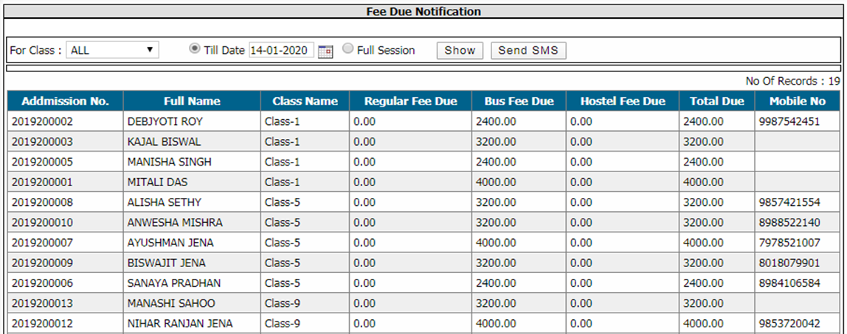
Q: To Send Sms to Fee Defaulters
Click Send SMS→ SMS Tool → Send Sms Fee Defaulters
Select search parameters and click show button
Click send sms button to send sms successfully

Slide 3
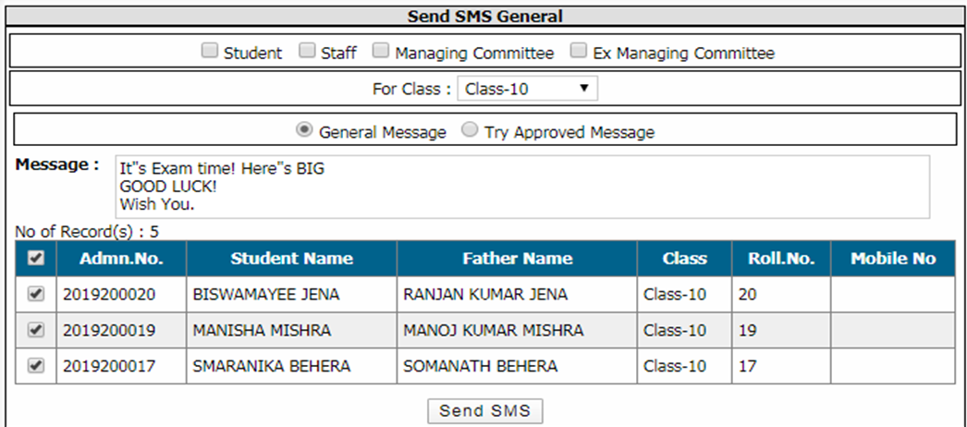
Q: To Send General Sms
Click Send SMS→ SMS Tool → Send General SMS
Select search parameters to get list of persons
Enter message to send and select all the checkbox who will get sms and click send sms button

Slide 4
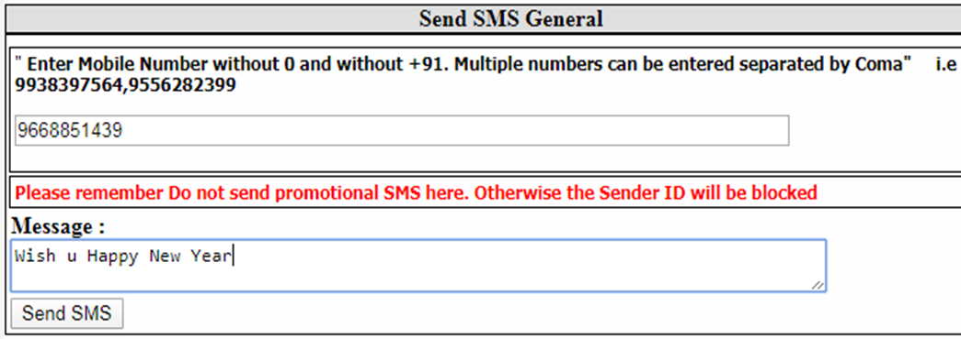
Q: To Send Sms To Other number
Click Send SMS→ SMS Tool → Send Sms To Others
Enter the mobile number to send sms
Enter the message in the box and click send sms button

Slide 5
Q: To Send Sms To absent students
Click Send SMS→ SMS Tool → Send Absentee Sms
Select search parameters and click show button to get absent student list
Click send sms button to send absent students’ parents a message

Slide 6
Q: To Send Sms regarding fee received
Click Send SMS→ SMS Tool → Send Fee Received Sms
Select search parameters and click show button
Click send sms button

Slide 7
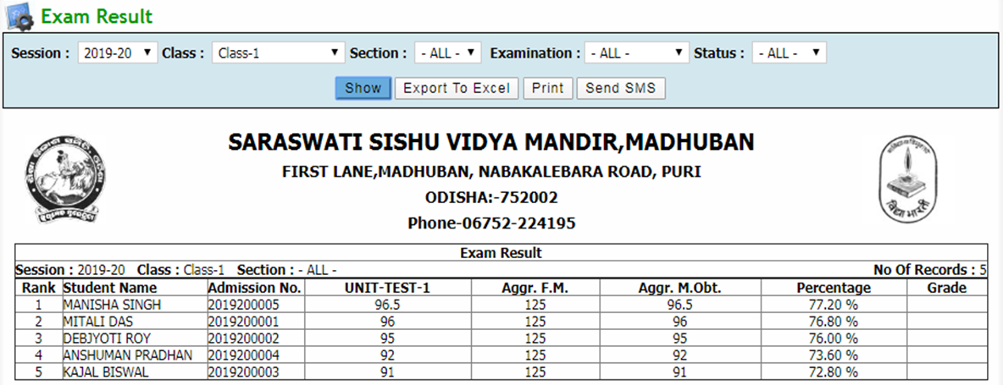
Q: To Send student result as sms
Click Send SMS→ SMS Tool → Send Result Sms
Select search parameters and click show button to get result
Click send sms button to send result to the student

