Slide 1
BASIC COMPUTER OPERATION and MAINTENANCE

Slide 2
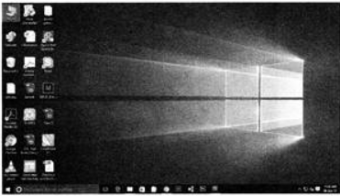
Switching on the Computer
Switch ON the main power switch
Press the ON button on the UPS of the computer (if you have it)
Press the ON button on the CPU of the computer
Switch ON the Monitor
Desktop is the first screen that you see on the computer when Windows has loaded

Slide 3
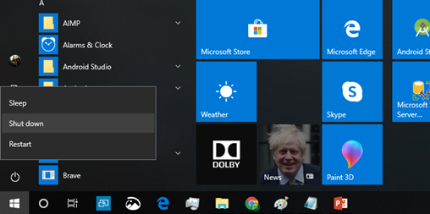
Switching off the Computer
Before switching off computer, make sure to close all opened files and folders
Click Windows button
When the Start menu appears, click on power option
Select the shutdown option from the power option list
If monitor is connected through external power plug then Switch it OFF, otherwise, it will automatically shut down after executing the shutdown command
Switch OFF the main power button

Slide 4
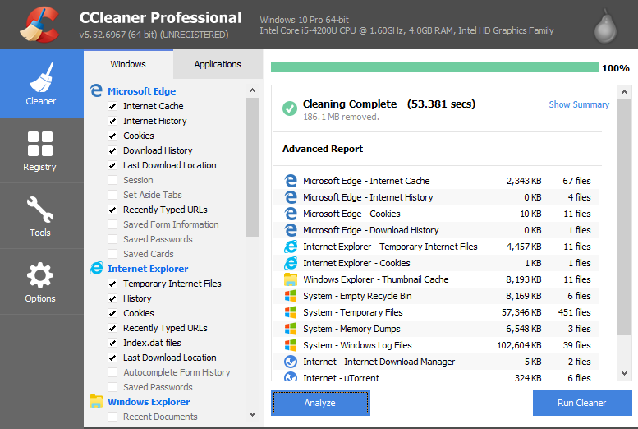
Using CCleaner
Install CCleaner in your computer
In CCleaner, click the Cleaner icon at left (contd…)

Slide 5
Using CCleaner (contd…)
Click the Analyze button. CCleaner analyzes the files and Registry keys belonging to the Windows features and applications. This may take some time.
Click Run Cleaner button. You are warned that CCleaner is about to permanently remove files from the system. Click OK to proceed.
When the cleaning is complete, CCleaner displays a report of deleted files in the text window.
Use CCleaner everyday after starting the computer

Slide 6
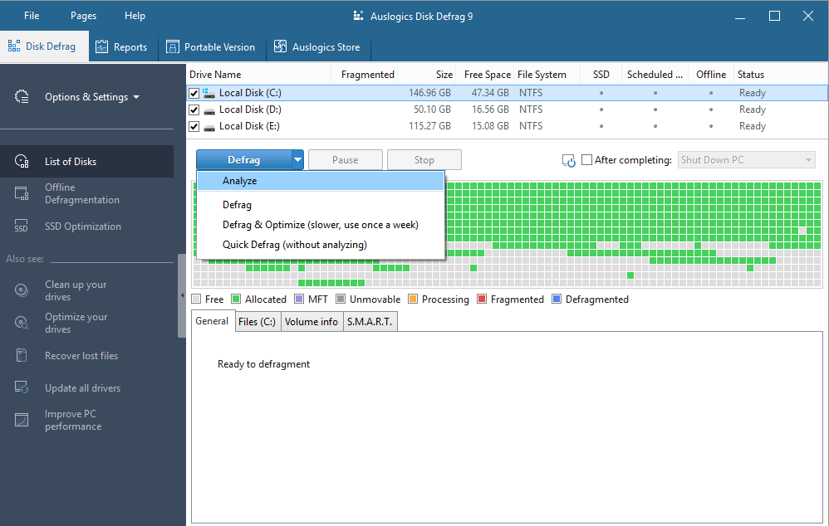
Using Disk Defrag
Install Auslogics Disk Defrag in your computer
After opening the application, select all the checkbox of drives (contd…)

Slide 7
Using Disk Defrag (contd…)
Select Analyse in defrag dropdown
After defragment analysis is done, click Defrag button
Don’t do any side works during this process
After defragment is done completely, restart your computer
Use disk defragment once in a week

Slide 8
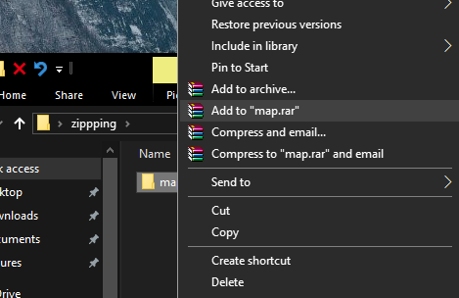
Zip a file
Install a zipping software (e.g., WinRAR)
Right Click on the file to zip and click Add to “filename.rar” option
The zipped file will appear in the folder

Slide 9
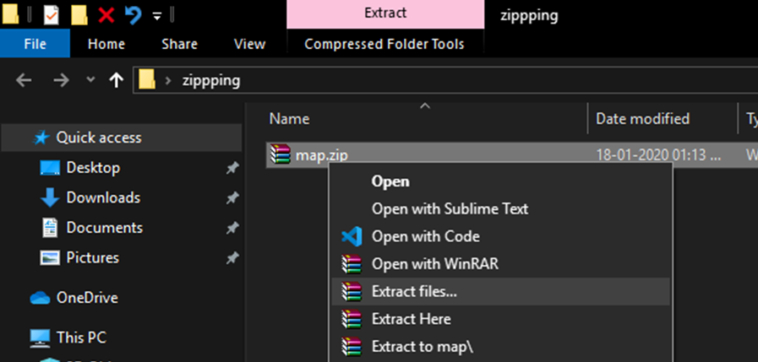
Unzip a file
Go to the folder where zipped file is present
Right click on the file and click ‘Extract files…’ option (contd…)

Slide 10
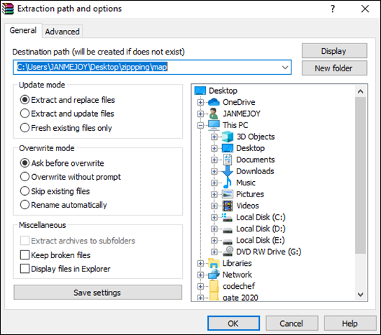
Unzip a file (contd…)
A new window will appear
Just click ‘ok’ button
Extracted folder will appear after that

Slide 11
Sending Mail to Someone (in GMAIL)
Open any browser and open gmail in it (image in next slide)
Click COMPOSE button to send a mail
A new message box will pop up
Enter e-mail id of the person whom the message is to be sent in TO box
Enter subject of the mail in SUBJECT box
Enter message in the blank box
Click attach symbol (marked with red circle in the image below) to attach any file
Click SEND button to send the message

Slide 12
