Slide 1
PSERP – master entry

Slide 2
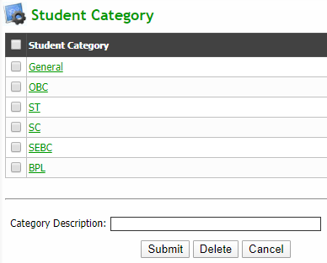
Q: To add new student category
Click Master Entry → Admission & Fee Masters → Define Student Category
Enter new category in category description field and click submit button to add new category
Delete: Select category checkbox to be deleted and click delete button

Slide 3
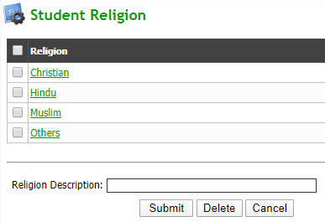
Q: To add new student religion
Click Master Entry → Admission & Fee Masters → Define Religion
Enter new category in religion description field and click submit button to add new religion
Delete: Select religion checkbox to be deleted and click delete button

Slide 4
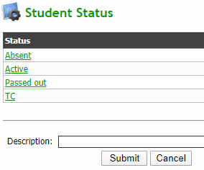
Q: To add status type for student
Click Master Entry → Admission & Fee Masters → Define Student Status
Enter new status in description field and click submit button to add new status

Slide 5
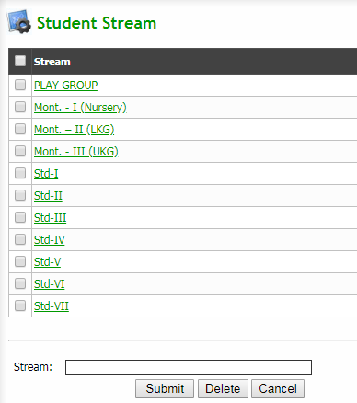
Q: To add new student stream
Click Master Entry → Admission & Fee Masters → Define Student Stream
Enter new stream in stream field and click submit button to add new stream
Delete: Select stream checkbox to be deleted and click delete button

Slide 6
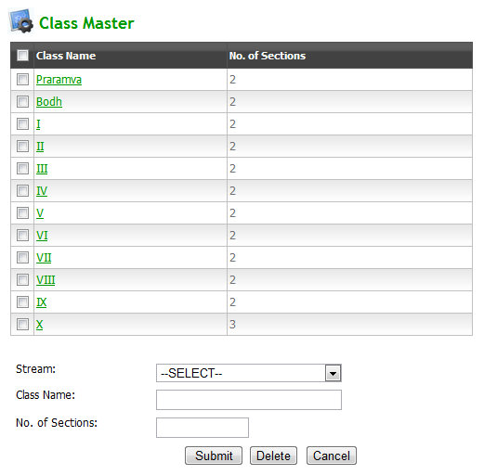
Q: To Define Class Details
Click Master Entry → Admission & Fee Masters → Define Class Details
Select stream from dropdown and enter corresponding details and click submit button
Delete: Select class checkbox to be deleted and click delete button

Slide 7
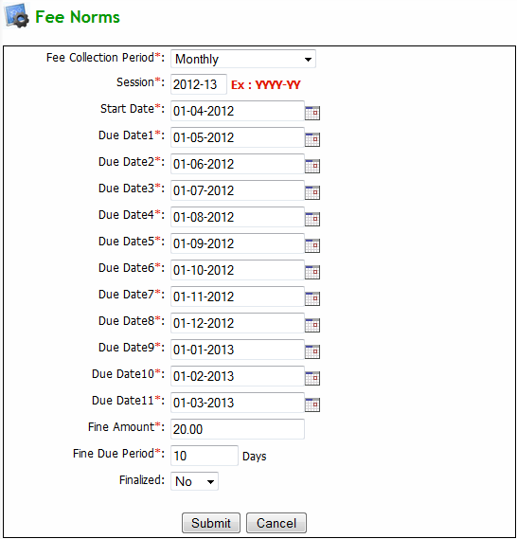
Q: To add new session detail
Click Master Entry → Admission & Fee Masters → Define Session Details
Now click add new button to add new session detail
Enter all the required details and click submit button

Slide 8
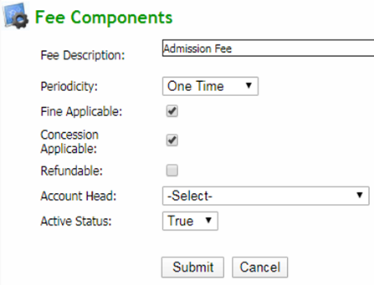
Q: To add new Fee Component
Click Master Entry → Admission & Fee Masters → Define Fee Components
Now click add new button which will redirect to fee components page
Enter all details carefully and click submit button to save the fee component

Slide 9
Q: To view fee components
Click Master Entry → Admission & Fee Masters → Define Fee Components
Set a/c head: Select a/c head from the dropdown in a/c heads column and click save button
Set payment priority: Enter priority number in payment priority column and select corresponding checkbox and click set priority order button
Delete: Select the checkbox to be deleted and click delete button

Slide 10
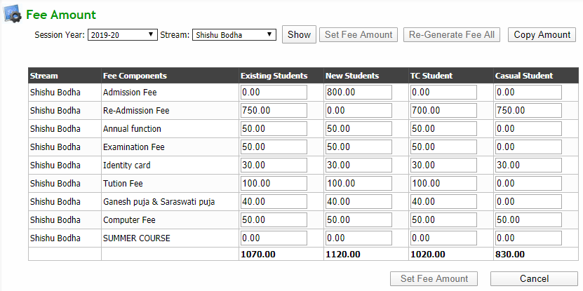
Q: To set fee component amount for different types of students (Existing, New, tc, casual)
Click Master Entry → Admission & Fee Masters → Define Fee Amount
Select search parameters and click show button
Enter fee details accordingly and click set fee amount button

Slide 11
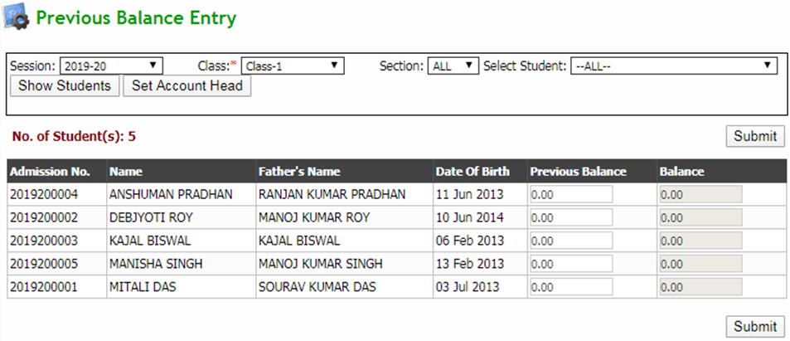
Q: To set old dues of a student (before computerisation)
Collect old dues of a student before regular fee is received
Click Master Entry → Settings on Computerisation → Set Old Dues (prev session)
Select search parameters and click show students button
Enter the previous due amount in the Previous Balance column and click submit button

Slide 12
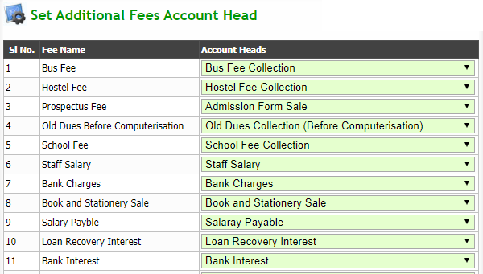
Q: To set additional fees a/c head
Click Master Entry → Settings on Computerisation → Set Old Dues (prev session)
Now click set account head button and this will redirect to a new page
Select particular account head from the dropdown for different Fee name

Slide 13
Q: To set Student’s Opening Balance (As on 1st April)
Click Master Entry → Settings on Computerisation → Set stud Open. Bal(as on 1st apr)
Select search parameters and click show students button
Select date from date initialized
Enter details of fee paid by the students and click initialize account button to make the entered details effective (contd…)

Slide 14
Q: To set Student’s Opening Balance (As on 1st April) (contd…)
To view the details of the student whose accounts has already been initialized click on Show Students(Already Initialized) button after selecting search parameters
To revert the a/c initialization process of the student, select the checkbox beside the student name displayed on the grid and click on revert a/c initialization button

Slide 15
Q: To generate fee of a student
Click Master Entry → Settings on Computerisation → Generate Fee
Select a particular student from dropdown and enter student type
Click on Re-Generate Fee button to regenerate fee of the particular student

Slide 16
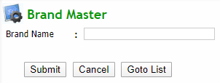
Q: To add brand name
Click Master Entry → Inventory Masters → Brand Master
Now click add new button
Enter brand name in the field and click submit button to save it

Slide 17
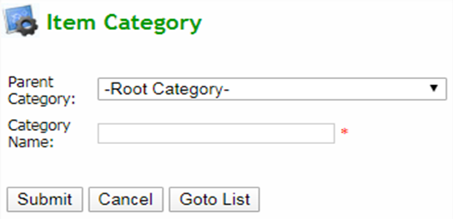
Q: To add item category
Click Master Entry → Inventory Masters → Category Master
Now click add new button
Enter required details and click submit button to save it

Slide 18
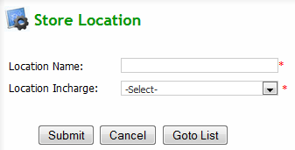
Q: To add Inventory location
Click Master Entry → Inventory Masters → Inventory Location Master
Now click add new button
Enter required details and click submit button to save it

Slide 19
Q: To add Inventory location
Click Master Entry → Inventory Masters → Item Master
Select search parameters and click search button
Click edit or delete button in action column of corresponding items to edit or delete respectively
Click add new button (contd…)

Slide 20
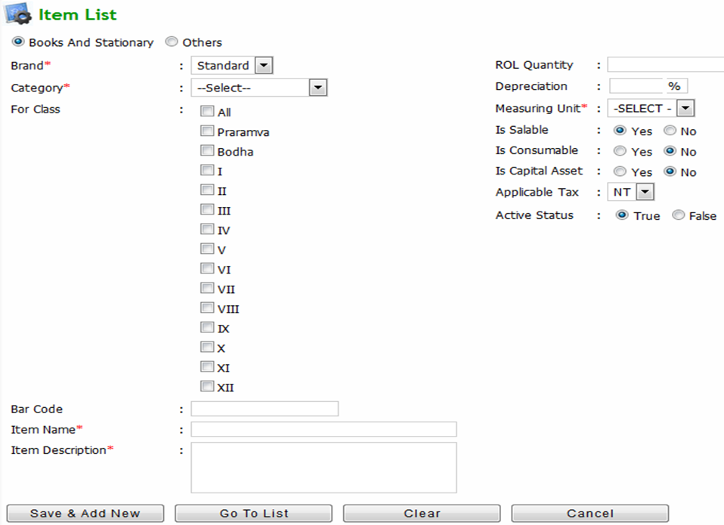
Q: To add Inventory location (contd…)
Enter all the required details and click save & add new button and if no other item is left to add, click cancel button

