Slide 1
PSERP – admission

Slide 2
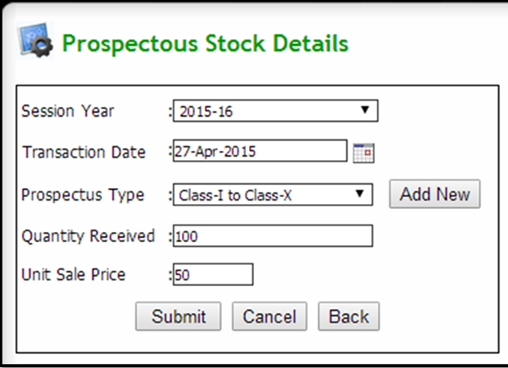
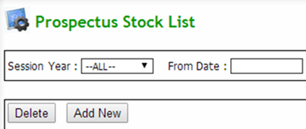
Q: admission form stock entry
Click Admission & Fee → Student Admission → Prospectus Stock
Now click Add New button to add admission form stock detail
Enter required details and click on submit button

Slide 3
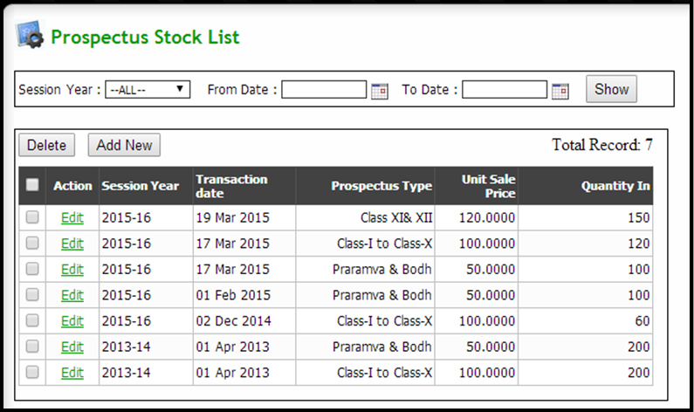
Q: to view admission form stock list
Click Admission & Fee → Student Admission → Prospectus Stock
VIEW: Select search parameters and click show button to get required stock list
EDIT: Click on edit from action column to change some details
DELETE: Select required checkbox to be deleted and click on delete button

Slide 4
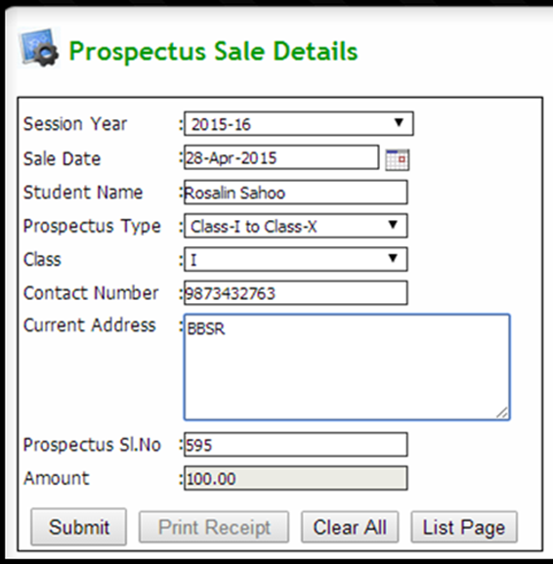
Q: admission form Sale
Click Admission & Fee → Student Admission → Prospectus Sale
Now click Add New button to add admission form sale detail
Enter all the required details and click on submit button

Slide 5
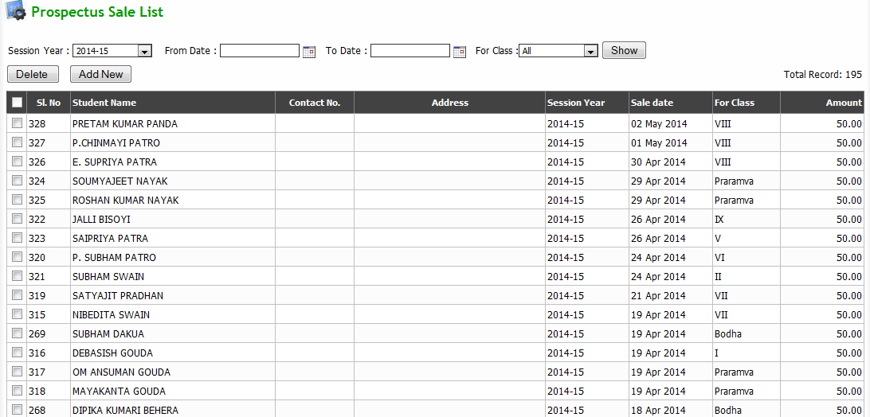
Q: to view admission form sale list
Click Admission & Fee → Student Admission → Prospectus Sale
VIEW: Select search parameters and click show button to get required stock list
DELETE: Select required checkbox to be deleted and click on delete button

Slide 6
Q: New Student Admission
Click Admission & Fee → Student admission → Student admission
Now click New Student button
Now Student admission page will appear (contd…)

Slide 7
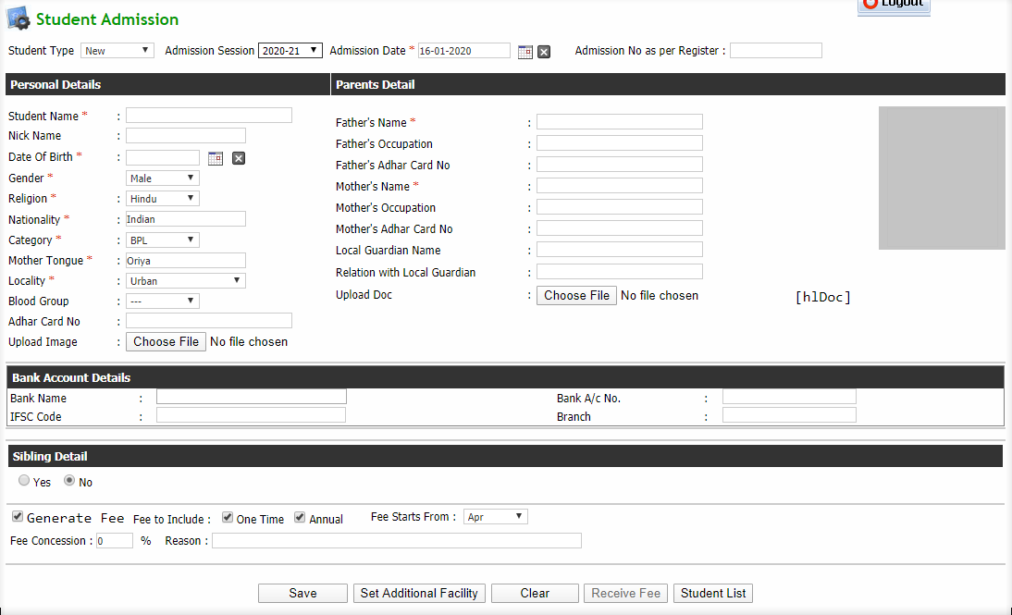
Q: New Student Admission (contd…)

Slide 8
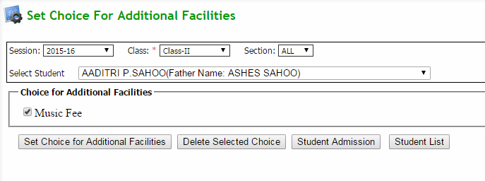
Q: New Student Admission (contd…)
Enter mandatory details of the new student in the form
Click Set Additional Facility (button) to assign additional facility to particular student
click on save button to save the details of new student

Slide 9
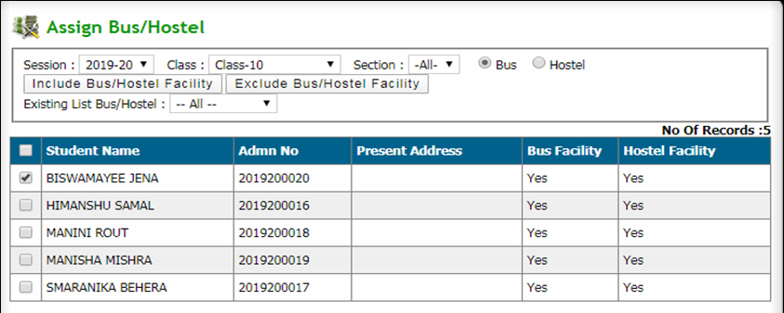
Q: To Assign bus/hostel to students
Click Admission & Fee → Student Admission →Modify bus/hostel choice
Select search parameters to get a list of students
Tick the required student checkbox and click include bus/hostel facility button to include bus/hostel facility for a student
Tick the required student checkbox and click exclude bus/hostel facility button to exclude bus/hostel facility for a student

Slide 10
Q: to Allot Section to students
Click Admission & Fee → Student Admission → Allot Section
Select search parameters and click show button to get required student list
Select section for each student from dropdown and select checkbox of the students to be allotted and then click allot section button

Slide 11
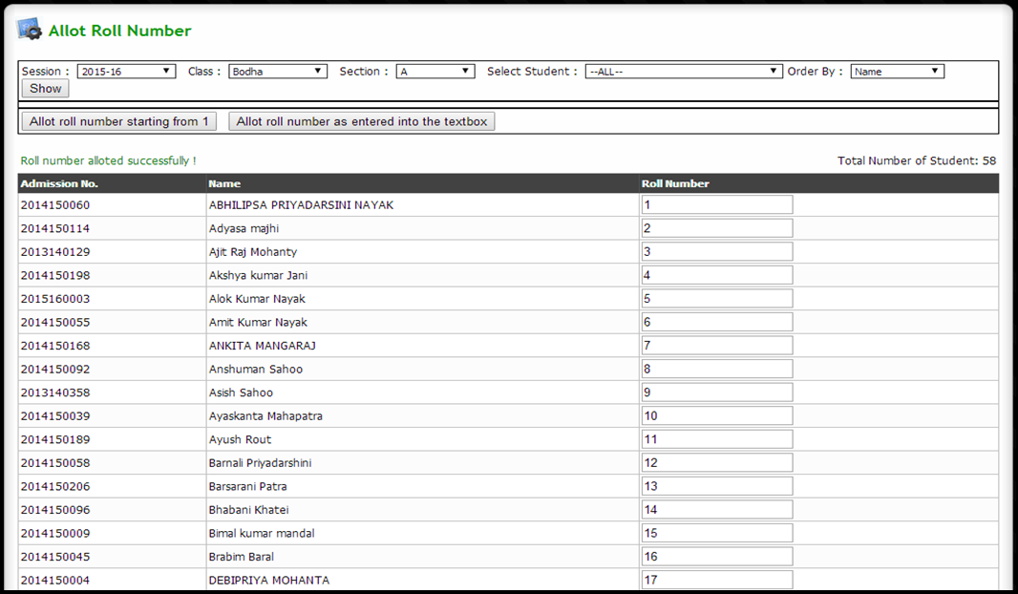
Q: to Allot Roll number to students
Click Admission & Fee → Student Admission → Allot RollNo
Select search parameters and click show button to get required student list
Click allot roll number starting from 1 button to allot serial number to all students
Click allot roll number as entered into the textbox button after entering roll numbers manually

Slide 12
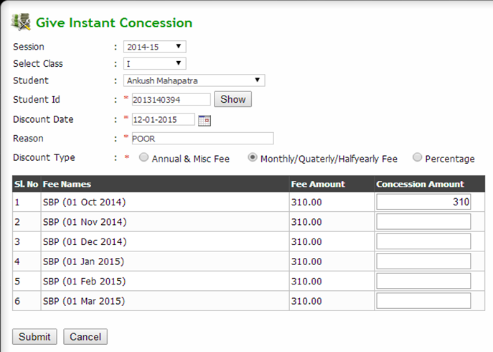
Q: Give discount to a student
Click Admission & Fee → Fee Management → Give Instant Concession
Select a student by entering student id and click show button or select student from the dropdown
Provide discount information and click submit button

Slide 13
Q: Cancel discount given to a student
Click Admission & Fee → Fee Management → Revert Instant Concession
Select a student by entering student id and click show button or select student from the dropdown
Select the discount checkbox to be cancelled and click revert concession button

Slide 14
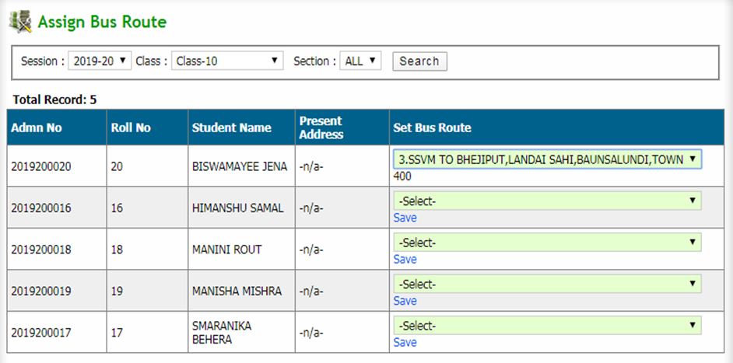
Q: assign bus route to students
Click Admission & Fee → Student Transport → Define Bus Route
Select search parameters and click search button to get student list
Select bus route from the set bus route section and click on save

Slide 15
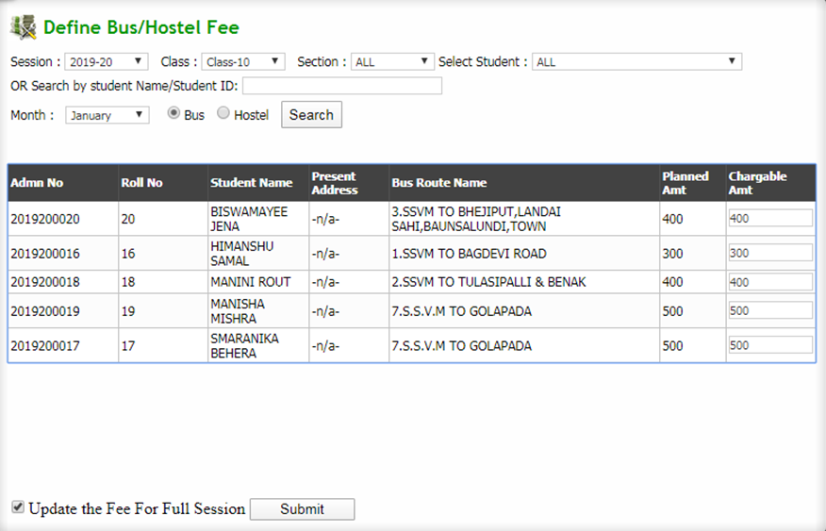
Q: Define bus/hostel fees for students
Click Admission & Fee → Student Transport → Define Transport Fee
Select a student by entering student id and click search button or select student from the dropdown
Enter the amount charged to a student in chargeable amount section
Check/Uncheck the check box to update fee details for full session and click submit button

Slide 16
Q: Define Miscellaneous fees for students
Click Admission & Fee → Fee management → Define Misc Fees
Select search parameters and click search button to get student list
Enter the amount charged to students in fee amount field
Tick the student checkbox to be charged and click generate misc fee button

Slide 17
Q: receiving regular fee of students
Click Admission & Fee → Fee management → Receive Regular Fee
Select search parameters and payment mode and click show button to get a list of students or enter student id to get a particular student
Delete Receipt: Select the required checkbox and click cancel selected receipt button
Receive Fee: Select the required checkbox and click receive fee button
The page will be redirected to the Receive Regular Fee entry page (contd…)

Slide 18
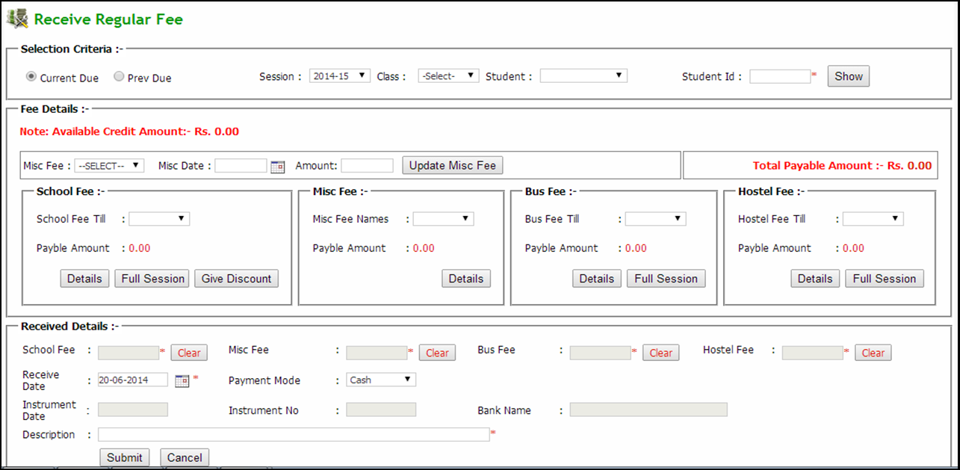
Q: receiving regular fee from students (contd…)
Select or enter payment details accordingly
After filling all fields carefully, click on submit button to generate the fee receipt

Slide 19
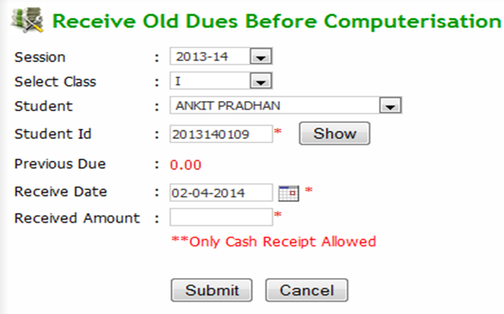
Q: receiving Old dues before computerisation
Click Admission & Fee → Fee Management →Receive Old dues
Select search parameters and payment mode and click show button
Delete Receipt: Select required checkbox and click on cancel selected receipt button
Select required checkbox and click receive fee button
The page will be redirected to the Receive Old Dues Before Computerisation page
Select a student by entering student id and click show button or select student from the dropdown
After filling payment details, click on submit button to generate the fee receipt

Slide 20
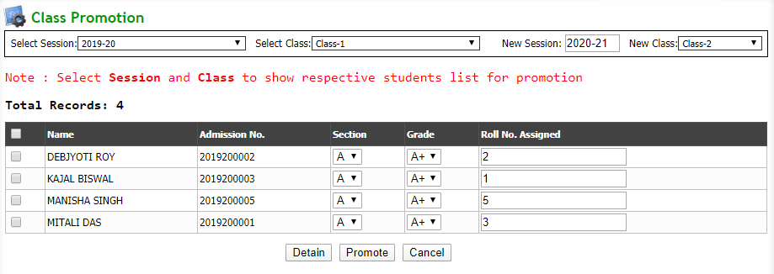
Q: Promotion of students to new class
Click Admission & Fee → Student Admission → Class Promotion
Select old session and class (new session and class will automatically appear)
After student list appears, Select required student checkbox and click promote button to promote students to next class or click detain button to detain students

Slide 21
Q: Revert class Promotion of a student
Click Admission & Fee → Student Admission → Revert Class Promotion
Select a student by entering student id and click show button or select student from the dropdown
After getting confirm click on Revert button to revert the student promotion

Slide 22
Q: Modify class of a student
Click Admission & Fee → Student Admission → Modify Student Class
Select details of the student and select new class to be assigned and then click submit button to change student class

Slide 23
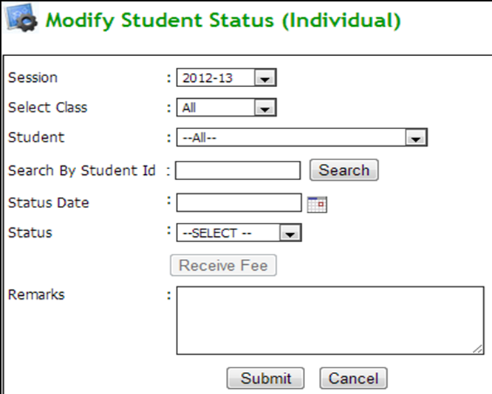
Q: giving tc to students upto class 9
Click Admission & Fee → Student Admission → Modify Student Status
Select a student by entering student id and click search button or select student from the dropdown
provide the status as TC from the dropdown and provide other details
In case of any due is pending against a student, to receive all pending dues click on Receive Fee button and the page gets redirected to Receive Regular Fee page
Click on submit button to save the modified student status.

Slide 24
Q: giving passout status for class x
Click Admission & Fee → Student Admission → Modify Student Status
Select a student by entering student id and click search button or select student from the dropdown
provide the status as PASSED from the dropdown and provide other details
In case of any due is pending against a student, to receive all pending dues click on Receive Fee button and the page gets redirected to Receive Regular Fee page
Click on submit button to save the modified student status.

Slide 25
Q: to get Prospectus Stock Position report
Click Admission & Fee → Reports → Prospectus stock received
Select search parameters and click show button to view prospectus stock position

Slide 26
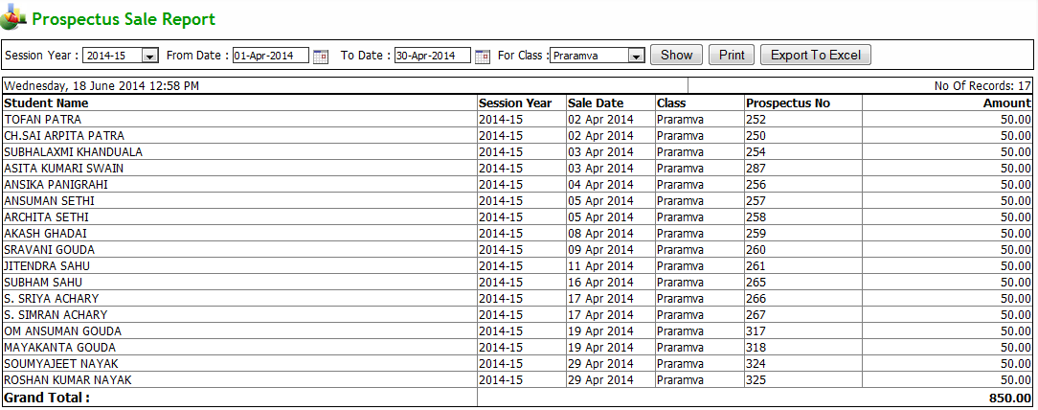
Q: to get Prospectus sale report
Click Admission & Fee → Reports → Prospectus sale details
Select search parameters and click show button to get the report
Export to excel: Click on export to excel button to export the report to an excel file
Print: Click on print button to print the report

Slide 27
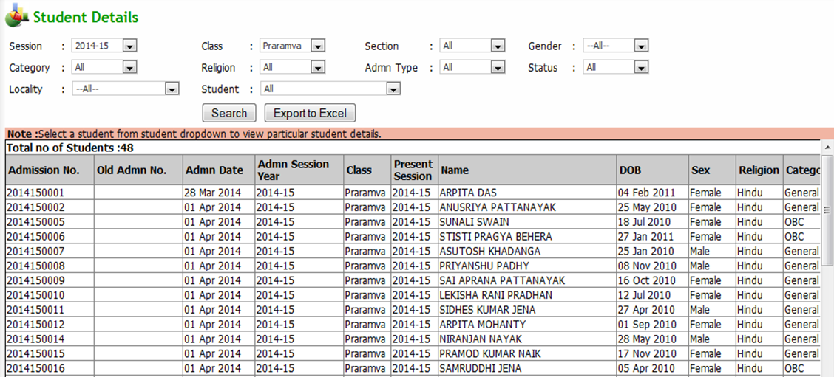
Q: to get Student Details
Click Admission & Fee → Reports → Student Details
Select search parameters and click search button
Export to excel: Click on export to excel button to export the report to an excel file

Slide 28
Q: to get Admission Summary
Click Admission & Fee → Reports → Student Admission Status
Select search parameters and click show button to get the report
Export to excel: Click on export to excel button to export the report to an excel file
Print: Click on print button to print the report

Slide 29
Q: to get Session/Class wise Fee report
Click Admission & Fee → Reports → Student Fee Status
Select search parameters and click show button to get the report
Export to excel: Click on export to excel button to export the report to an excel file
Print: Click on print button to print the report
Click on link available under Previous Year Due column to view previous year due fee details of a respective student(s), a typical screen is shown in next slide (contd…)

Slide 30
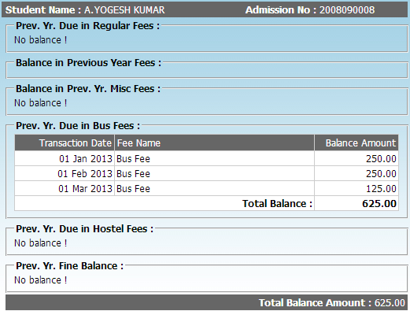

Slide 31
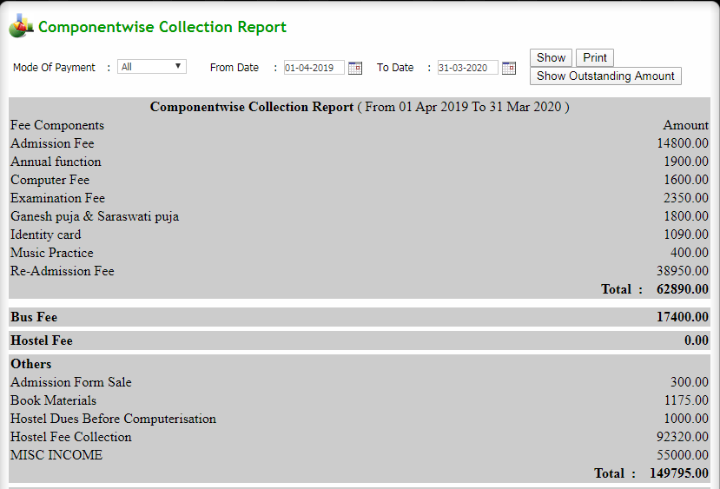
Q: to get Component wise Collection Report
Click Admission & Fee → Reports → Component wise Collection Report
Select search parameters and click show button to get the report
Print: Click on print button to print the report
Click on show outstanding amount button to get outstanding amount (contd…)

Slide 32
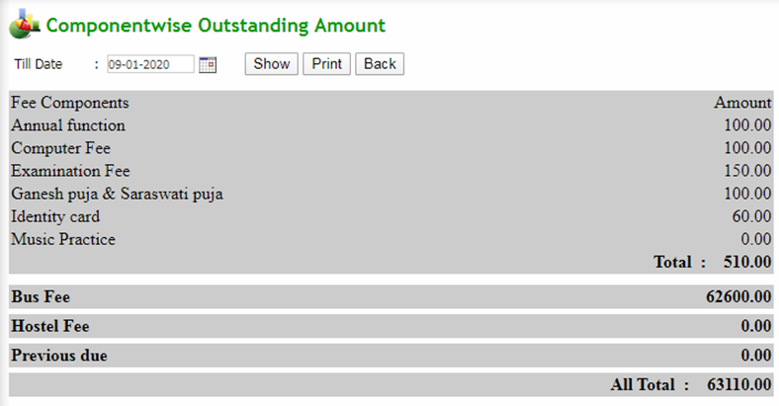
Q: to get Component wise Collection Report (contd…)
Select search parameters and click show button to get the report
Print: Click on print button to print the report
Back: Click on back button to go back to the previous form

Slide 33
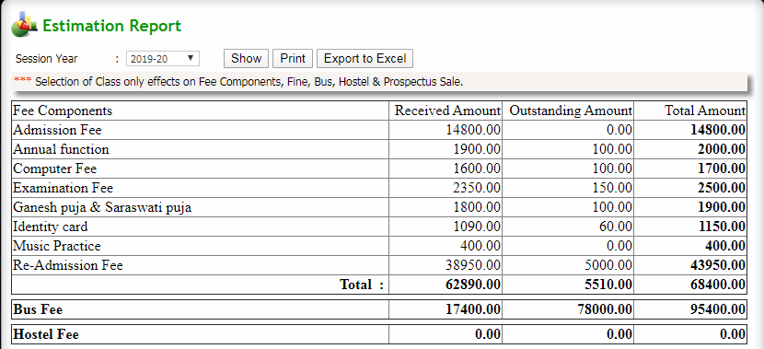
Q: to get Estimation Report
Click Admission & Fee → Reports → Estimation Report
Select session year from dropdown and click show button to get the report
Export to excel: Click on export to excel button to export the report to an excel file
Print: Click on print button to print the report

Slide 34
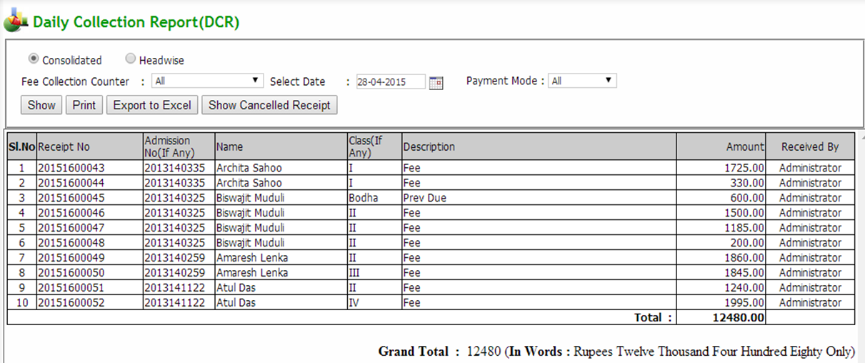
Q: to get Daily Collection Report (DCR)
Click Admission & Fee → Reports → Daily Collection Report
Select search parameters and click show button to get the report
Export to excel: Click on export to excel button to export the report to an excel file
Print: Click on print button to print the report (contd…)

Slide 35
Q: to get Daily Collection Report (DCR) (contd…)
Click on Show Cancelled Receipt button to view all cancelled receipt
Select search parameters and click show button to get the report
Export to excel: Click on export to excel button to export the report to an excel file
Print: Click on print button to print the report

Slide 36
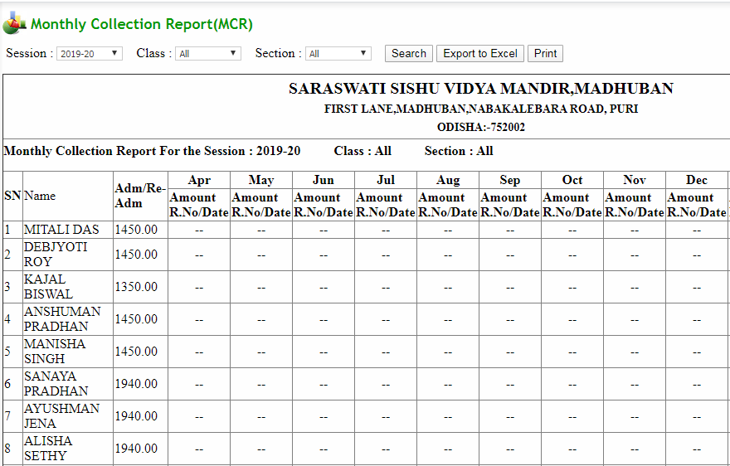
Q: to get Monthly Collection Report (MCR)
Click Admission & Fee → Reports → Monthly Collection Report
Select search parameters and click show button to get the report
Export to excel: Click on export to excel button to export the report to an excel file
Print: Click on print button to print the report

Slide 37
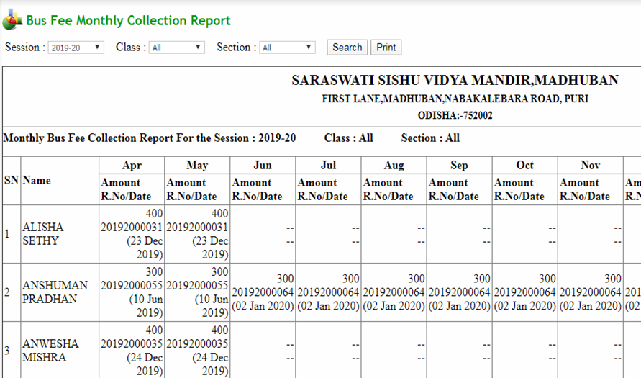
Q to get Bus Fee (MCR) Report
Click Admission & Fee → Reports → Bus Fee(MCR)
Select search parameters and click show button to get the report
Print: Click on print button to print the report

Slide 38
Q: to get Fee Collection Report
Click Admission & Fee → Reports → Fee Collection Report
Select search parameters and click show button to get the report
Export to excel: Click on export to excel button to export the report to an excel file
Print: Click on print button to print the report

Slide 39
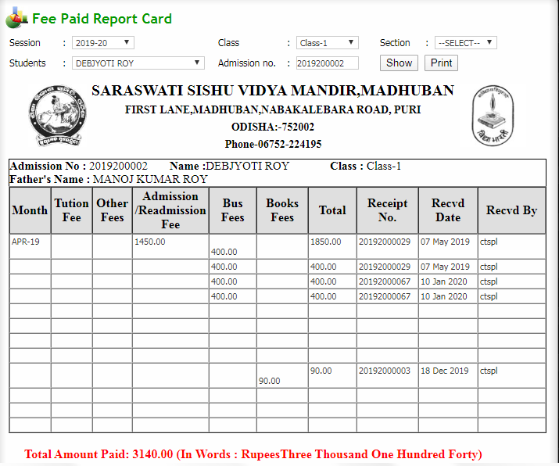
Q: to get Student Fee Report Card
Click Admission & Fee → Reports → Student Fee Report Card
Select a student from dropdown and click show button to get the report
Print: Click on print button to print the report

Slide 40
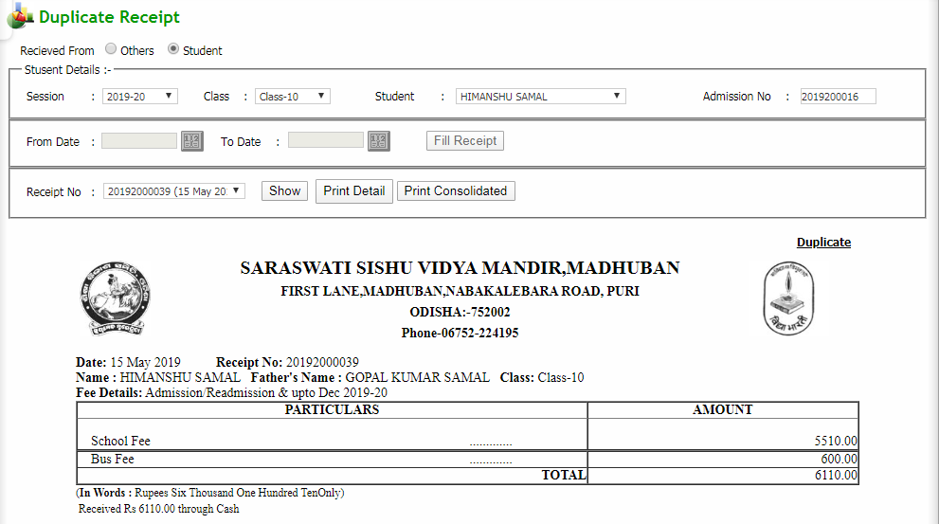
Q: to get Duplicate Receipt
Click Admission & Fee → Reports → Duplicate Receipt
Select search parameters and click show button to get the report
Click on print detail button to print the report
Click on print consolidated button to print the receipt in consolidated format

Slide 41
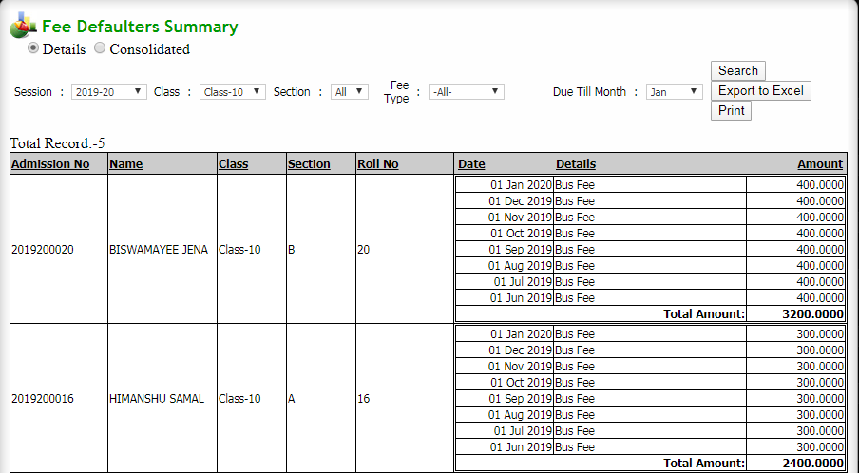
Q: to get Fee Defaulters report
Click Admission & Fee → Reports → Fee Defaulters
Select search parameters and click show button to get the report
Export to excel: Click on export to excel button to export the report to an excel file
Print: Click on print button to print the report

