Slide 1
PSERP – sales & accounts

Slide 2
Q: Opening a new financial year
Click Sales & Accounts → Master setting → Open Financial Year
Now click Add New button to initialize a new financial year. This will redirect to a new page
To set opening balance: click on Reset Current Opening Balance button and edit the required field

Slide 3
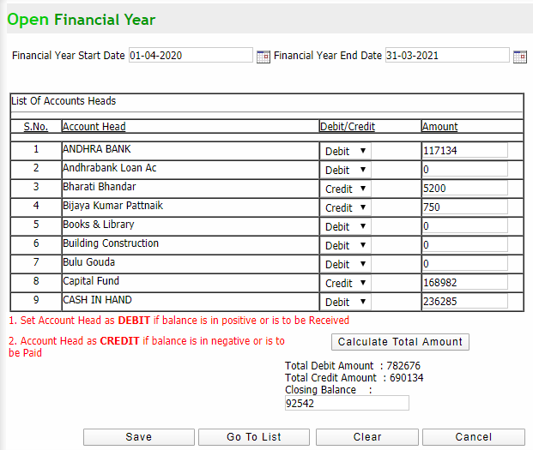
Q: Opening a new financial year (contd…)
Select Financial year start and end date with all other details
Click calculate total amount button to check closing balance
Click on save button

Slide 4
Q: to Create a new account group
Click Sales & Accounts → Master setting → Define Account Groups
Click on Add New button to create a new a/c group and the page will get redirected to new a/c group page
Enter all required details and click save & and new button

Slide 5
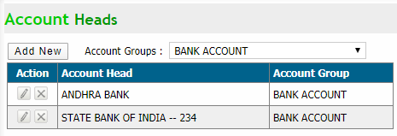
Q: to Create a new account Head
Click Sales & Accounts → Master setting → Define Account Heads
Click on Add New button to create a new a/c head and the page will get redirected to new a/c head page
Enter all required details and click save & add new button

Slide 6
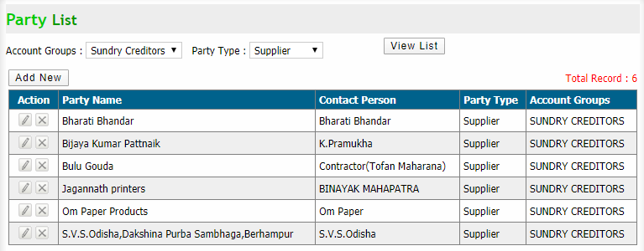
Q: to add a new Party master
Click Sales & Accounts → Master setting → Party Master
Click on Add New button to add a new party and the page will get redirected to party details page
Enter all required details and click save & add new button (contd…)

Slide 7
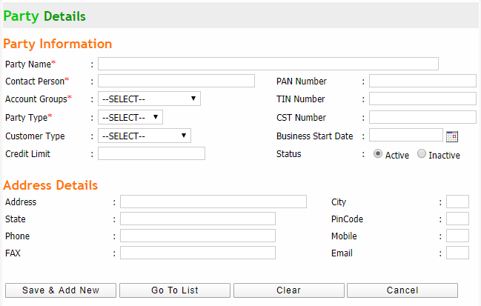
Q: to add a new Party master

Slide 8
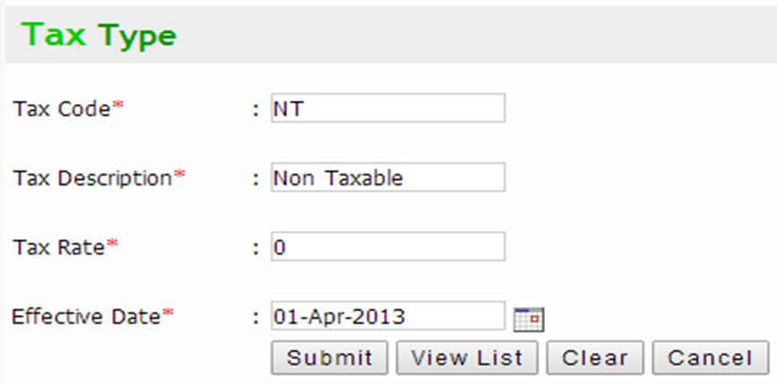
Q: to add a new Type of tax
Click Sales & Accounts → Master setting → Define Tax
Click on Add New button to add a new tax type and the page will get redirected to new page
Enter all required details and click submit button

Slide 9
Q: to receive purchase stock
Click Sales & Accounts → Purchase → Receive Purchase Stock
Click on Add New button to add a new tax type and the page will get redirected to new page
Enter all required details and click save button (contd…)

Slide 10
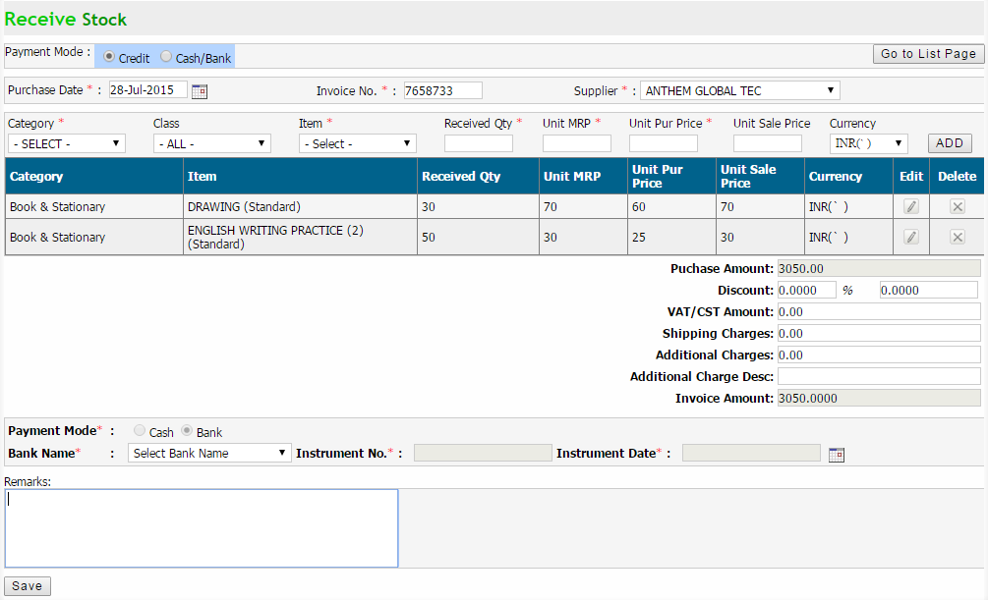
Q: to receive purchase stock

Slide 11
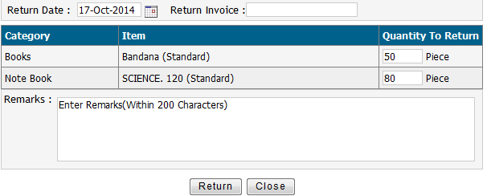
Q: to return purchase stock
Click Sales & Accounts → Purchase → Return Purchase Stock
Select search parameters to get the stock list and click view button in return items column to view the required stock detail and click return button to return the required purchase stock

Slide 12
Q: To Stock Writes Off List
Click Sales & Accounts → Purchase → Stock WritesOff
Click on Add New button to add a writes off
Select search parameters to get items and the enter writesOff qty and click on click to writesoff button to save

Slide 13
Q: To set opening Stock
Click Sales & Accounts → SALE (Book Materials) → Set Opening Stock
Click on Set New Opening Stock button to add new opening stock
Modify Opening Stock: Select search parameters and click search button. Then change quantity column and click update button (contd…)

Slide 14
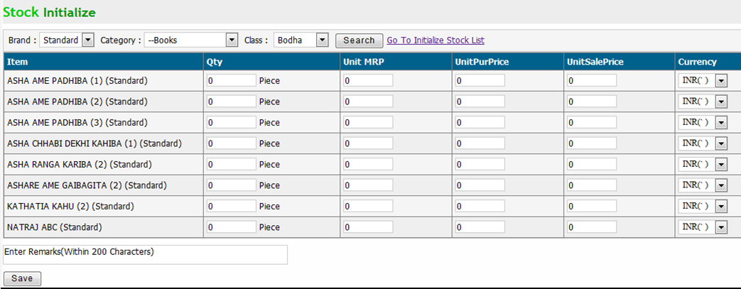
Q: To set opening Stock (contd…)
Select search parameters and click search button to get item list
Enter data for each column and click save button to initialize the stock

Slide 15
Q: To make Book material sale to an individual student
Click Sales & Accounts → SALE (Book Materials) → Sale Individual Student
Click on New Sale button to add new opening stock
This will redirect to book material sale page (contd…)

Slide 16
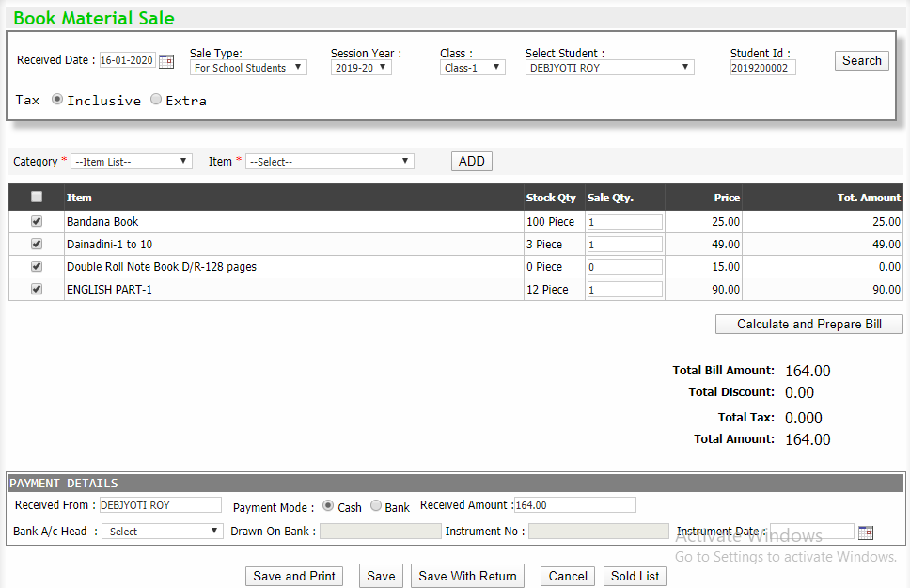
Q: To make Book material sale to an individual student (contd…)

Slide 17
Q: To make Book material sale to an individual student (contd…)
Select a student by entering student id or by selecting student from dropdown and click search button
Enter required details and click calculate and prepare bill button to generate total amount
Enter payment details and save button

Slide 18
Q: To view Items sold to individual students
Click Sales & Accounts → SALE (Book Materials) → Sale Individual Student
Select a student by entering student id or by selecting student from dropdown and click search student button (or enter bill number and click show button)
View: Click binocular icon from details column to view
Delete: Click cross icon from Action column to delete

Slide 19
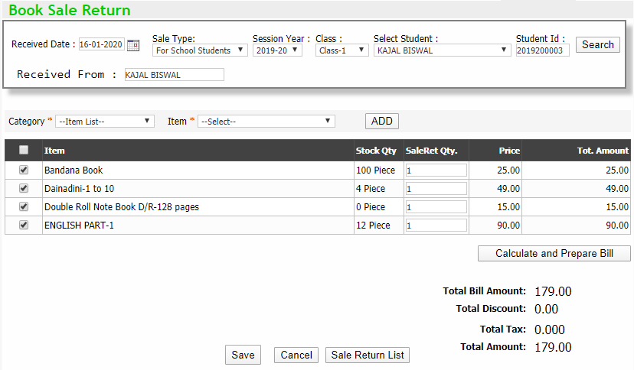
Q: To make Book material sale return
Click Sales & Accounts → SALE (Book Materials) → Sale Return
Select a student by entering student id or by selecting student from dropdown and click search button
Enter required details and click calculate and prepare bill button to generate total amount
Now click save button

Slide 20
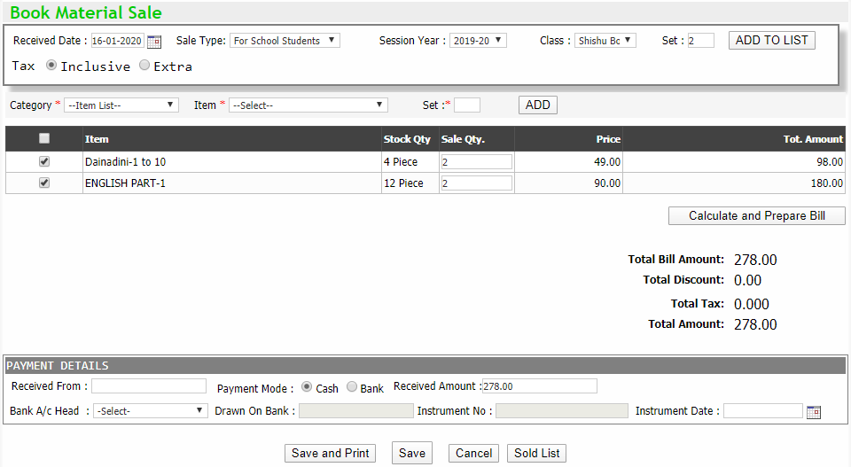
Q: To make consolidated Book material sale to teacher
Click Sales & Accounts → SALE (Book Materials) → Sale Consolidated
Select a student by entering student id or by selecting student from dropdown and click search button
Enter required details and click calculate and prepare bill button to generate total amount
Enter payment details and save button

Slide 21
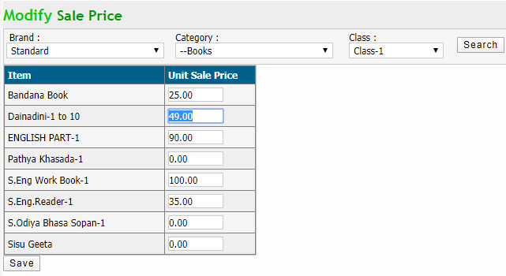
Q: To modify Stationary item price
Click Sales & Accounts → SALE (Book Materials) → Sale Return
Select search parameters to get items and click search button
Edit the price in unit sale price column and click save button

Slide 22
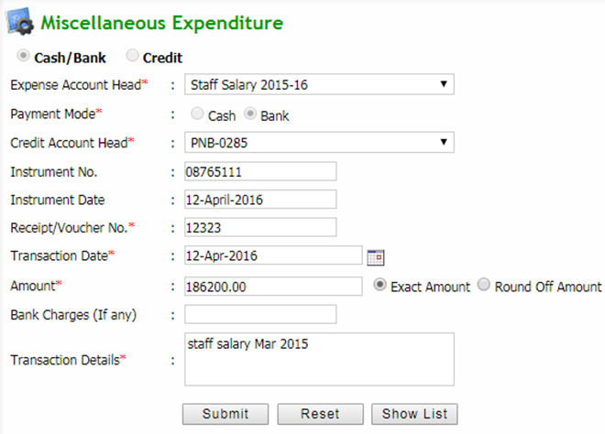
Q: To add miscellaneous expense detail
Click Sales & Accounts → Transactions → Expense
Now click new expense button. This will redirect to miscellaneous expenditure page
Enter required expenditure detail in the form and click submit button to save the expenditure

Slide 23
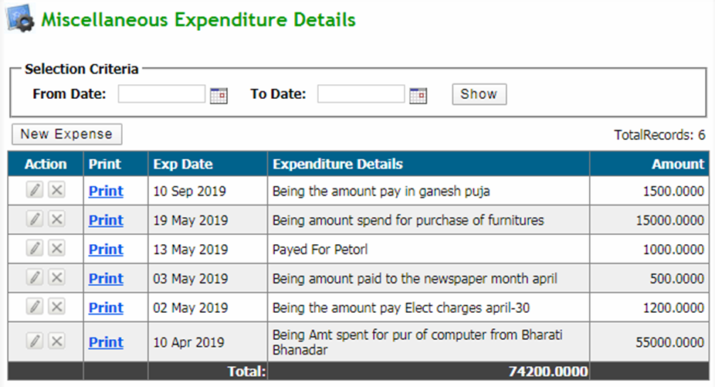
Q: To get miscellaneous expense details
Click Sales & Accounts → Transactions → Expense
Select search parameter and click show button to get all expense
Edit: Click pencil icon button in action column and edit all details
Delete: Click cross icon button to delete desired expense detail
Print: Click print link in Print column

Slide 24
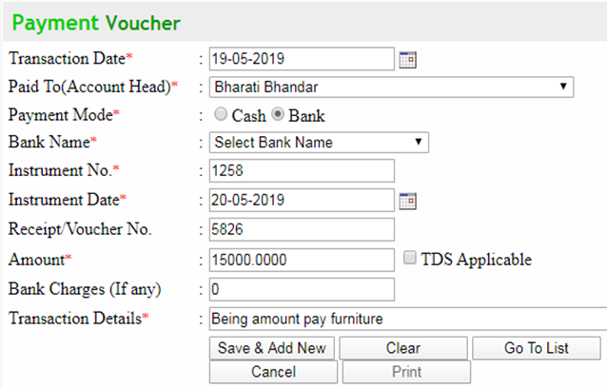
Q: To add Payment Voucher
Click Sales & Accounts → Transactions → Payment Voucher
Now click add new button. This will redirect to payment voucher page
Enter required details in the form and click save & add new button to save the detail and then click cancel button if there is no payment voucher detail to add
Print: Click print button to print the corresponding payment voucher

Slide 25
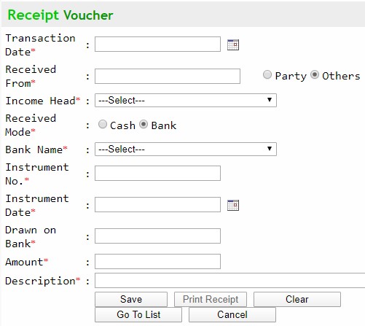
Q: To add receipt Voucher
Click Sales & Accounts → Transactions → Receipt Voucher
Now click receipt new button. This will redirect to receipt voucher page
Enter required details in the form and click save button to save the detail
Print: Click print receipt button to print the corresponding receipt voucher

Slide 26
Q: To modify bank a/c for received cheque
Click Sales & Accounts → Transactions → Re-Assign Bank A/C
Select the required criteria and click view list to view the records
Select bank a/c from the dropdown in credited to bank a/c section and click modify to modify the bank a/c

Slide 27
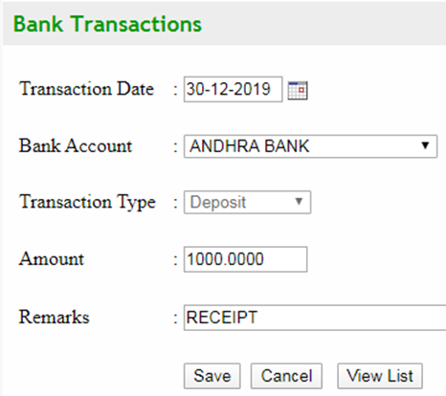
Q: To add Bank transaction detail
Click Sales & Accounts → Transactions → Bank Payment/Receipt Status
Now click on cash deposit/withdraw button to add new bank transaction detail
Enter transaction detail and after confirming click save button

Slide 28
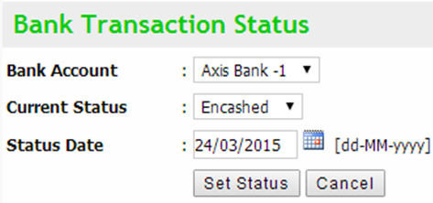
Q: To give Status to Bank transaction
Click Sales & Accounts → Transactions → Bank Payment/Receipt Status
Select search parameters and click view list to view the records
Click corresponding select button to give a status to a desired bank transaction
Select bank a/c from the dropdown in credited to bank a/c section and click modify to modify the bank a/c

Slide 29
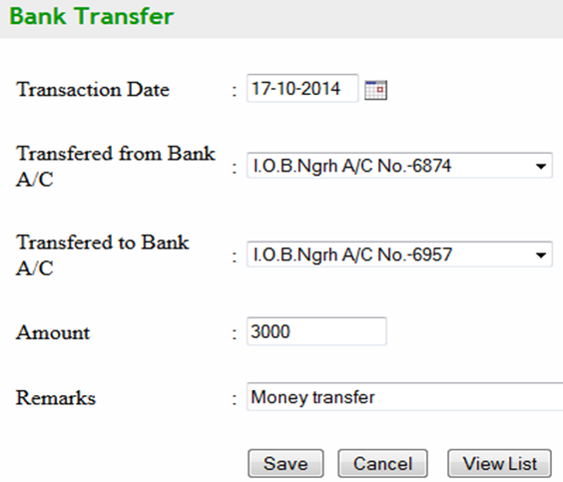
Q: To add transaction detail of bank to bank transfer
Click Sales & Accounts → Transactions → Bank Transfer
Enter transaction detail and after confirming click save button
Click View List Button to view the transaction list (image on next slide)

Slide 30
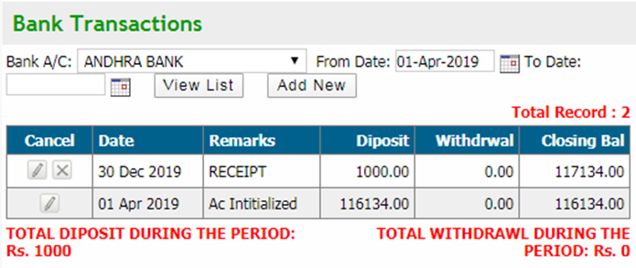
Q: To view transaction detail of bank to bank transfer
Click Sales & Accounts → Transactions → Bank deposit / withdrawal
Enter search parameter and click view list button to get the records

Slide 31
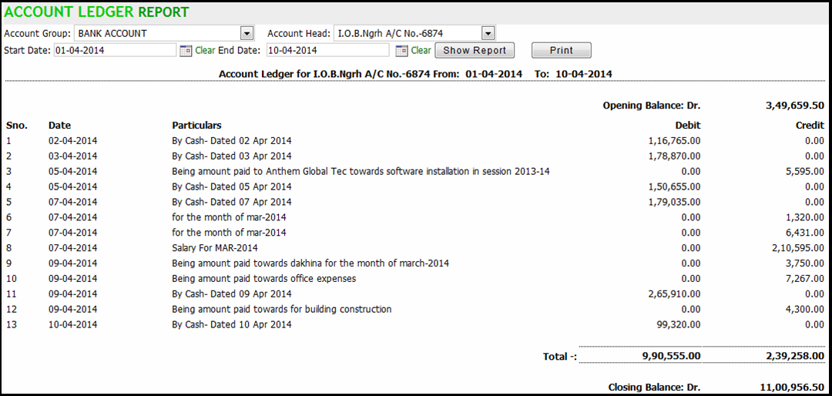
Q: to get Account Ledger Report
Click Sales & Accounts → Account Report → Account Ledger Report
Select search parameters and click show report button to get the report
Print: Click on print button to print the report

Slide 32
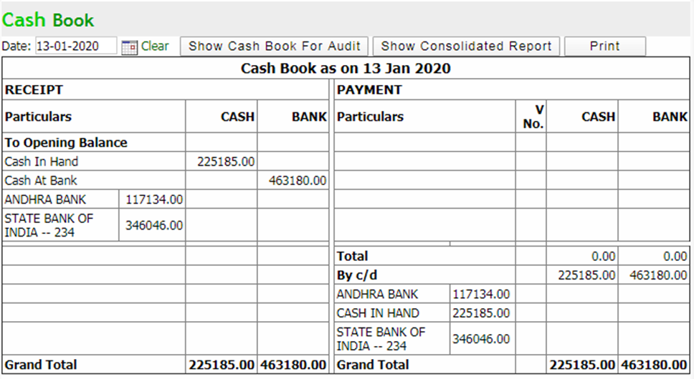
Q: to get Cash Book (Consolidated Reports)
Click Sales & Accounts → Account Report → Cash Book
Select search parameters and click show cash book for audit button or show consolidated report button as per need to get the report
Print: Click on print button to print the report

Slide 33
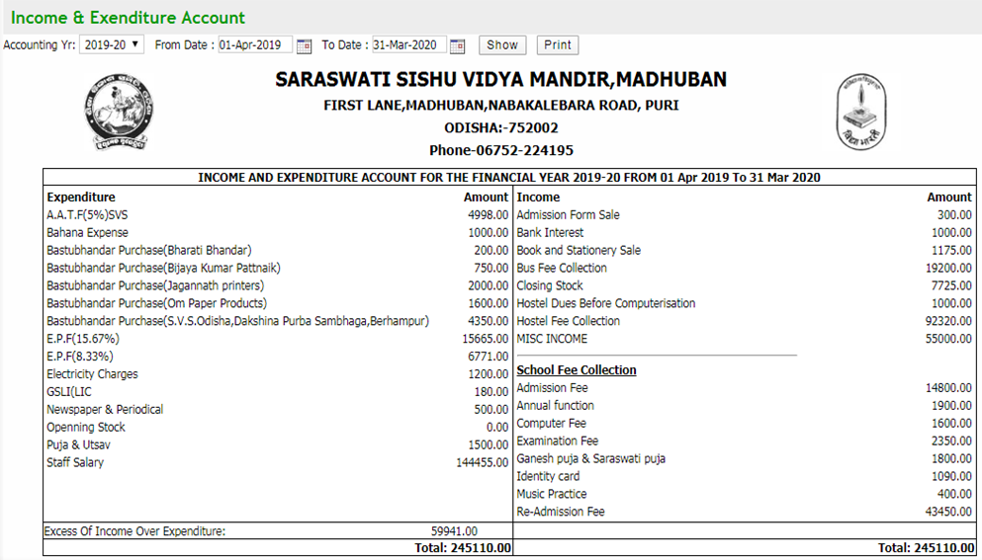
Q: to get Income And Expenditure Account detail
Click Sales & Accounts → Account Report → Income And Expenditure Account
Select search parameters and click show button to get the report
Print: Click on print button to print the report

Slide 34
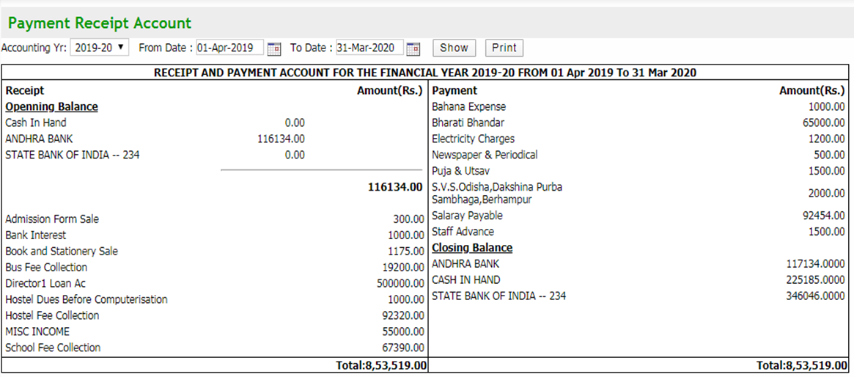
Q: to get payment receipt account detail
Click Sales & Accounts → Account Report → Receipt & Payment
Select search parameters and click show button to get the report
Print: Click on print button to print the report

Slide 35
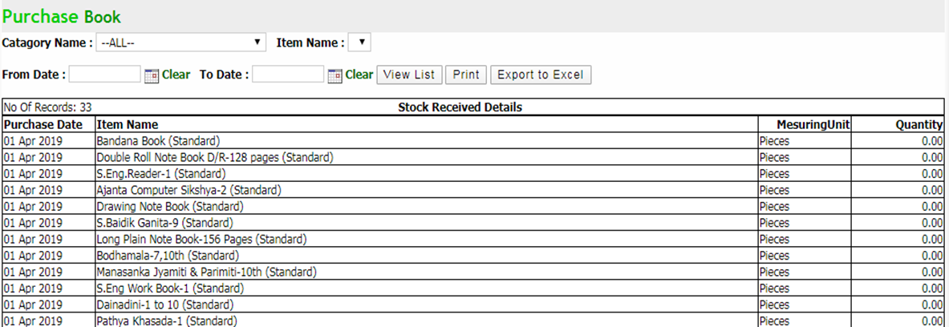
Q: to get Item purchase report
Click Sales & Accounts → Account Report → Purchase Book
Select search parameters and click view list button to get the report
Print: Click on print button to print the report
Export to excel: Click on export to excel button to export the report to an excel file

Slide 36
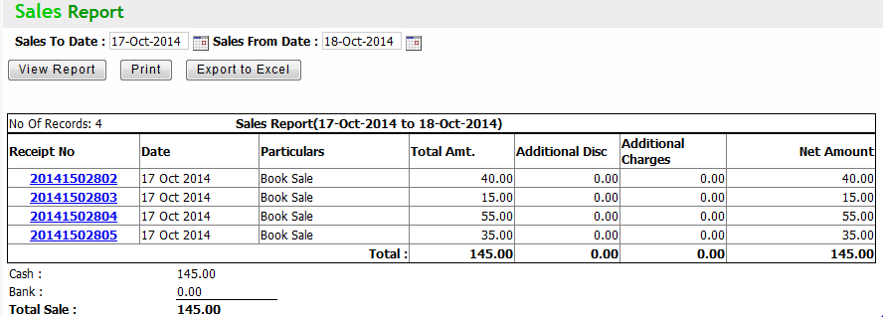
Q: to get Sales report
Click Sales & Accounts → Account Report → Daily Sales Book
Select search parameters and click view report button to get the report
Print: Click on print button to print the report
Export to excel: Click on export to excel button to export the report to an excel file

Slide 37
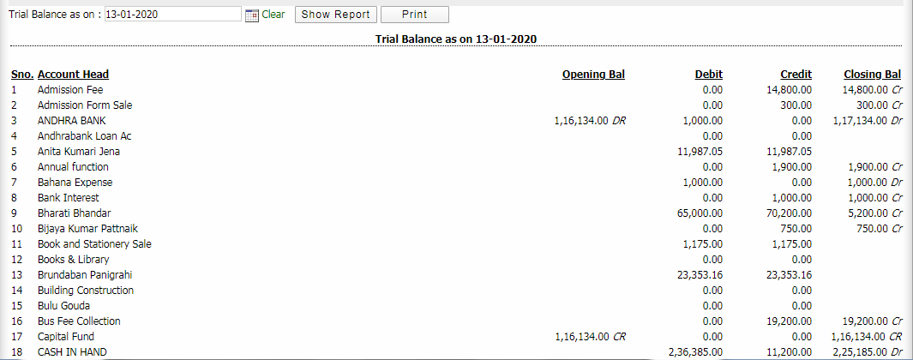
Q: to get Trial Balance
Click Sales & Accounts → Account Report → Trial Balance
Select search parameters and click show report button to get the report
Print: Click on print button to print the report

Slide 38
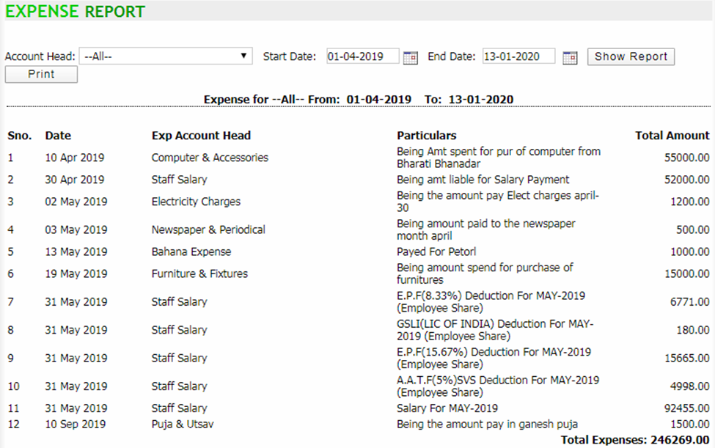
Q: to get Expense Report
Click Sales & Accounts → Account Report → Expense Report
Select search parameters and click show report button to get the report
Print: Click on print button to print the report

Slide 39
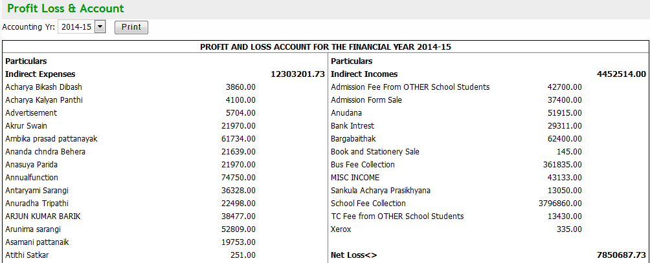
Q: to get Profit & Loss Statement
Click Sales & Accounts → Account Report → Profit & Loss Statement
Select search parameters and click view report button to get the report
Print: Click on print button to print the report

Slide 40
Q: to get Balance Sheet statement
Click Sales & Accounts → Account Report → Balance Sheet
Select search parameters and the statement will appear
Print: Click on print button to print the report

Slide 41
Q: to get Consolidated Stock report
Click Sales & Accounts → Account Report → Stock Statement
Select search parameters and click view list button to get the report
Print: Click on print button to print the report
Export to excel: Click on export to excel button to export the report to an excel file

