Slide 1
Pserp - inventory

Slide 2
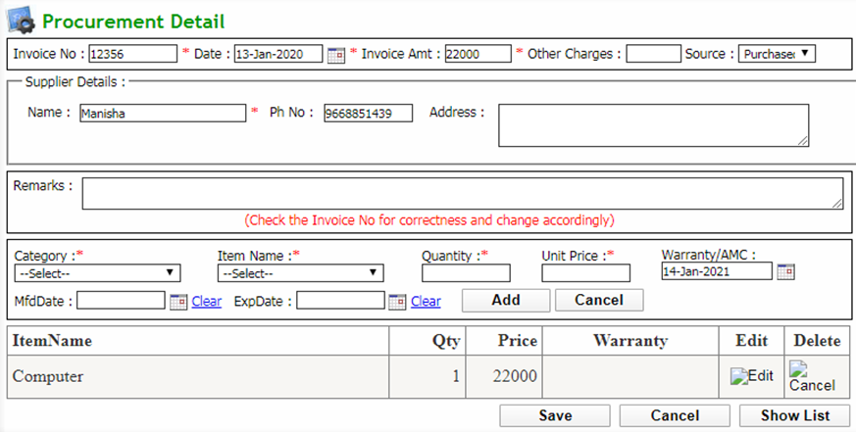
Q: To add a new Inventory procurement
Click Inventory → Inventory Management → Inventory Procurement
Now click add new button which will redirect to procurement detail page
Enter all the required details and click save button

Slide 3
Q: To view Inventory procurement list
Click Inventory→ Inventory Management → Inventory Procurement
Select search parameters and click search button to get the list
Edit: Click view items button in item list column
Delete: Select all the checkbox to be deleted and click delete button

Slide 4
Q: To make an issue/transfer of item
Click Inventory→ Inventory Management → Issue/Transfer
Click add new button which will redirect to Issue Master page
Enter all required details and click save button

Slide 5
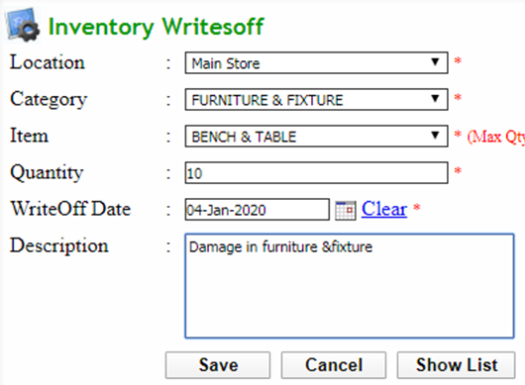
Q: To add a new Inventory writes off
Click Inventory→ Inventory Management → Inventory writes off
Click add new button which will redirect to Inventory writesoff page
Enter all required details and click save button

Slide 6
Q: To add Inventory stock Check detail
Click Inventory→ Inventory Management → Inventory stock Check
Click add new button which will redirect to stock check page
Enter all required details and click save button

Slide 7
Q: To verify a stock
Click Inventory→ Inventory Management → Verify Stock
Select search parameters and click all stock button to get stock list
Enter remarks of corresponding stock and click verify button
Click mismatched stock button to get all mismatching stock list

Slide 8
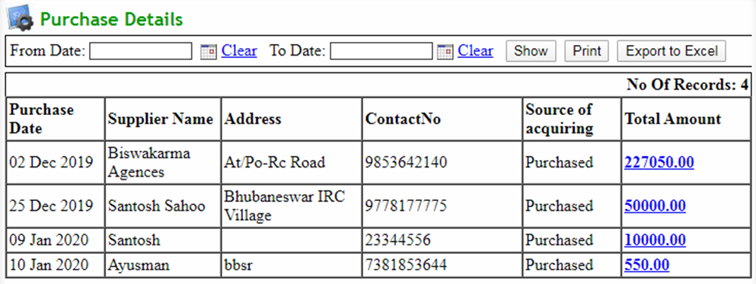
Q: To get purchase detail
Click Inventory→ Reports → Purchase Details
Select search parameters and click show button to get the report
Export to excel: Click on export to excel button to export the report to an excel
Print: Click on print button to print the report
Click amount in total amount column to view total amount paid details of a supplier

Slide 9
Q: To get Issue Details
Click Inventory→ Reports → Issue Details
Select search parameters and click show button to get the report
Export to excel: Click on export to excel button to export the report to an excel file
Print: Click on print button to print the report

Slide 10
Q: To get Location Wise Stock List
Click Inventory→ Reports → Location Wise Stock List
Select search parameters and click show button to get the report
Export to excel: Click on export to excel button to export the report to an excel file
Print: Click on print button to print the report

Slide 11
Q: To get Item List On Rol
Click Inventory→ Reports → Item List On ROL
Export to excel: Click on export to excel button to export the report to an excel file
Print: Click on print button to print the report

Slide 12
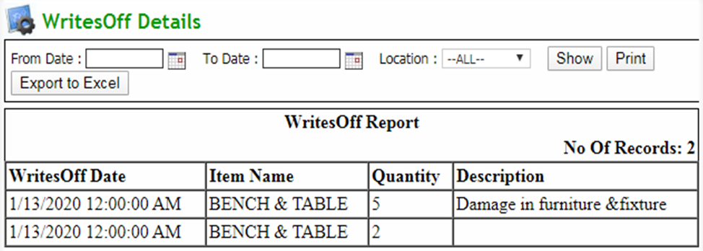
Q: To get Writes off Details
Click Inventory→ Reports → Writes off Details
Select search parameters and click show button to get the report
Export to excel: Click on export to excel button to export the report to an excel file
Print: Click on print button to print the report

Slide 13
Q: To get verify stock report
Click Inventory→ Reports → Verified Stock
Select search parameters and click show button to get the report
Export to excel: Click on export to excel button to export the report to an excel file
Print: Click on print button to print the report

