Slide 1
Pserp - hostel

Slide 2
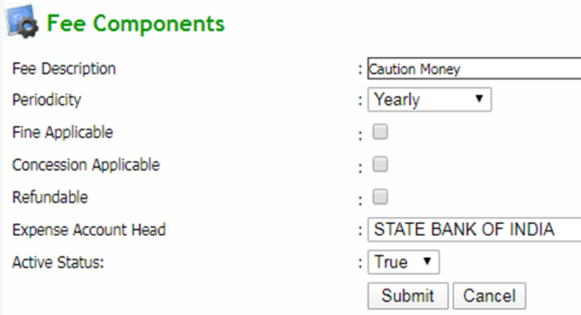
Q: Add a new hostel fee component
Click Hostel → Master Entry → Hostel Fee Components
Now click Add New button to add a new hostel fee component
Enter required details and click on submit button to save a fee component

Slide 3
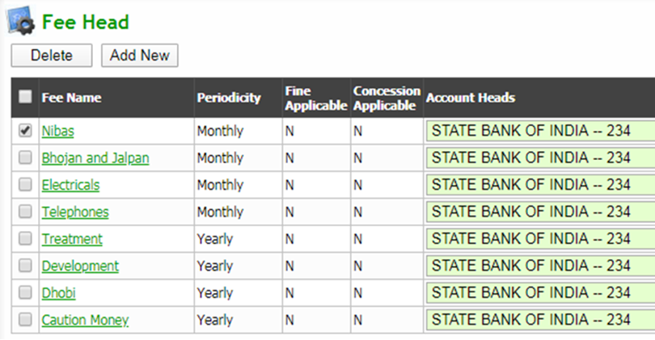
Q: to view Hostel fee components
Click Hostel → Master Entry → Hostel Fee Components
Assign Account Head To a Particular Fee Name: Choose required expense account head from the dropdown corresponding to each fee name and click update button and save button
EDIT: Click on particular fee name, this will redirect to edit page. Modify the required field and click submit button
DELETE: Tick all the checkbox to be deleted and click delete button (the record will be deleted if the particular fee component is not used anywhere in the application)

Slide 4
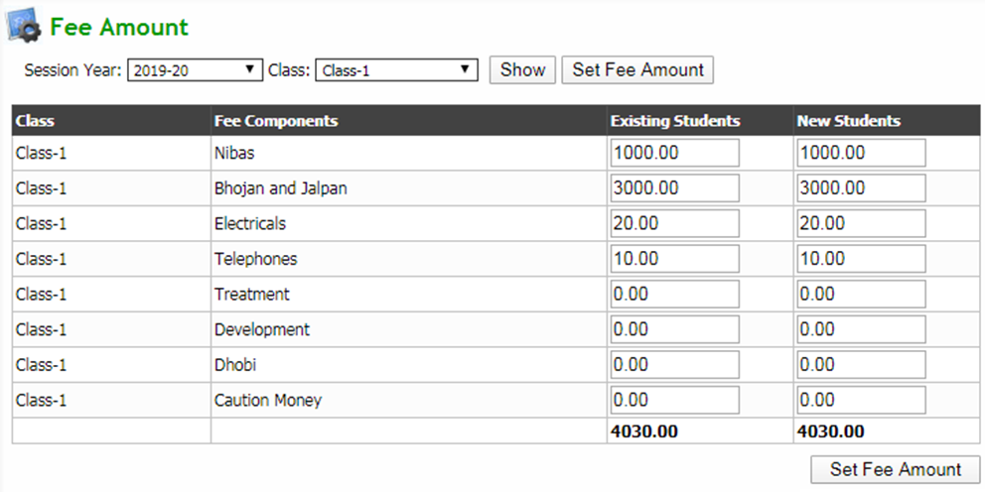
Q: To set component wise hostel fee amount on starting of the session
Click Hostel → Master Entry → Hostel Fee Amount
Select search parameters and click show button
Now Enter the respective fee amounts on Existing Students and New Students column
Click Set Fee Amount button to save details

Slide 5
Q: To set previous balance of the session
Click Hostel → Master Entry → Set Hostel Prev Balance
Select search parameters and click show button to get a list of students
Enter the previous due amount in the Previous Balance field for each student and then click submit button

Slide 6
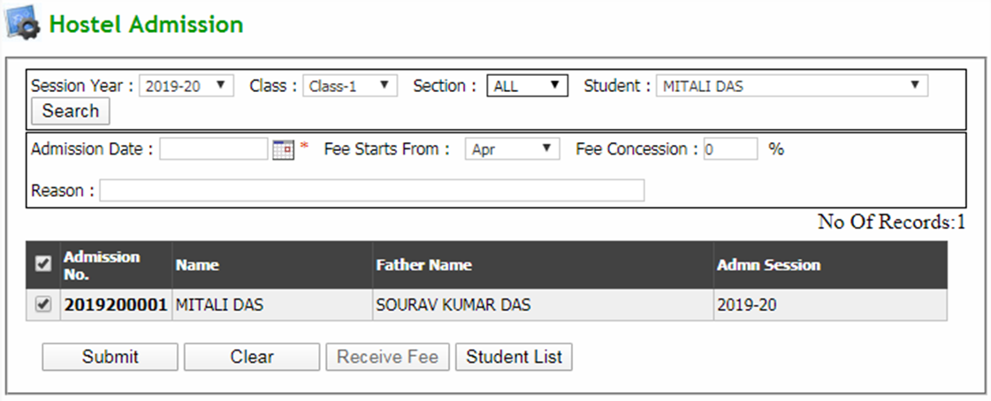
Q: student admission in hostel
Click Hostel → Hostel Management → Hostel Admission
Select search parameters and click search button to get required student list
Select required student checkbox for admission in hostel and then click submit button

Slide 7
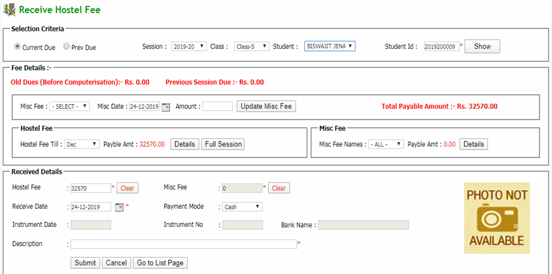
Q: To RECEIVE HOSTEL FEE
Click Hostel → Hostel Management → Receive Hostel Fee (contd…)

Slide 8
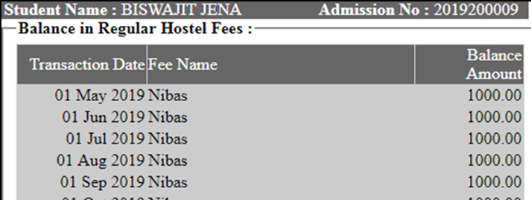
Q: To RECEIVE HOSTEL FEE (contd…)
Select a student by entering student id and click show button or select student from the dropdown
Select Misc Fee Type, date and enter the respective fee amount and click on Update Misc Fee button
Select a respective month from Hostel Fee Till drop down to view fee due till date and select the On Admission option to receive all other fee except monthly fee
Click on Full Session button to view fee due of particular student for a full session
Click on Details button to view fee payable details
Enter details of fee received and click submit button to generate the fee receipt

Slide 9
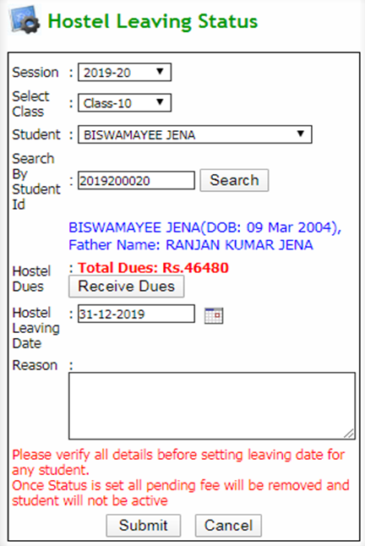
Q: To set hostel unwillingness
Click Hostel → Hostel Management → Hostel leaving status
Select a student by entering student id and click search button or select student from the dropdown
Click receive dues button to receive hostel payment
After filling details, click on submit button

Slide 10
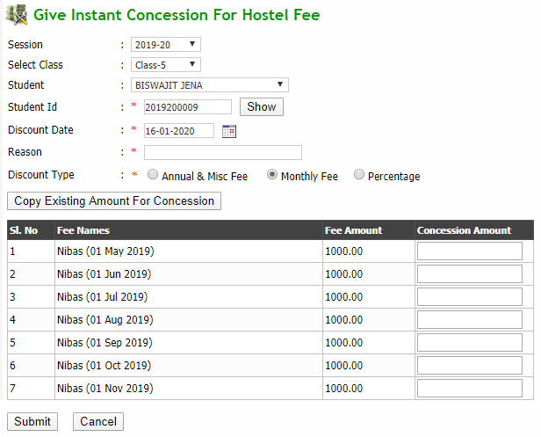
Q: give discount to a student on HOSTEL FEE
Click Hostel → Hostel Management → Hostel Fee Concession
Select a student by entering student id and click search button or select student from the dropdown
Provide discount information
Click copy existing amount for concession button to copy fee amount to concession amount column
Then click submit button to save details

Slide 11
Q: Cancel discount given to a student on hostel fee
Click Hostel → Hostel Management → Revert Hostel Fee Concession
Select a student by entering student id and click search button or select student from the dropdown
Select the discount checkbox to be cancelled and click revert concession button

Slide 12
Q: to Receive hostel previous dues
Click Hostel → Hostel Management → Receive hostel previous due
Select search parameters and click show button to get required receipts
Select the checkbox to be cancelled and click Cancel Selected Receipt button to delete the receipt
After selecting the checkbox, click receive fee button to receive old dues. This will redirect to Receive old dues before computerisation page. (contd…)

Slide 13
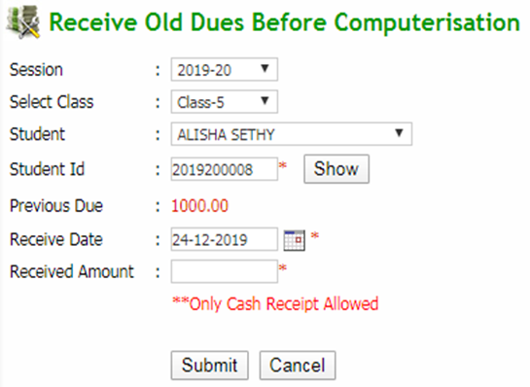
Q: to Receive hostel previous dues (contd…)
Select a student by entering student id and click show button or select student from the dropdown
Enter payment details and click submit button

Slide 14
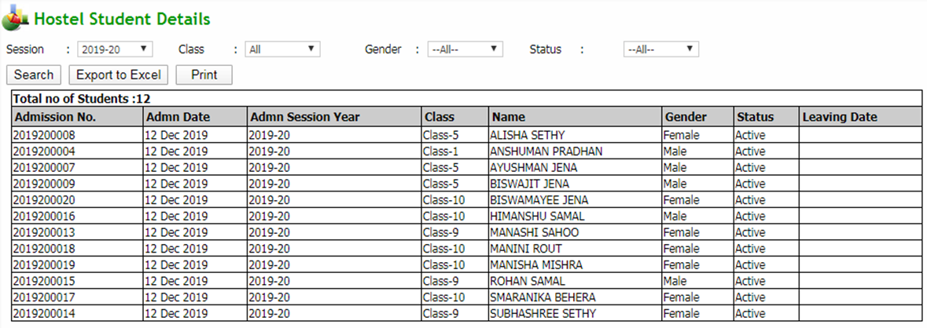
Q: to get HOSTEL ADMISSION LIST
Click Hostel → Reports → Hostel admission list
Select search parameters and click search button to get the list
Export to excel: Click on export to excel button to export the report to an excel file
Print: Click on print button to print the report

Slide 15
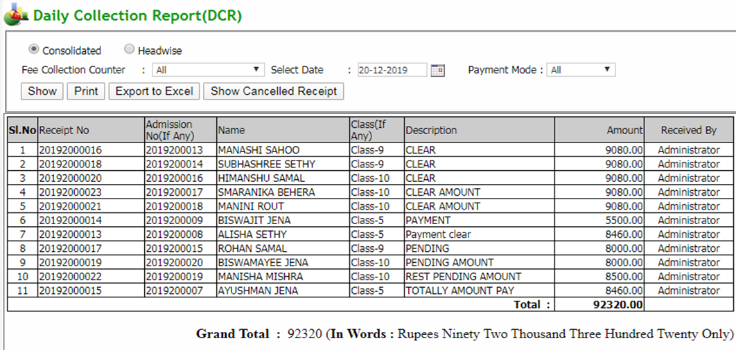
Q: to get Daily Collection Report (DCR)
Click Hostel → Reports → Daily Collection Report (DCR)
Select search parameters and click show button to get the list
Export to excel: Click on export to excel button to export the report to an excel file
Print: Click on print button to print the report (contd…)

Slide 16
Q: to get Daily Collection Report (DCR) (contd…)
Click on Show Cancelled Receipt button to view all cancelled receipt
Select search parameters and click show button to get the report
Export to excel: Click on export to excel button to export the report to an excel file
Print: Click on print button to print the report

Slide 17
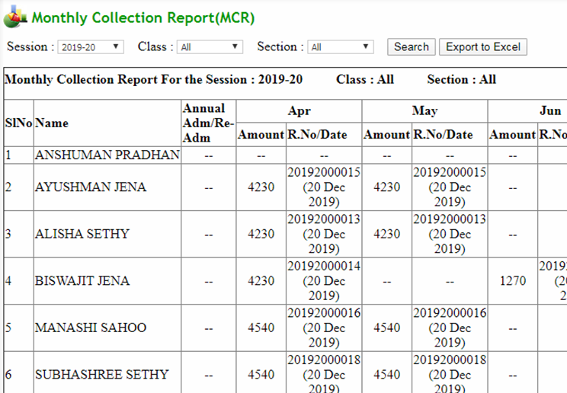
Q: to get Monthly Collection Report (MCR)
Click Hostel → Reports → Monthly Collection Report (MCR)
Select search parameters and click search button to get the list
Export to excel: Click on export to excel button to export the report to an excel file

Slide 18
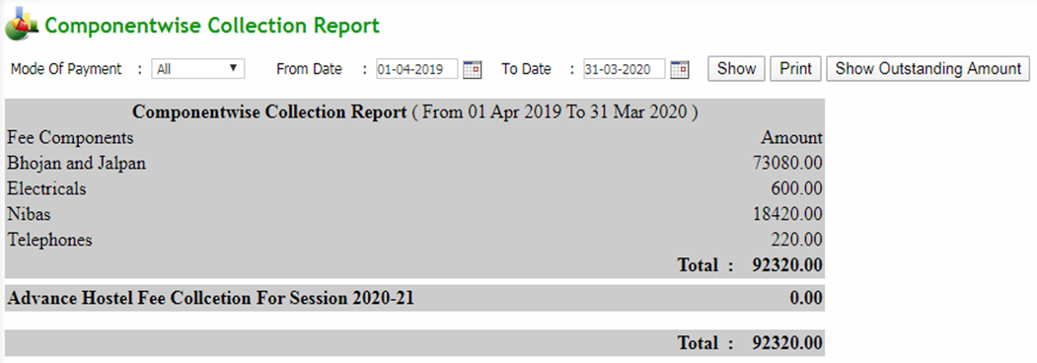
Q: to get Component wise Collection Report
Click Hostel → Reports → Component wise Collection Report
Select search parameters and click show button to get the list
Print: Click on print button to print the report
Click on show outstanding amount button to get outstanding amount (contd…)

Slide 19
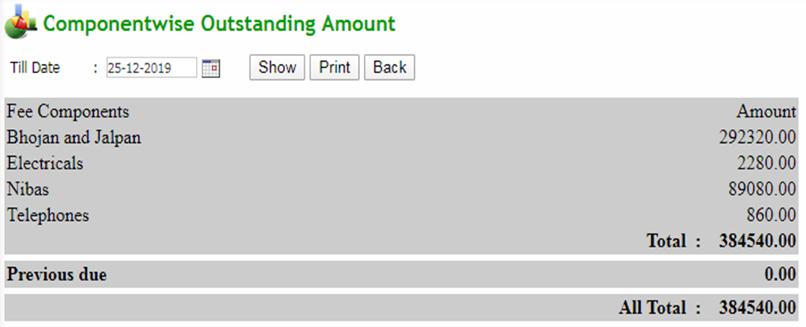
Q: to get Component wise Collection Report (contd…)
Select search parameters and click show button to get the report
Print: Click on print button to print the report
Back: Click on back button to go back to the previous form

Slide 20
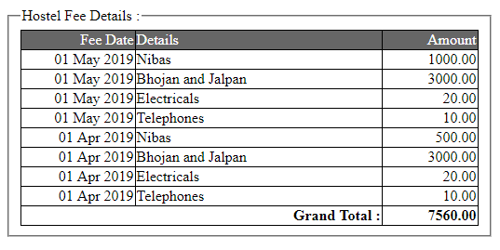
Q: to get HOSTEL FEE DEFAULTERS LIST
Click Hostel → Reports → Hostel fee defaulters
Select search parameters and click show button to get the list
Print: Click on print button to print the report
Click on link available under Regular fee due column to view Regular fee due details of a respective student

Slide 21
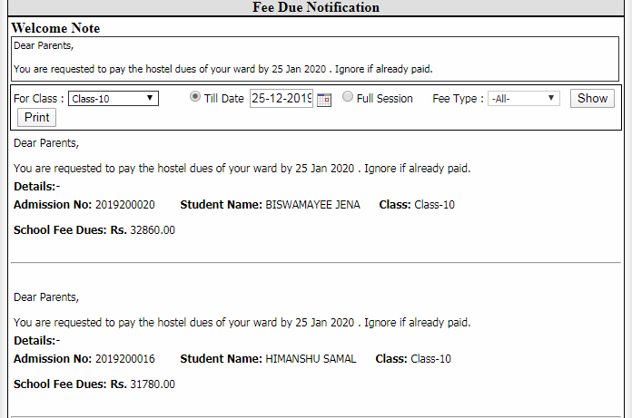
Q: to generate HOSTEL FEE DUE NOTIFICATION
Click Hostel → Reports → Hostel fee due notification
Select search parameters and click show button to get the list
Print: Click on print button to print the report

Slide 22
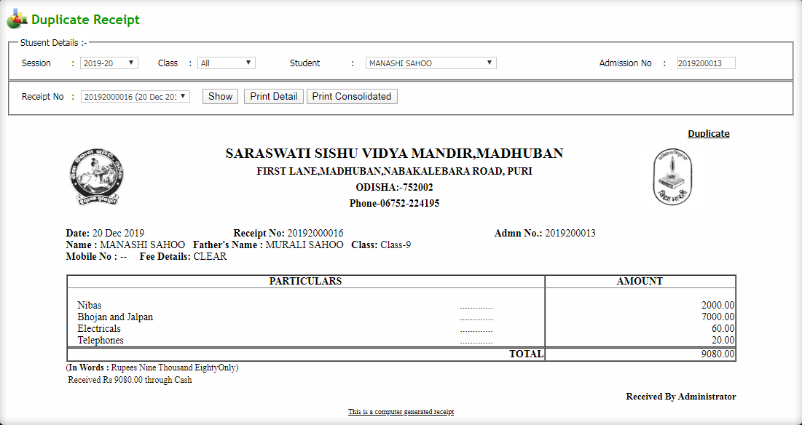
Q: to get DUPLICATE RECEIPT
Click Hostel → Reports → Print duplicate receipt
Select search parameters and click show button to get the list
Click on print detail button to print the report
Click on print consolidated button to print the receipt in consolidated format

Slide 23
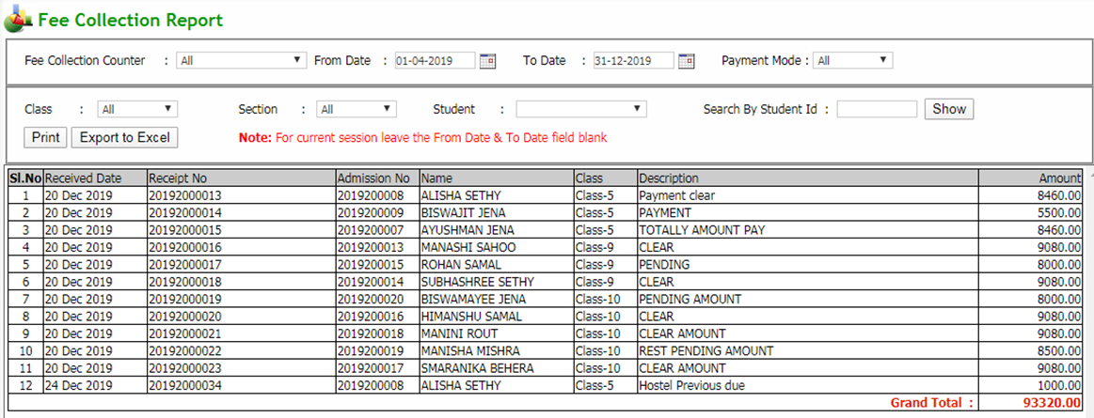
Q: to get HOSTEL FEE COLLECTION REPORT
Click Hostel → Reports → Hostel fee collection
Select search parameters and click show button to get the list
Export to excel: Click on export to excel button to export the report to an excel file
Print: Click on print button to print the report

