Slide 1
PSERP english – exam & result

Slide 2
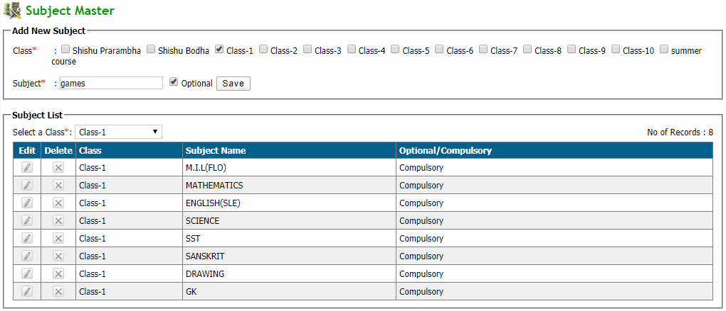
Q: To add new subject
Click Exam & Result → Examination & Result → Subject Master
Enter new subject details in add new subject box and click save button
Edit: Click edit button in edit column and then modify subject and click update button
Delete: Click delete button in delete column of corresponding subjects

Slide 3
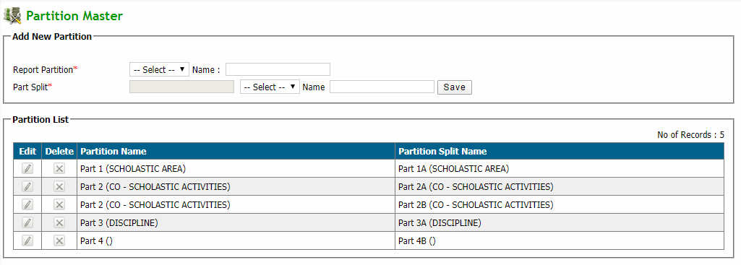
Q: Partition master
Click Exam & Result → Examination & Result → Partition Master
Select report partition and add new partition name box and select part split and add split partition name. And click on save button.
Edit: Click edit button in edit column and then modify partition and click update button
Delete: Click delete button in delete column of corresponding partition

Slide 4
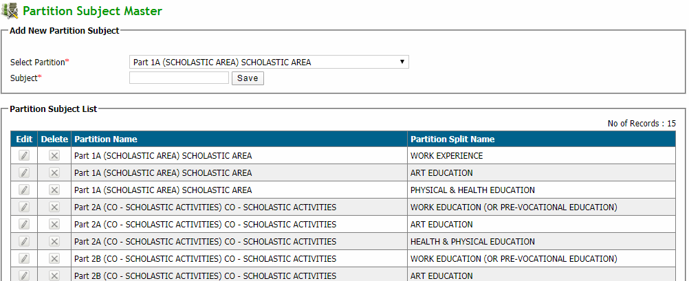
Q: Partition subject master(i-x)
Click Exam & Result → Examination & Result → Partition subject master(i-x)
Select partition and add subject name box and click on save button.
Edit: Click edit button in edit column and then modify subject partition and click update button
Delete: Click delete button in delete column of corresponding partition subject.

Slide 5
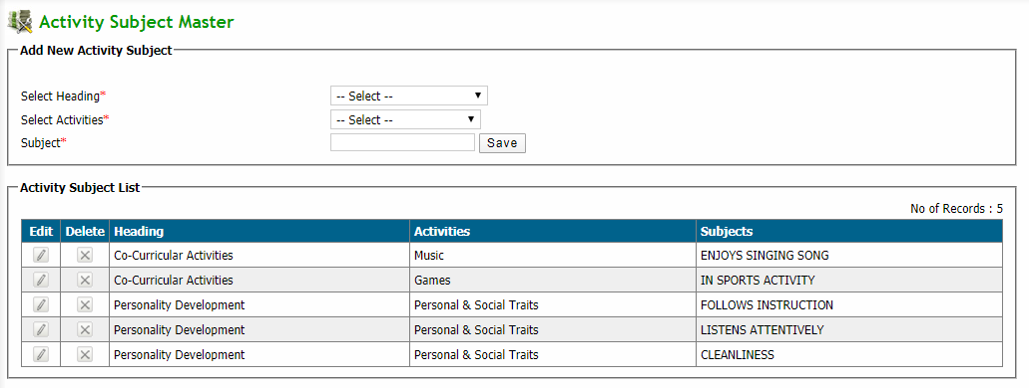
Q: activities subject master(nur-ukg)
Click Exam & Result → Examination & Result → activities subject master(nur-ukg)
Select heading and select activities and add subject name in box and click on save button.
Edit: Click edit button in edit column and then modify activities and click update button
Delete: Click delete button in delete column of corresponding activities.

Slide 6
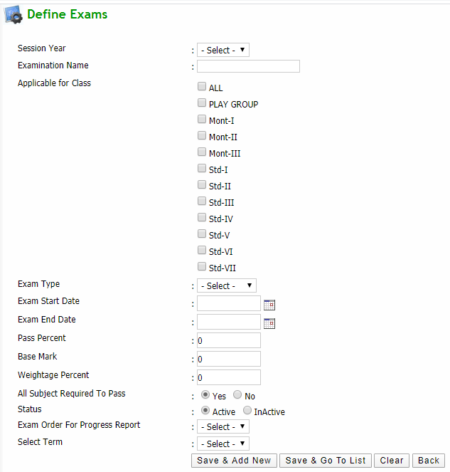
Q: To define exams for each class
Click Exam & Result → Examination & Result → Define Exams
Click add new button and this will redirect to define exams page
Enter all required details and click save & add new button or save & go to list button according to your need
If want to copy all Exam type for previous session to new session then click on import data from prev session button.

Slide 7
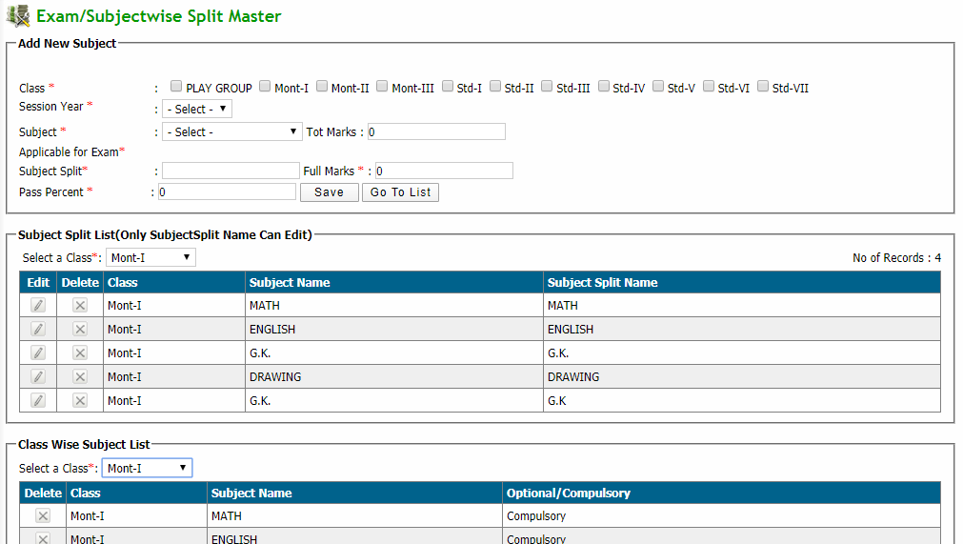
Q: : Define Exam/ Classwise subject split
Click Exam & Result → Examination & Result → Define Exam Subject
Select class for exam then enter all required details and click save .
For view click on go to list button according to your need.

Slide 8
Q: To assign optional subject to students
Click Exam & Result → Examination & Result → Assign Optional Subjects
Select search parameters and the list will appear
Assign optional: Select desired student checkbox and click assign button to assign the optional subject to the selected students
Un-Assign optional: Select desired student checkbox and click un-assign button to un-assign the optional subject to the selected students

Slide 9
Q: To assign optional subject to students
Click Exam & Result → Examination & Result → Assign Optional Subjects
Select search parameters and the list will appear
Assign optional: Select desired student checkbox and click assign button to assign the optional subject to the selected students
Un-Assign optional: Select desired student checkbox and click un-assign button to un-assign the optional subject to the selected students

Slide 10
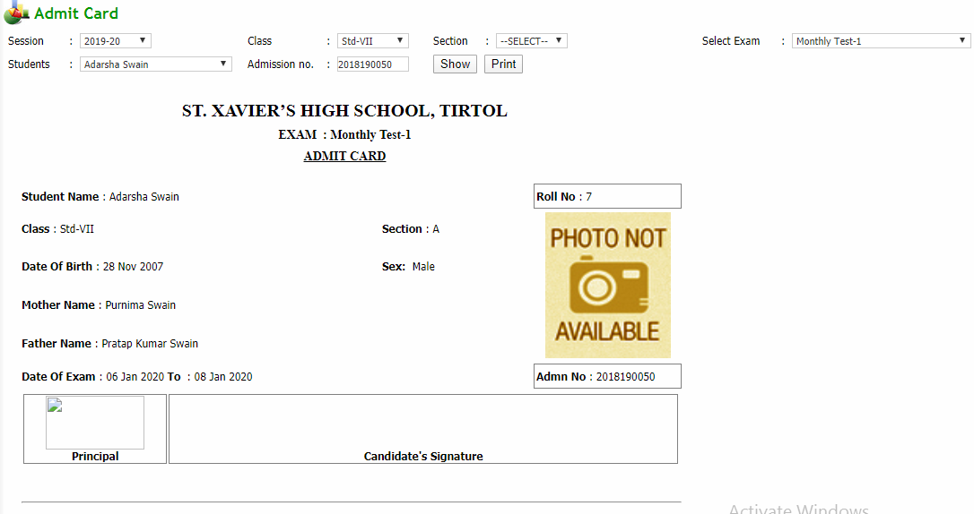
Q: To print admit card
Click Exam & Result → Examination & Result → print admit card
Select search parameters and click show button to get admit card
Print: Click on print button to print the admit card

Slide 11
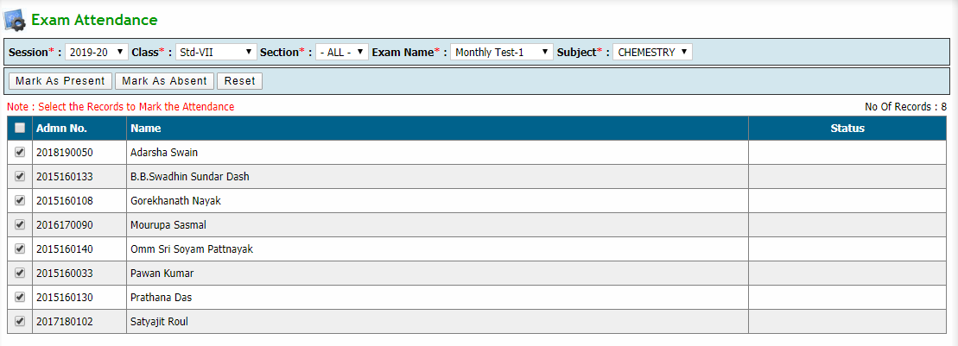
Q: To give exam attendance to students
Click Exam & Result → Examination & Result → Exam Attendance
Select search parameters and the list will appear
Present: Select desired student checkbox and click mark as present button to assign present to the selected students
Absent: Select desired student checkbox and click mark as absent button to assign present to the selected students

Slide 12
Q: To give exam marks to students
Click Exam & Result → Examination & Result → Enter Exam Marks
Select student from the dropdown
Enter marks of the student in the marks field and click save button to save respective subject marks

Slide 13
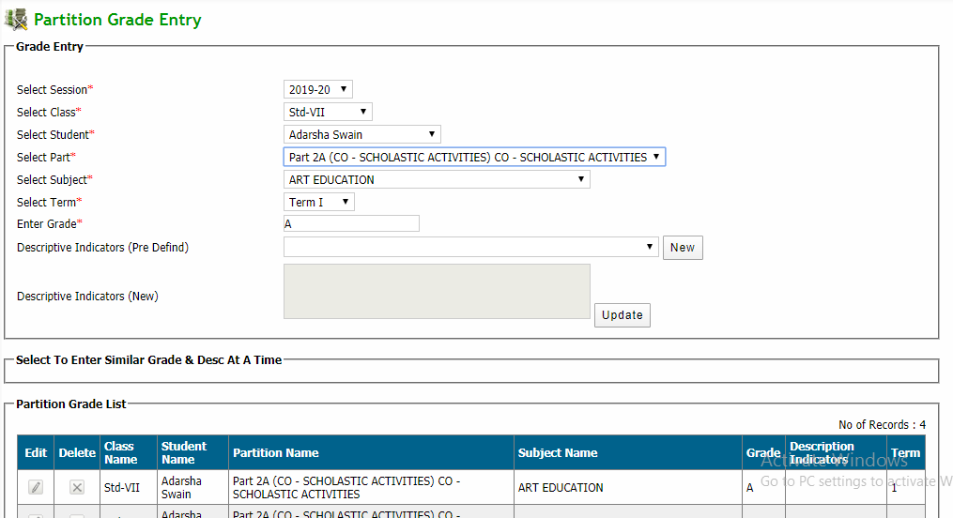
Q: Partition grade entry (i-x)
Click Exam & Result → Examination & Result → partition grade entry
Enter all required details and click save .
Edit: Click edit button in edit column and then modify and click update button
Delete: Click delete button in delete column of corresponding Student

Slide 14
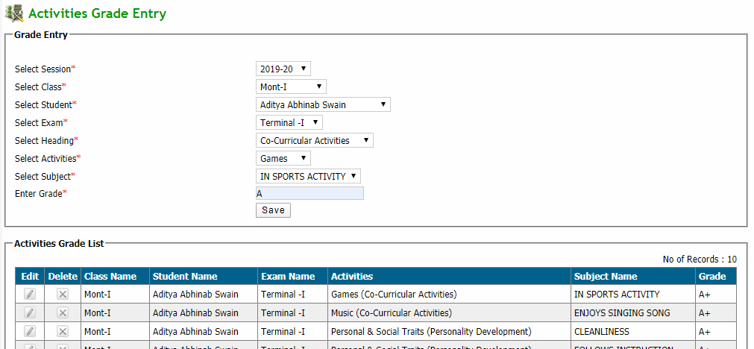
Q: Activities grade entry (nur-ukg)
Click Exam & Result → Examination & Result → Activities grade entry
Enter all required details and click save .
For View select student in dropdown then view student details
Edit: Click edit button in edit column and then modify and click update button
Delete: Click delete button in delete column of corresponding Student

Slide 15
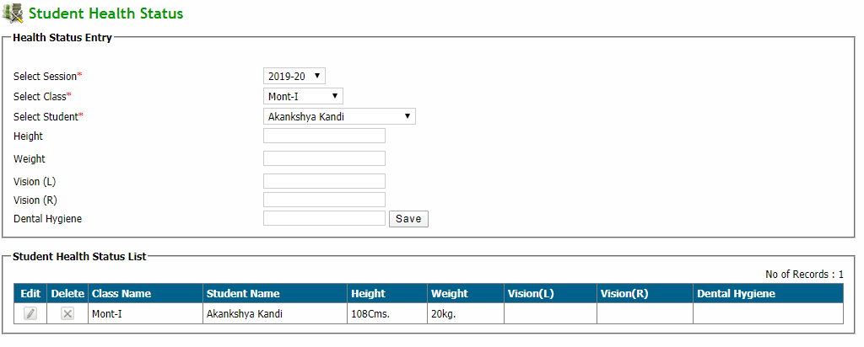
Q: health status entry
Click Exam & Result → Examination & Result → Health status entry
Enter all required details and click save .
For View select student in dropdown then view student details
Edit: Click edit button in edit column and then modify and click update button
Delete: Click delete button in delete column of corresponding Student

Slide 16
Q: To modify exam marks of students
Click Exam & Result → Examination & Result → Modify Exam Marks
Select search parameters and select student from the dropdown
Enter modified marks of the student in the marks field and click save button to save selected subject marks.

Slide 17
Q: To generate result of students
Click Exam & Result → Examination & Result → Generate Results
Select search parameters and click generate result button

Slide 18
Q: Work on new session start
Click Exam & Result → Work on new session start→ import exam det. From prev year
Then Click To Copy Data .

Slide 19
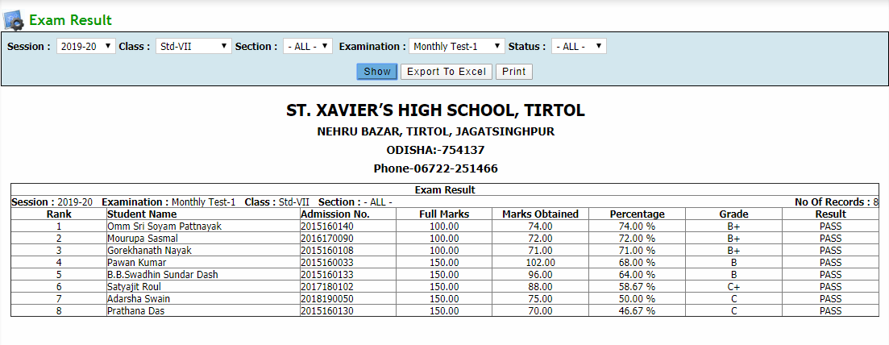
Q: To get Exam Results
Click Exam & Result → Reports → Exam Result
Select search parameters and click show button to get the result
Export to excel: Click on export to excel button to export the result to an excel file
Print: Click on print button to print the result

Slide 20
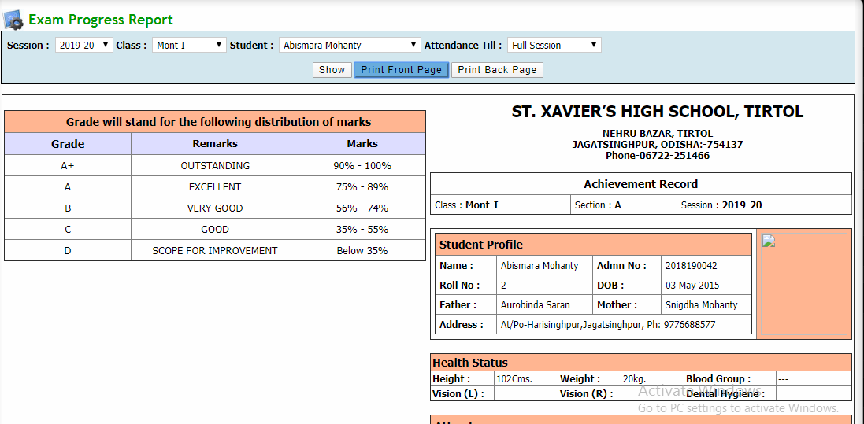
Q: progress Report(nur -ukg) split
Click Exam & Result → Reports → Exam Progress report
Select search parameters and click show button to get the result
Print: Click on print button to print the report

Slide 21
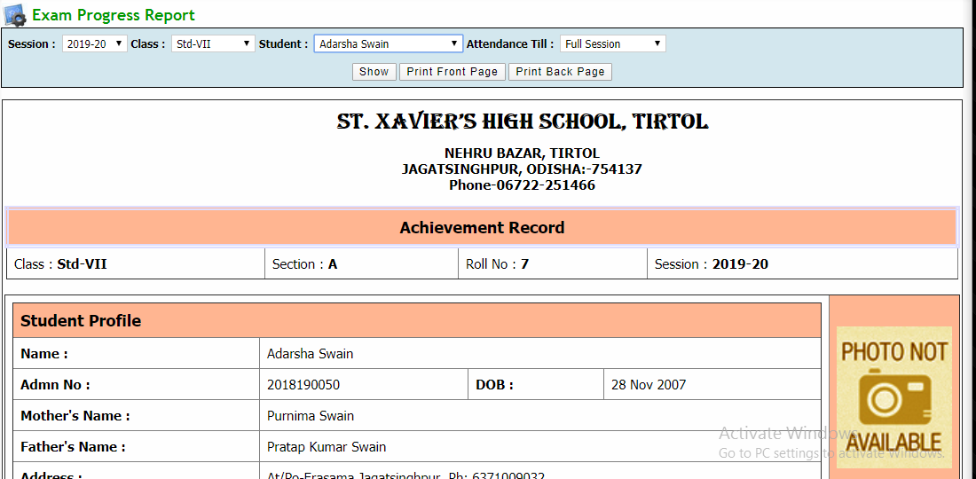
Q: progress Report(nur -ukg) con
Click Exam & Result → Reports → Exam Progress report
Select search parameters and click show button to get the result
Print: Click on print button to print the report

Slide 22
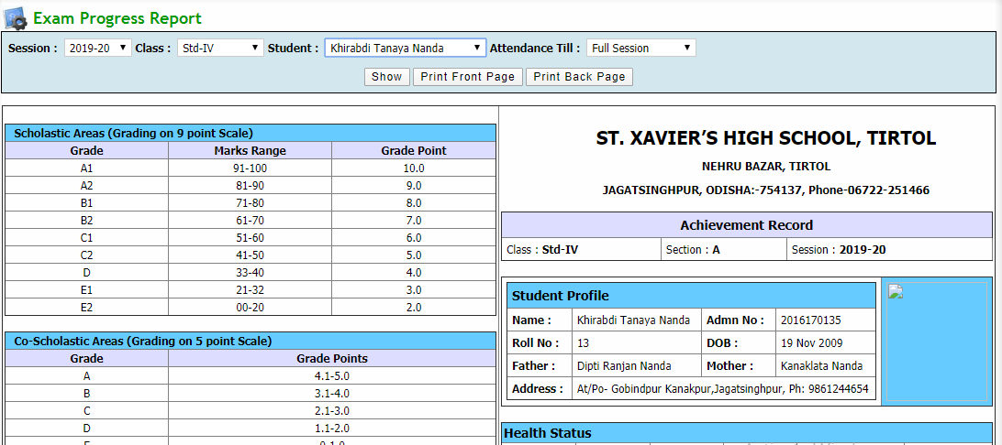
Q: progress Report(i -v)
Click Exam & Result → Reports → Exam Progress report
Select search parameters and click show button to get the result
Print: Click on print button to print the report

Slide 23
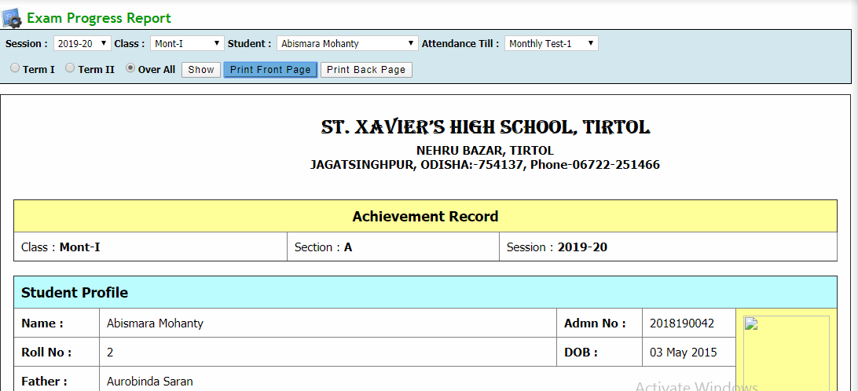
Q: progress Report(vi -viii)
Click Exam & Result → Reports → Exam Progress report
Select search parameters and click show button to get the result
Print: Click on print button to print the report

