Slide 1
BILLING SOFTWARE JEWELLERY
Presented By: Creative Terabite Solutions Pvt. Ltd.

Slide 2
ABOUT US
CTSPL is a privately owned and passionately company with a management team that boasts more than 10 years’ experience in billing market.
We pride ourselves on our vast market knowledge and ability to provide a wide range of billings services that deliver real benefits to our customers.
Our highly skilled in-house development team is available to support you throughout the billing process and with any further individual needs.
It’s an old saying but it’s true; CTSPL are big enough to cope but small enough to care.

Slide 3
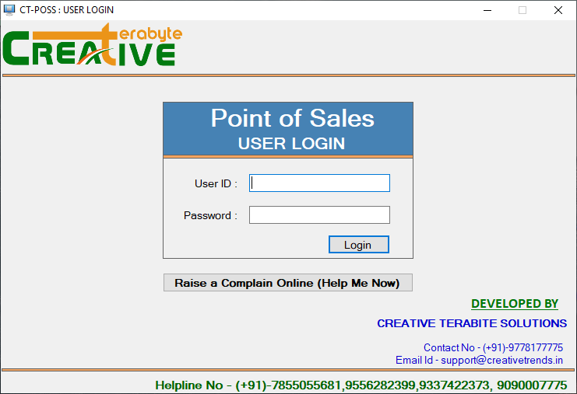
USER LOGIN

Slide 4
HOME PAGE

Slide 5
SHORTCUT ACCESS
To define Item
To make a Purchase
To make a Sale Bill
To make a Sale Return
To make a Service Bill
To Receipt Voucher
To Expense Voucher
To Payment Voucher
To obtain Stock Statement
To obtain Daily Sale Report

Slide 6
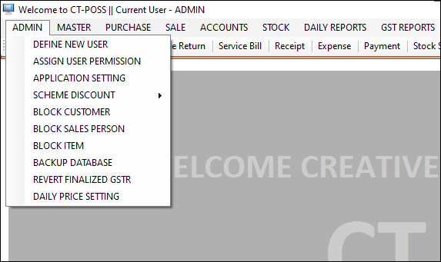
ADMIN

Slide 7
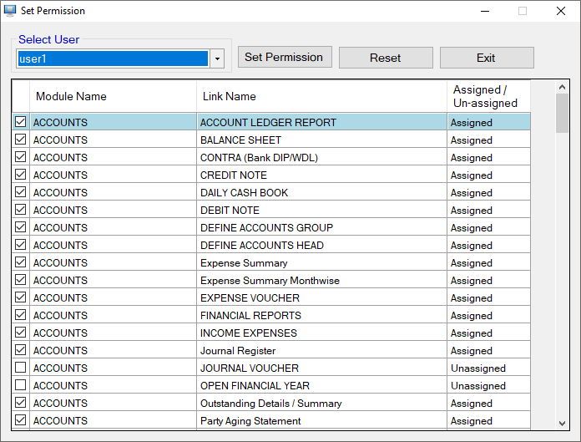
ASSIGN USER PERMISSION

Slide 8
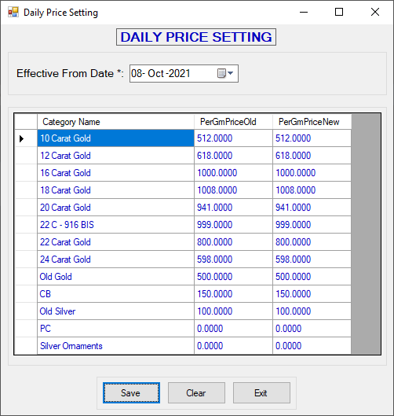
DAILY PRICE SETTING

Slide 9
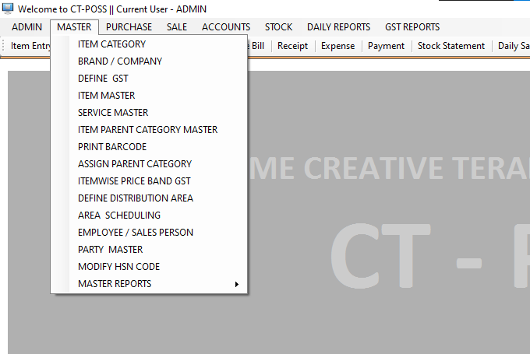
MASTER ENTRY

Slide 10
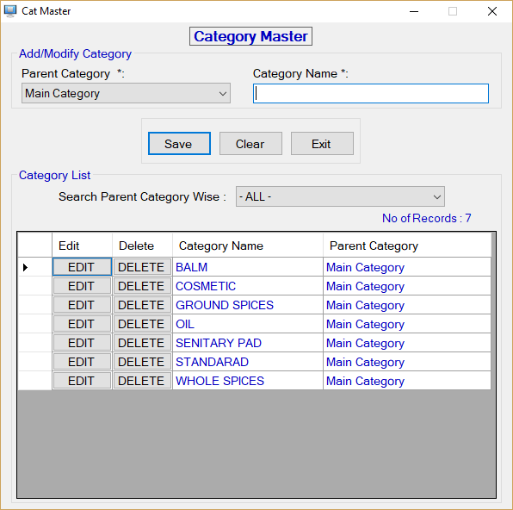
ITEM CATEGORY

Slide 11
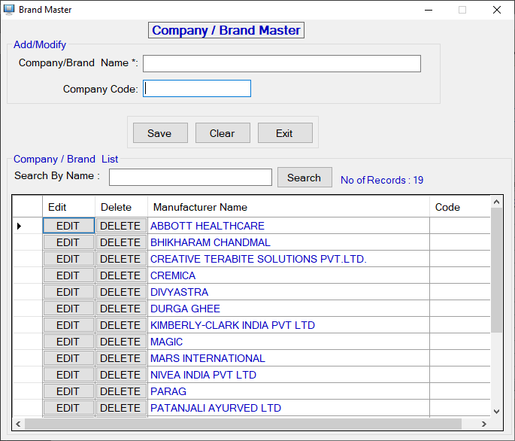
ITEM BRAND / COMPANY

Slide 12
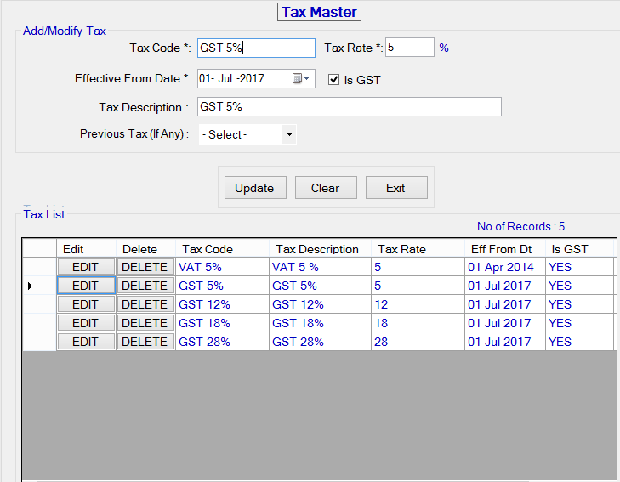
TAX MASTER

Slide 13
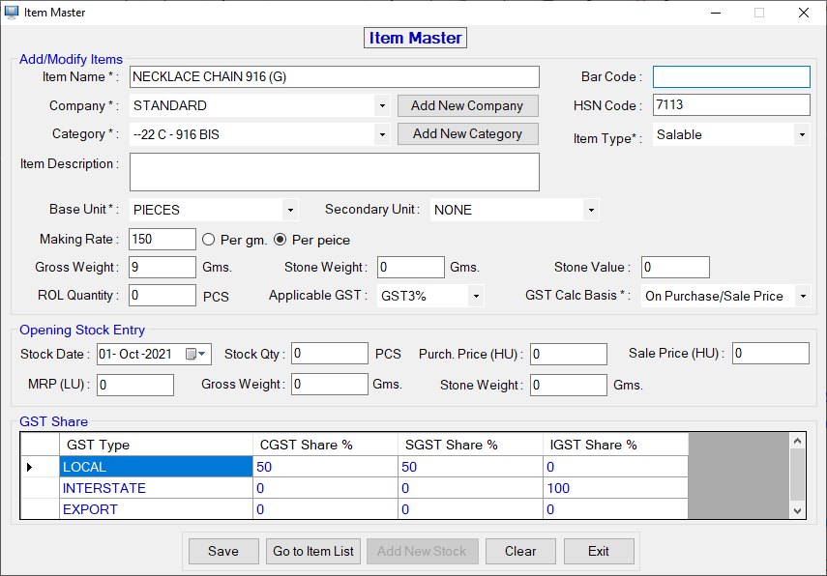
ITEM MASTER

Slide 14
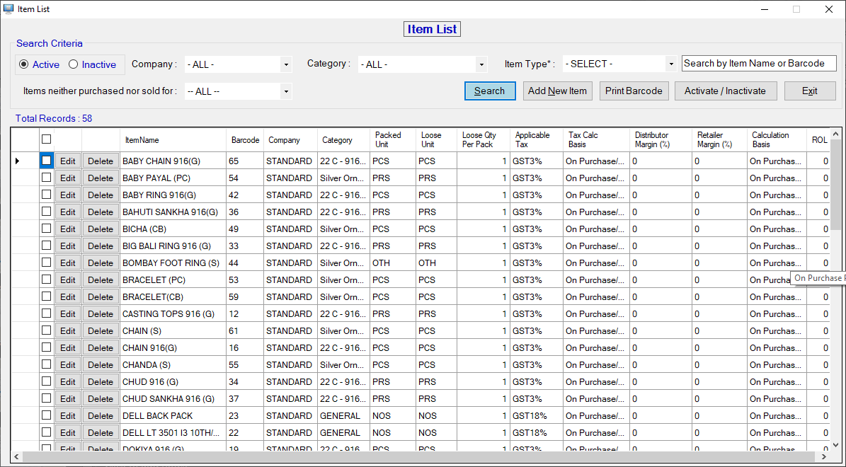
ITEM MASTER LIST

Slide 15
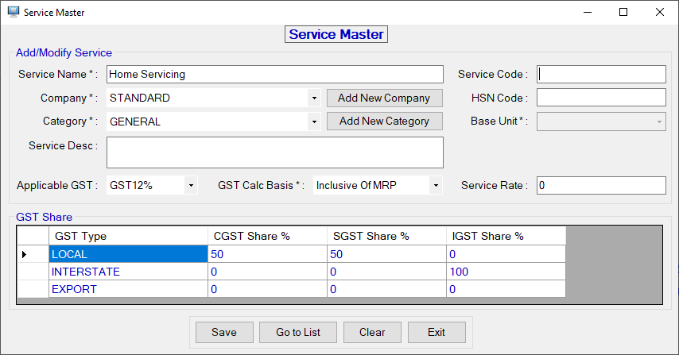
SERVICE MASTER

Slide 16
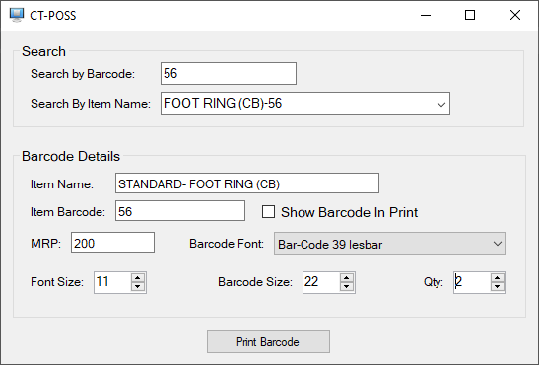
PRINT BARCODE

Slide 17
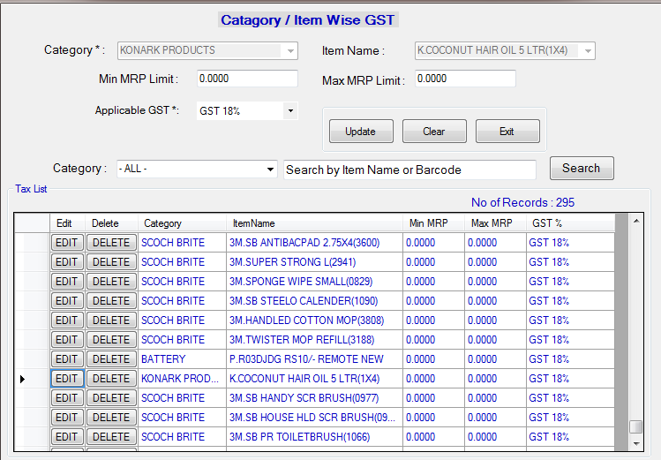
ITEM WISE PRICE BAND GST

Slide 18
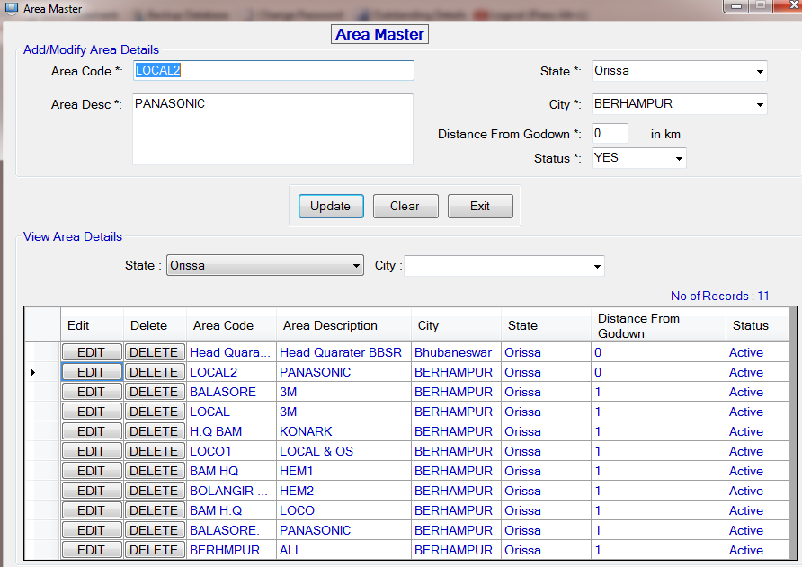
DISTRIBUTION AREA MASTER

Slide 19
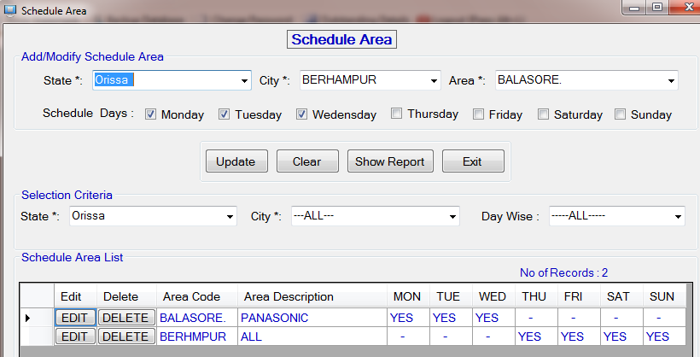
AREA SCHEDULING

Slide 20
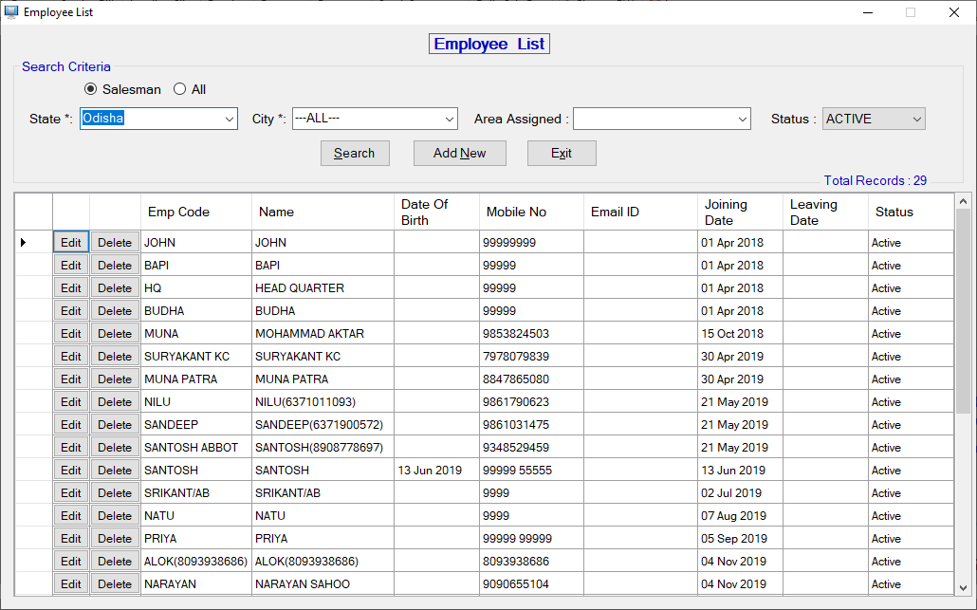
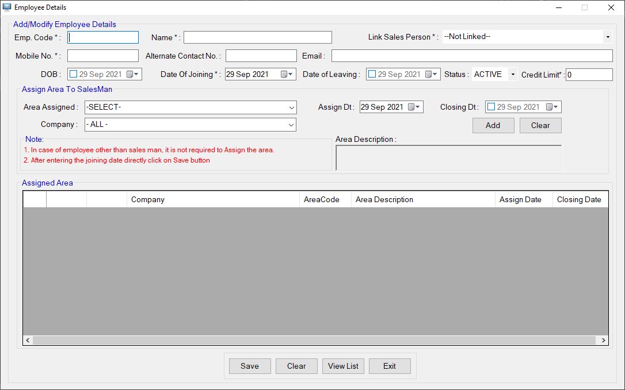
SALESMAN MASTER

Slide 21
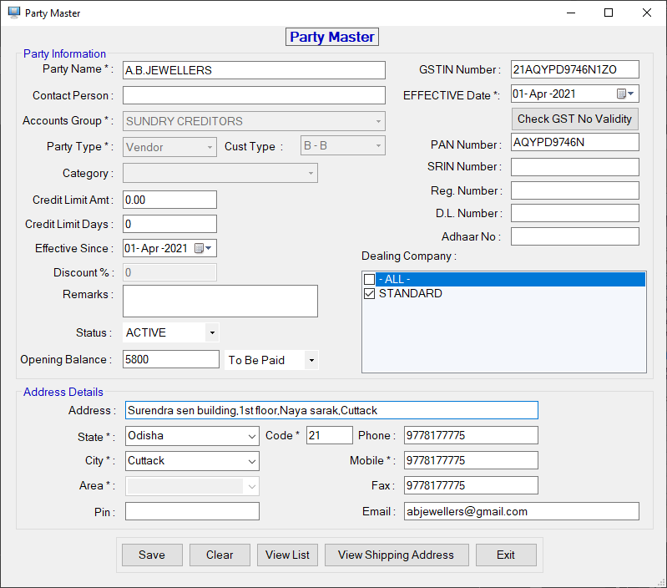
PARTY MASTER

Slide 22
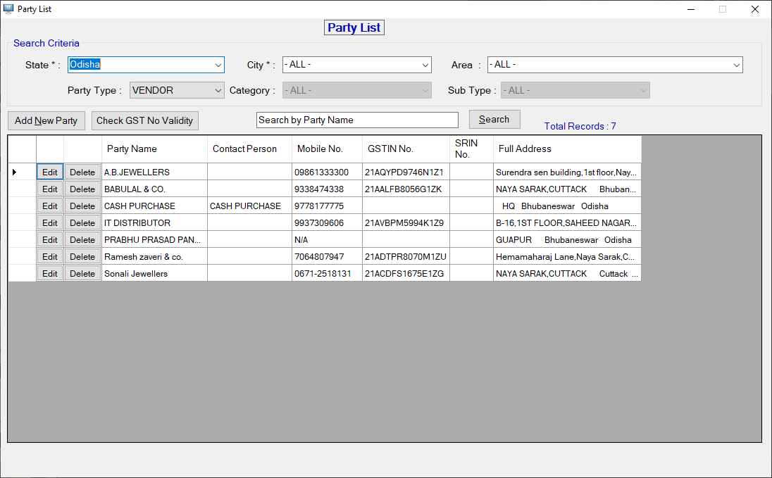
PARTY LIST

Slide 23
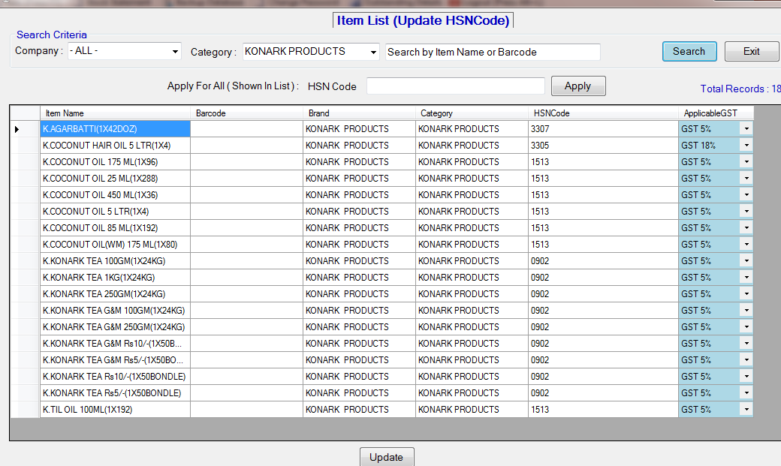
MODIFY HSN CODE

Slide 24
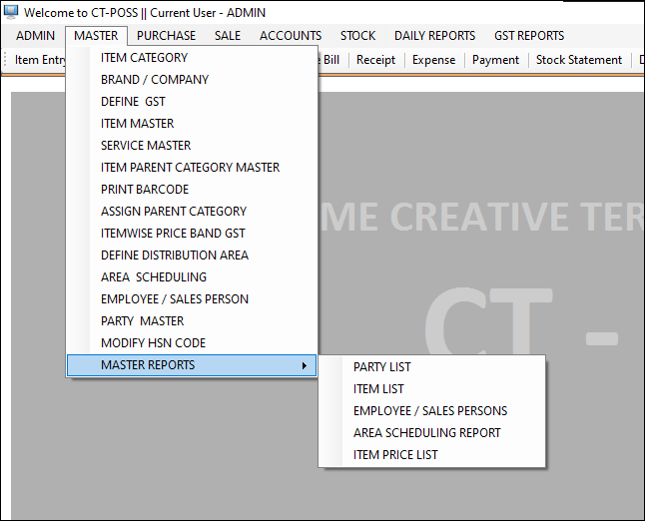
MASTER REPORTS

Slide 25
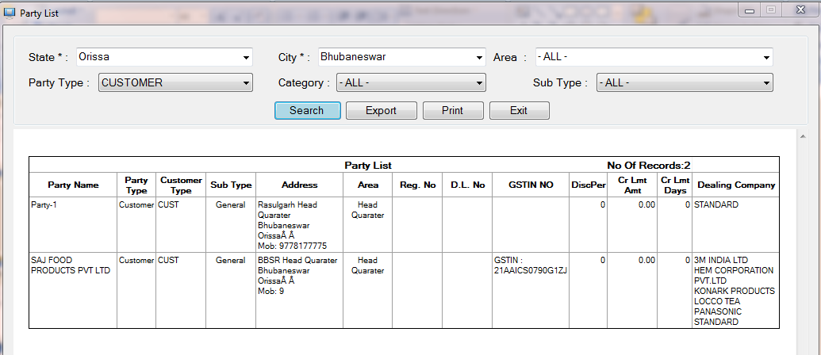
MASTER REPORTS (PARTY LIST)

Slide 26
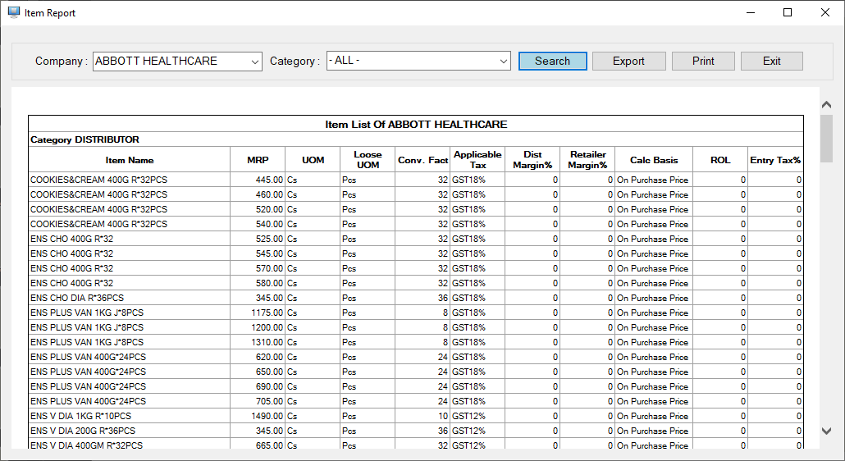
MASTER REPORTS (ITEM LIST)

Slide 27
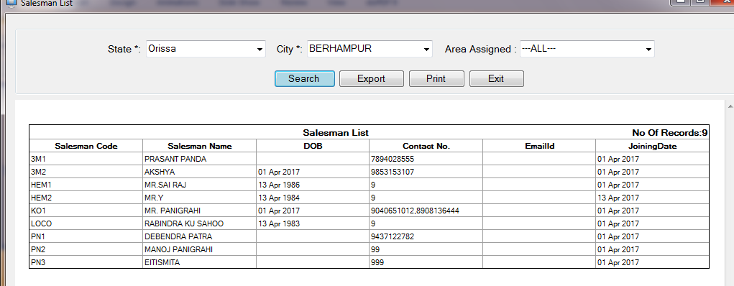
SALESMAN LIST - DSE

Slide 28
MASTER REPORTS (DSE SCHEDULE)

Slide 29
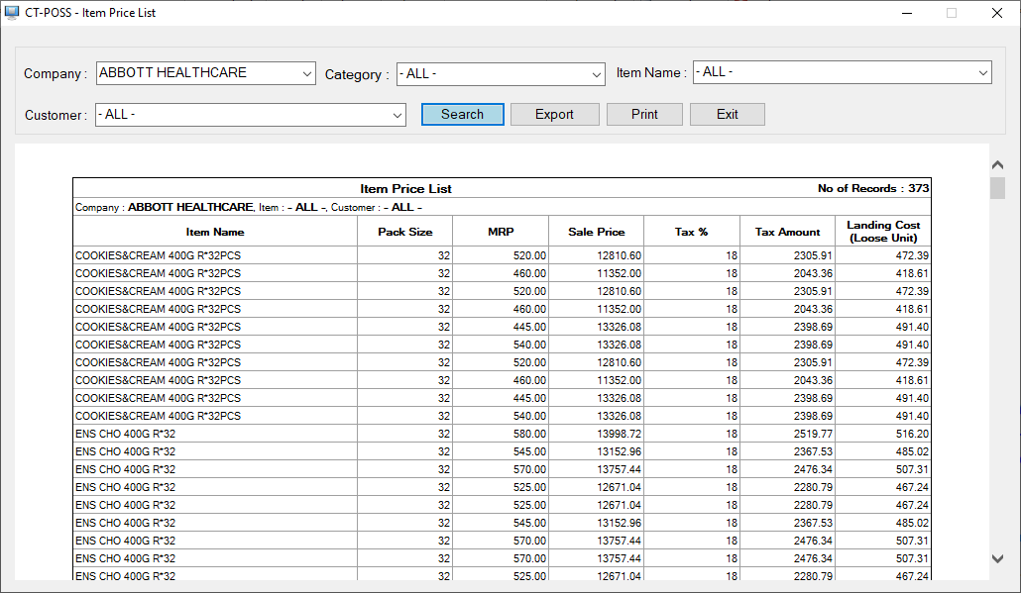
ITEM PRICE LIST

Slide 30
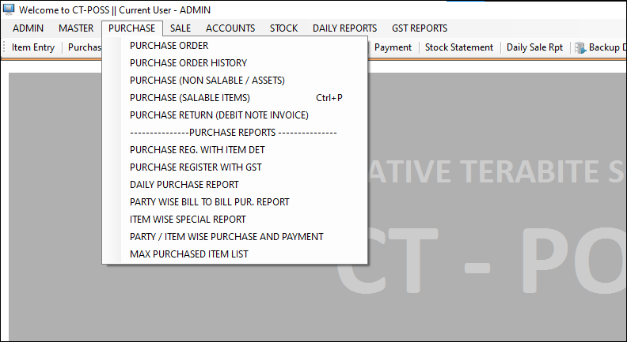
PURCHASE

Slide 31
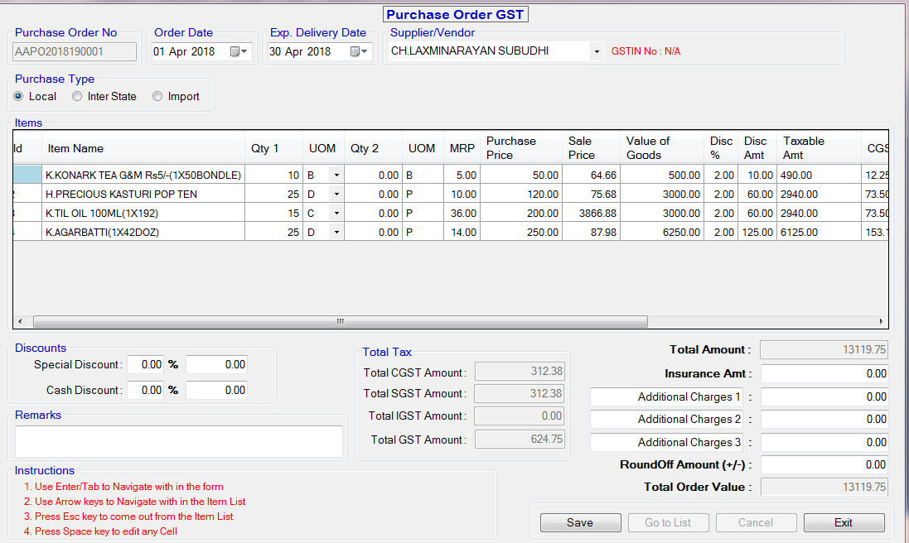
PURCHASE ORDER

Slide 32
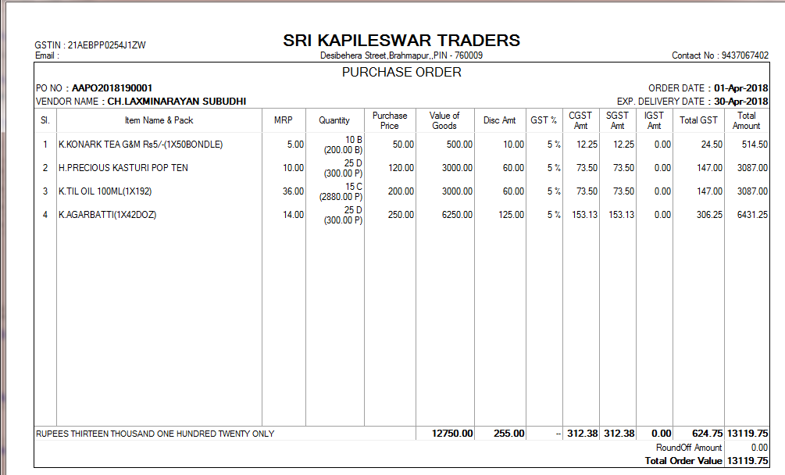
PURCHASE ORDER BILL PRINT

Slide 33
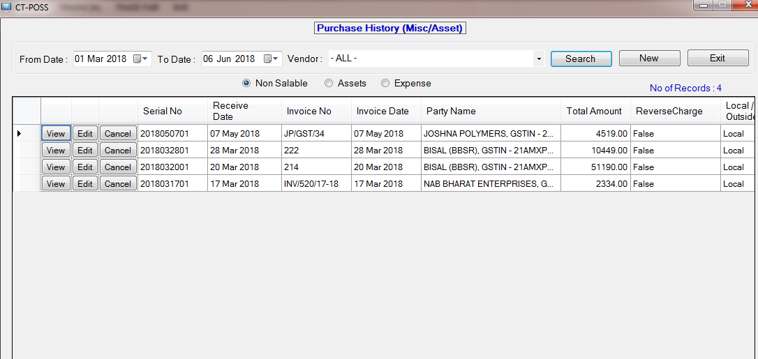
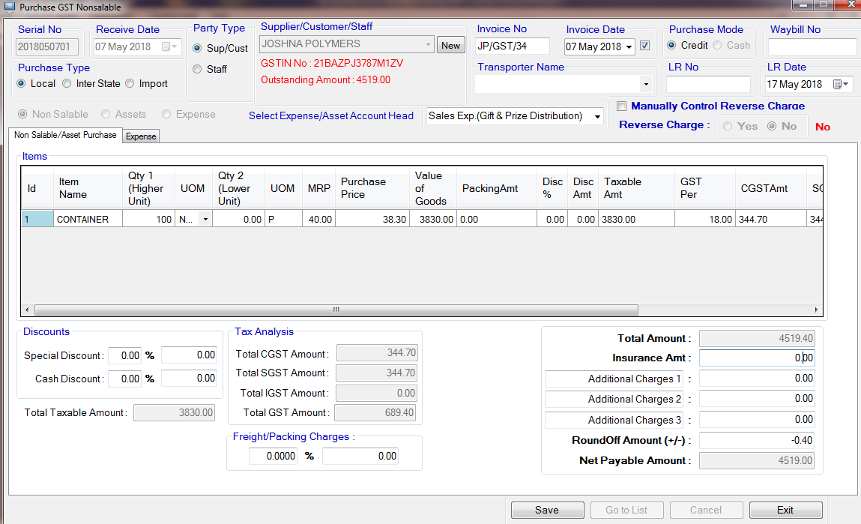
PURCHASE (NON SALABLE/ASSETS)

Slide 34
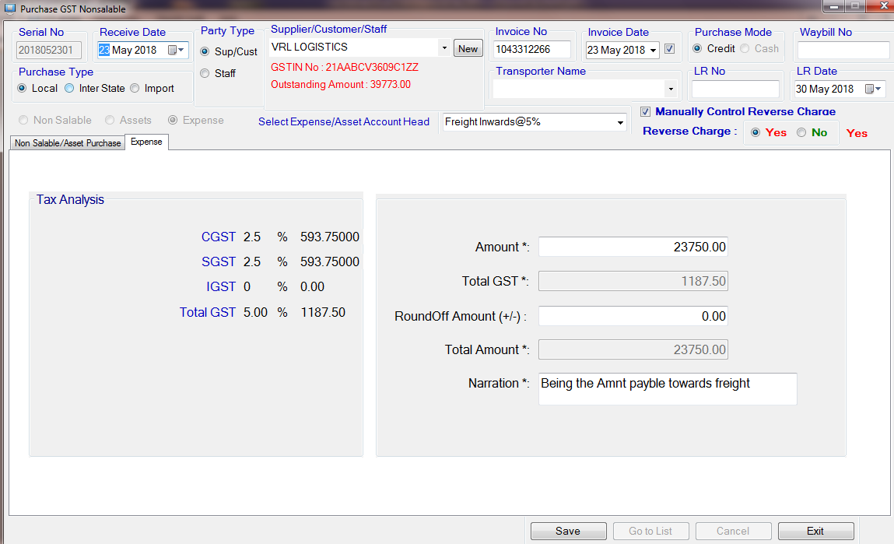
PURCHASE EXPENSE

Slide 35
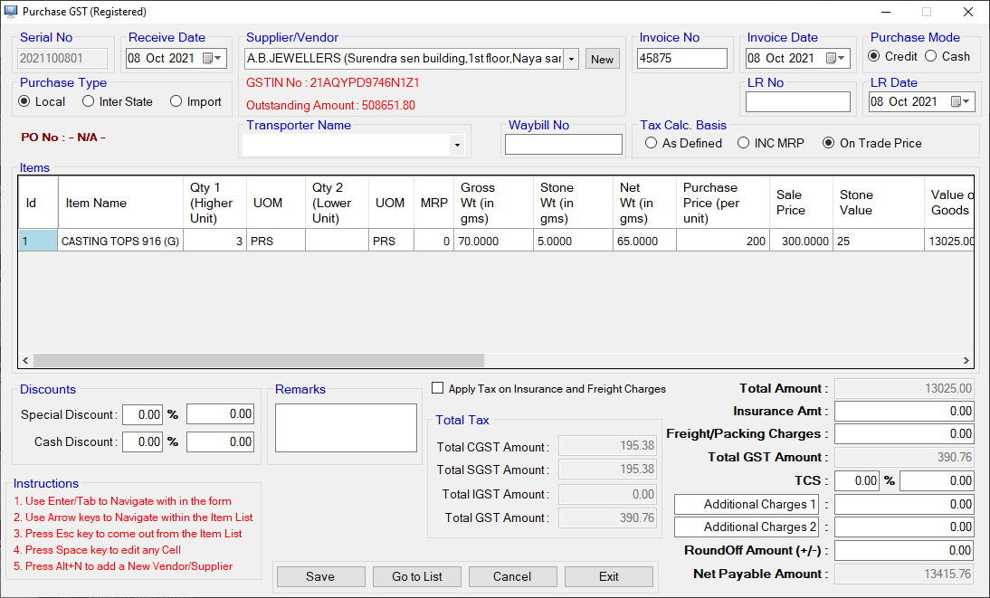
PURCHASE REGISTERED (GST)

Slide 36
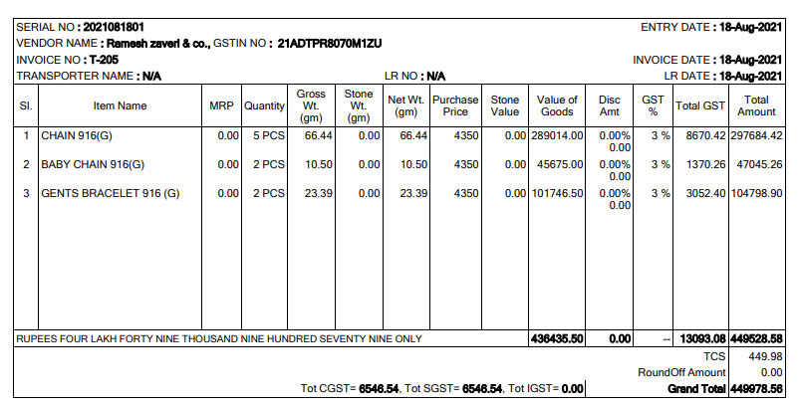
PURCHASE-BILL PRINT

Slide 37
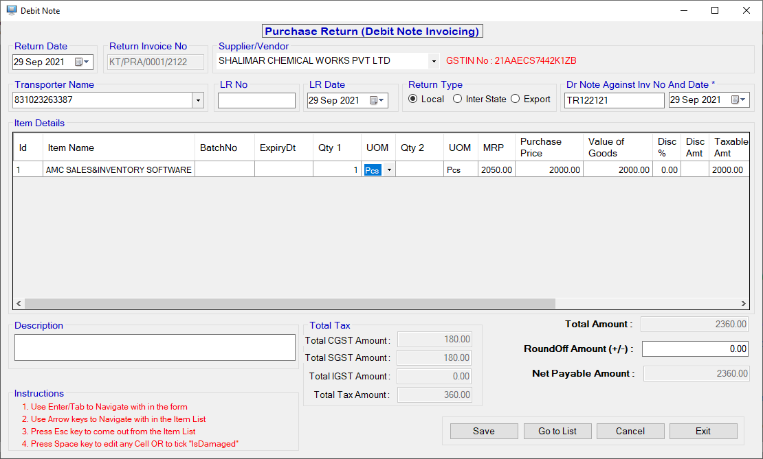
PURCHASE RETURN (Debit Note Invoicing)

Slide 38
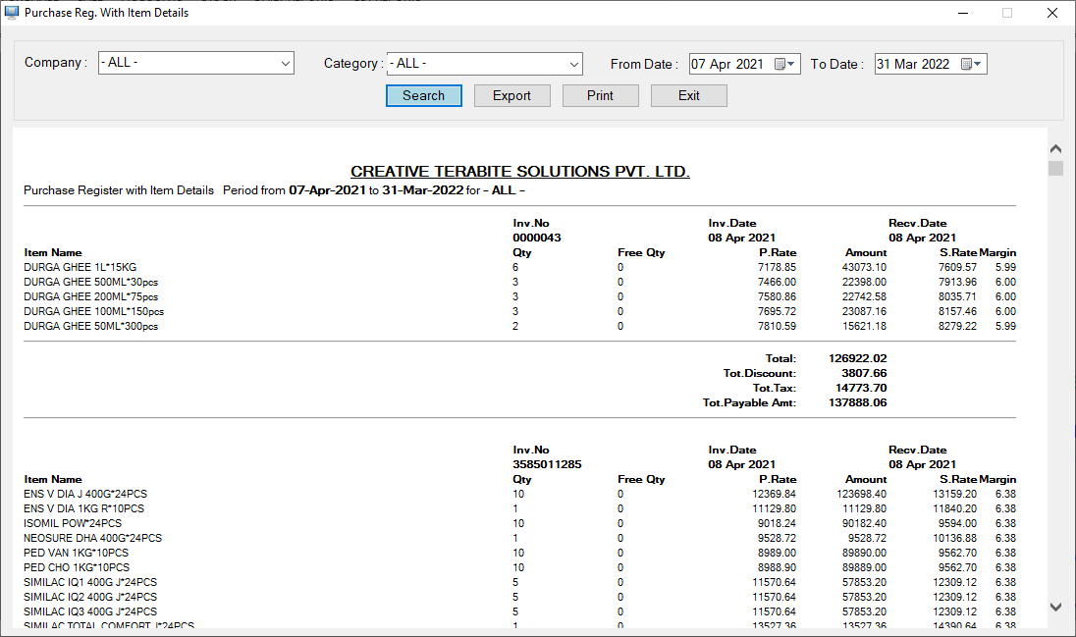
PURCHASE REGISTER WITH ITEM DETAILS

Slide 39
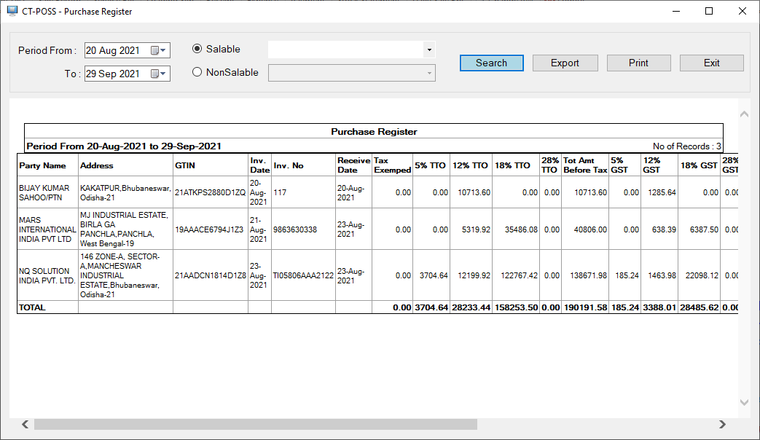
PURCHASE REGISTER WITH GST

Slide 40
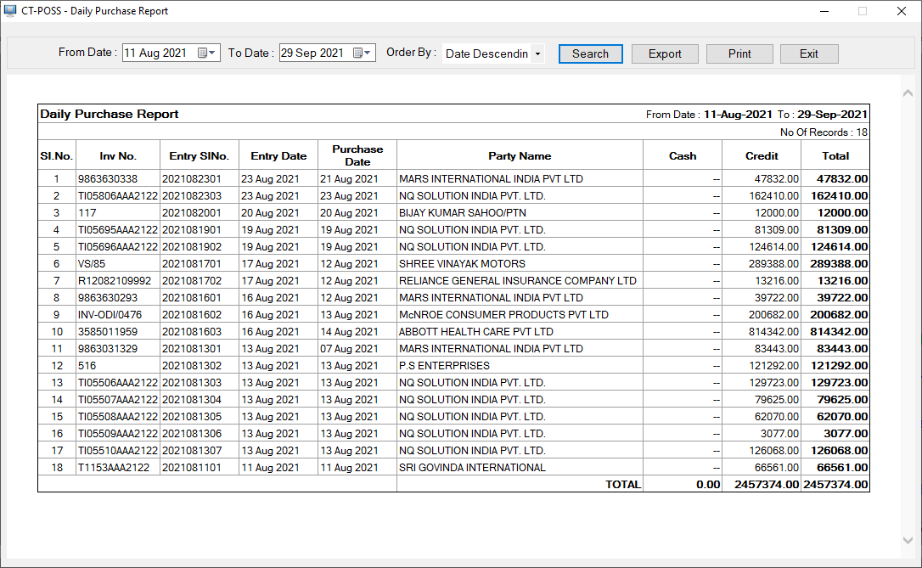
DAILY PURCHASE REPORT

Slide 41
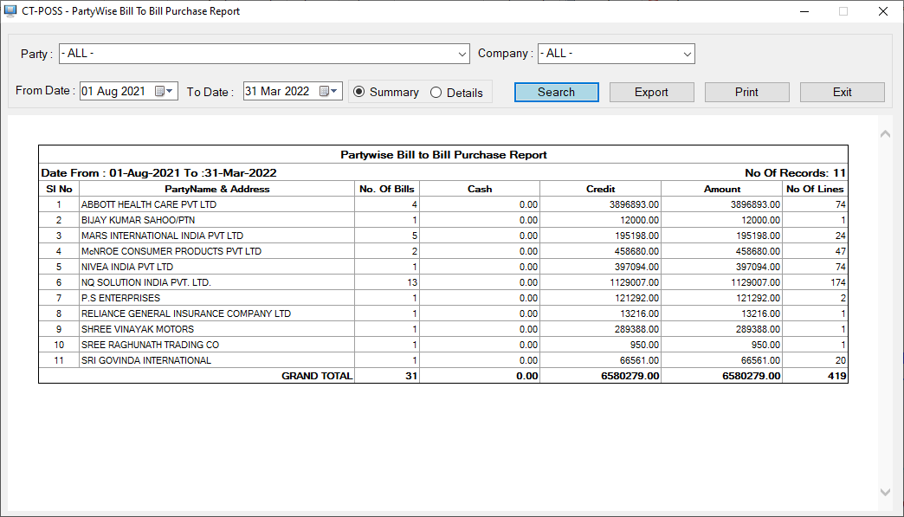
PARTY WISE BILL TO BILL PURCHASE REPORT

Slide 42
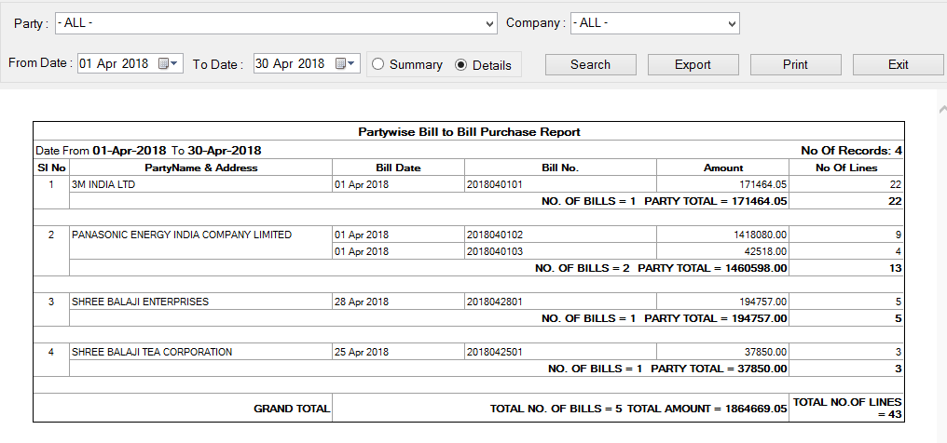
PARTY WISE BILL TO BILL PURCHASE REPORT(DETAILS)

Slide 43
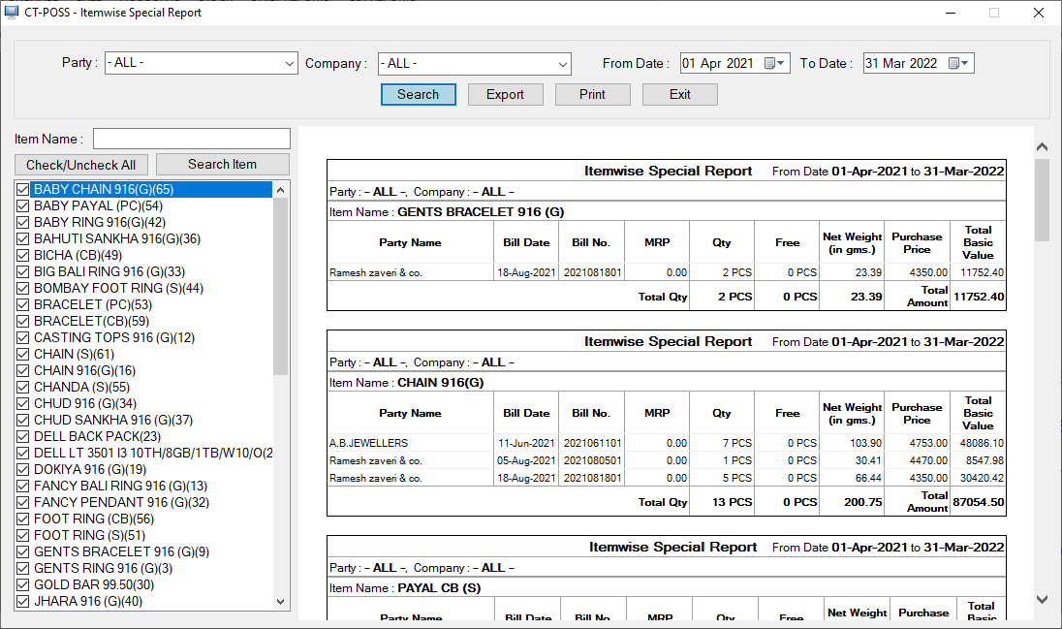
ITEM WISE SPECIAL REPORT

Slide 44
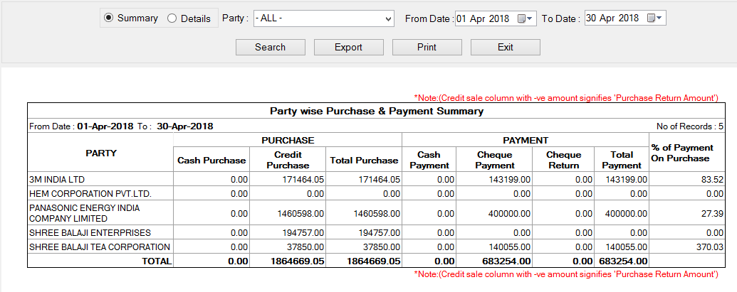
PARTY WISE PURCHASE & PAYMENT(SUMMARY)

Slide 45
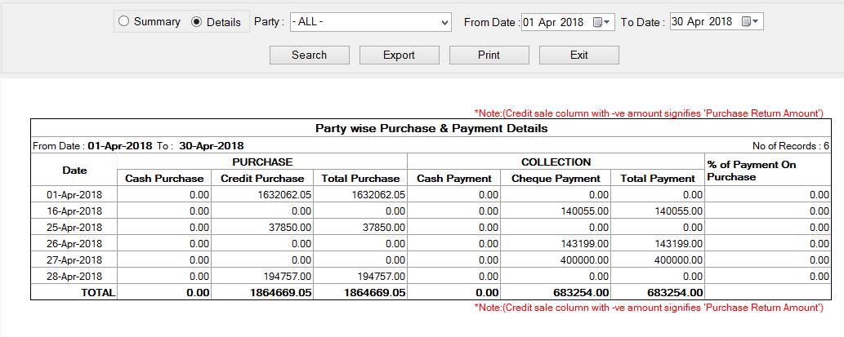
PARTY WISE PURCHASE & PAYMENT(DETAILS)

Slide 46
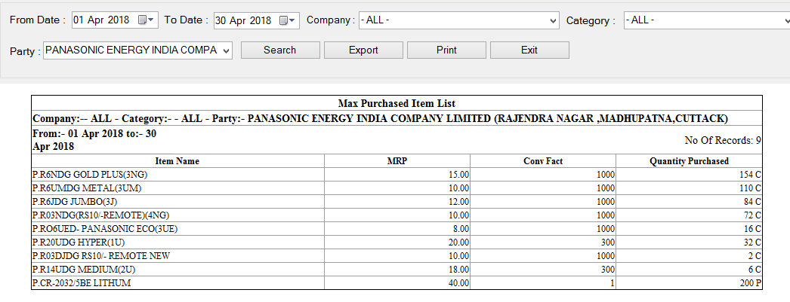
MAX PURCHASED ITEM

Slide 47
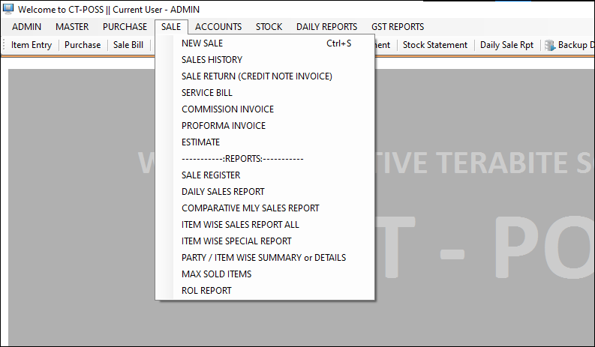
SALE

Slide 48
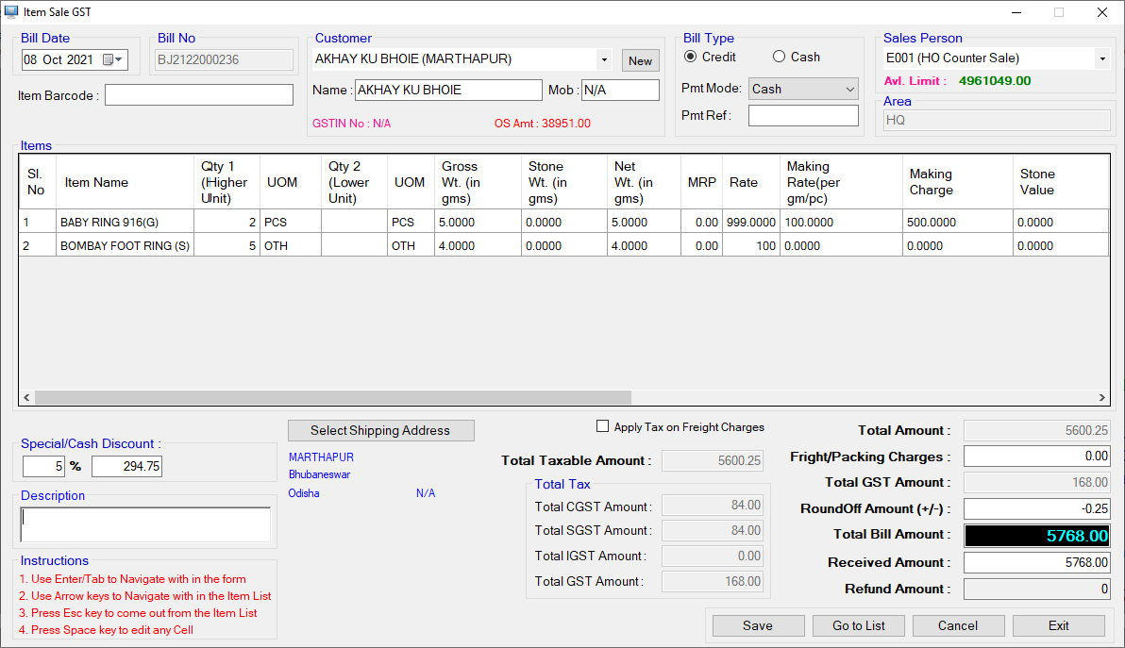
SALE

Slide 49
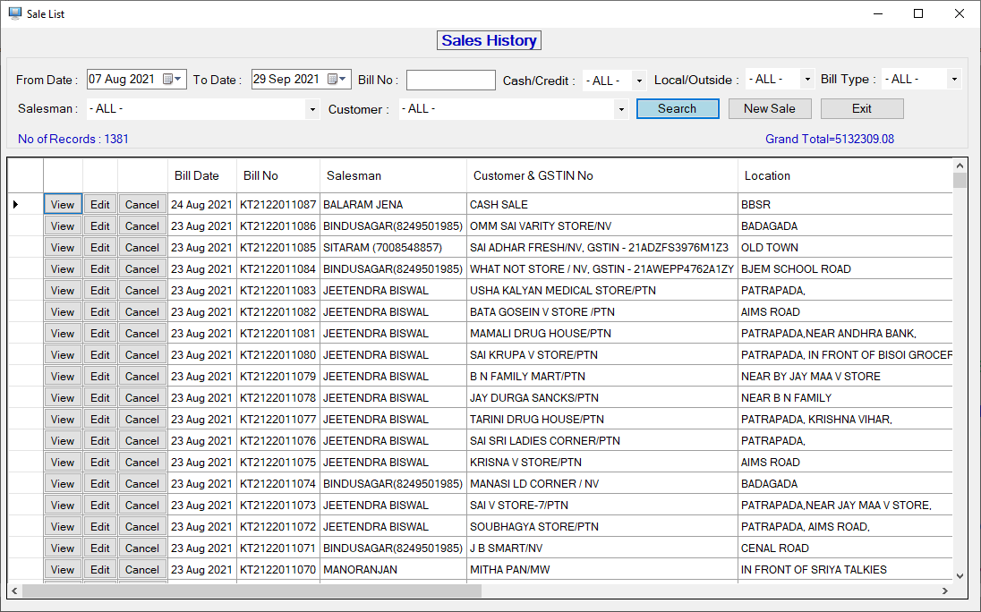
SALE HISTORY

Slide 50
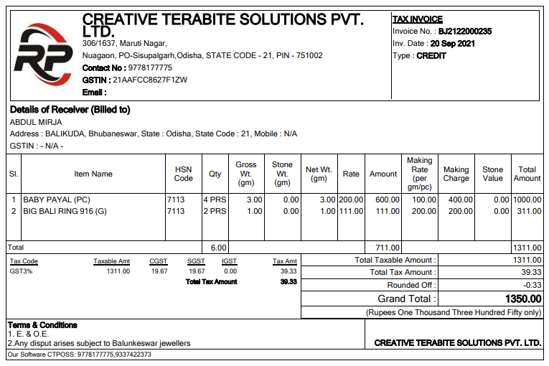
SALE BILL PRINT (FULL)

Slide 51
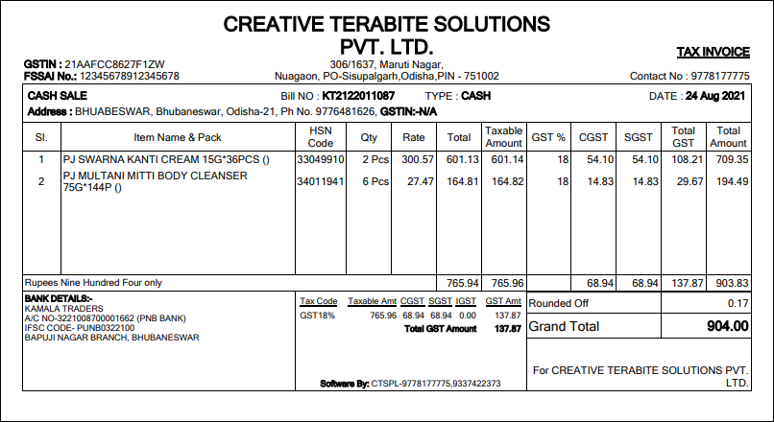
SALE BILL PRINT (HALF)

Slide 52
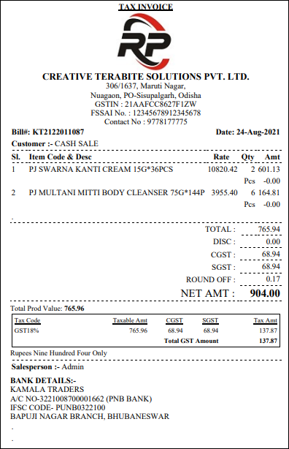
SALE BILL PRINT (SHORT)

Slide 53
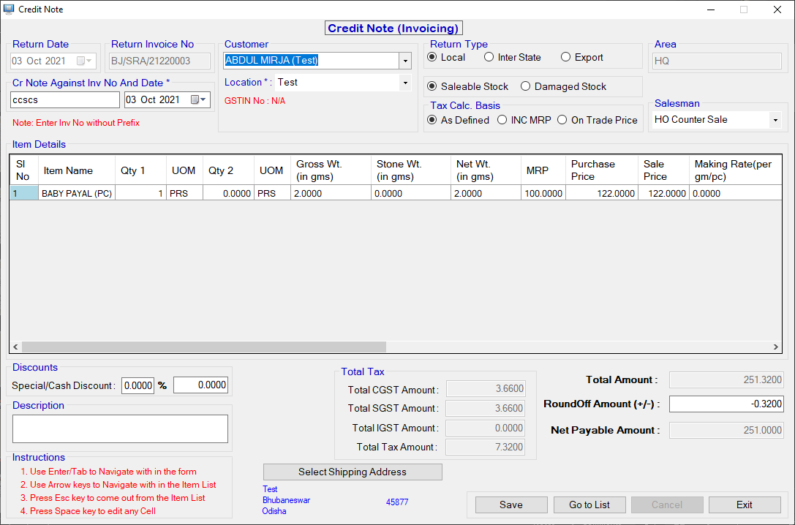
SALE RETURN (Credit Note Invoicing)

Slide 54
SALE RETURN BILL PRINT (HALF)

Slide 55
SERVICE BILL

Slide 56
SERVICE BILL PRINT

Slide 57
COMMISSION INVOICE

Slide 58
COMMISSION INVOICE BILL PRINT

Slide 59
PROFORMA INVOICE

Slide 60
PROFORMA INVOICE BILL PRINT

Slide 61
ESTIMATE BILL PRINT

Slide 62
SALE REGISTER GST

Slide 63
DAILY SALES REPORT

Slide 64
COMPARATIVE MONTHLY SALE REPORT

Slide 65
ITEM WISE SALES REPORT

Slide 66
ITEM WISE SALES REPORT ALL

Slide 67
ITEM WISE SPECIAL REPORT

Slide 68
PARTY & ITEM WISE SUMMARY OR DETAILS

Slide 69
MAX SOLD ITEM

Slide 70
ROL REPORT

Slide 71
ACCOUNTS

Slide 72
OPEN FINANCIAL YEAR

Slide 73
SET OPENING BALANCE AS PER A/C GROUP

Slide 74
ACCOUNTS GROUP MASTER

Slide 75
ACCOUNTS HEAD MASTER

Slide 76
PAYMENT VOUCHER GENERAL

Slide 77
PAYMENT VOUCHER (STATUTORY –GST)

Slide 78
RECEIPT VOUCHER

Slide 79
JOURNAL VOUCHER

Slide 80
EXPENSE VOUCHER

Slide 81
CONTRA ENTRY

Slide 82
CREDIT NOTE

Slide 83
DEBIT NOTE

Slide 84
ACCOUNTS (FINANCIAL REPORTS)

Slide 85
PARTY AGING STATEMENT

Slide 86
PARTY AGING STATEMENT (DAYS OLD)-DETAILS

Slide 87
PARTY AGING STATEMENT (DAYS OLD)-CONSOLIDATED

Slide 88
PARTY AGING STMT DAY OLD(DETAILS)

Slide 89
PARTY AGING STMT DAY OLD (SUMMARY)

Slide 90
RECEIPT DETAILS

Slide 91
PAYMENT DETAILS

Slide 92
EXPENSE SUMMARY

Slide 93
EXPENSE SUMMARY-MONTH WISE

Slide 94
OUTSTANDING DETAILS

Slide 95
OUTSTANDING SUMMARY

Slide 96
ACCOUNTS (STATUTORY REPORTS)

Slide 97
DAILY CASHBOOK

Slide 98
INCOME EXPENSE

Slide 99
RECEIPT PAYMENT

Slide 100
TRIAL BALANCE

Slide 101
TRIAL BALANCE (SUMMARY)

Slide 102
BALANCE SHEET

Slide 103
ACCOUNT LEDGER REPORT

Slide 104
TRADING P/L ACCOUNT

Slide 105
STOCK

Slide 106
SET OPENING STOCK

Slide 107
STOCK WRITESOFF

Slide 108
STOCK STATEMENT (Quantity Wise)

Slide 109
STOCK STATEMENT (Weight Wise)

Slide 110
DAMAGE STOCK ENTRY

Slide 111
ISSUE FOR MAKING FINISHED ITEM

Slide 112
FINISHED ITEM ENTRY

Slide 113
DAILY REPORTS

Slide 114
PDC CHEQUE REPORTS

Slide 115
CASH FLOW STATEMENT

Slide 116
LEDGER ENTRY REPORT

Slide 117
INVOICE WISE SALE REGISTER

Slide 118
MR/BANK STATEMENT

Slide 119
DISCOUNT REPORTS

Slide 120
CANCELLED BILLS

Slide 121
SALES MODIFICATION REPORT

Slide 122
CANCELLED MR REPORT

Slide 123
GST REPORTS

Slide 124
GSTR – 3B

Slide 125
GSTR 1 (B2B)

Slide 126
GSTR 1 (B2CS)

Slide 127
GSTR 1 (CDNR)

Slide 128
GSTR 1 (EXEMP)

Slide 129
GSTR 1 (HSN)

Slide 130
GSTR 1 HSN (4DIGIT)

Slide 131
GSTR 1 (DOCS)

Slide 132
GSTR 2 (B2B)

Slide 133
GSTR 2 (B2BUR)

Slide 134
GSTR 2 (EXEMP)

Slide 135
GSTR 2 (HSN)

Slide 136
GSTR 2 HSN(4DIGIT)

Slide 137
To Find Out More…
Please contact:
Santosh Kumar Sahoo, Director
Creative Terabite Solutions Pvt. Ltd
Maruti Nagar | Vijaya Vihar Lane-2 | Nuagaon | Samantarapur
Cont: 9778177775 / 9090007775 / 9337422373(W) / 9556282399
Email: admin@creativetrends.in
www.creativetrends.in

