Slide 1
College Management System (Complete ERP Solutions for all Stake Holders)
DEVELOPED BY:-
Creative Terabite Solutions Pvt. Ltd.
Bhubaneswar, Odisha – 751002
Email Id: admin@creativetrends.in
Mob: 9778177775, 9556282399

Slide 2
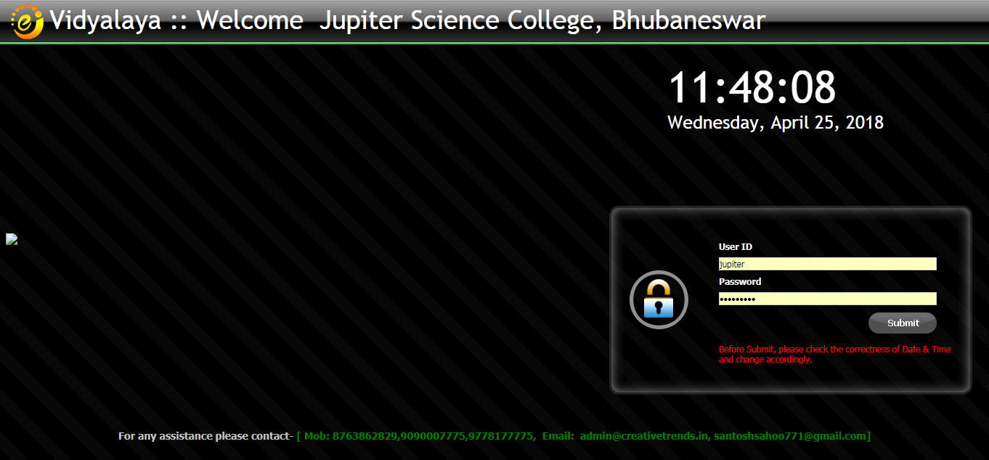
User Log In
Note: Authorized users can enter into the system with valid Login provided by the concerned administrator

Slide 3
User Dashboard
Note: Module wise complete navigation dashboard for all users

Slide 4
USER ADMINISTRATION

Slide 5
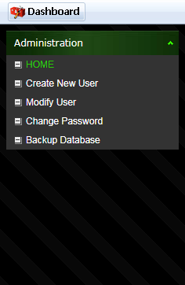
User Administration
Note: Administration Module to define different users and assign permission to access different pages in the software

Slide 6
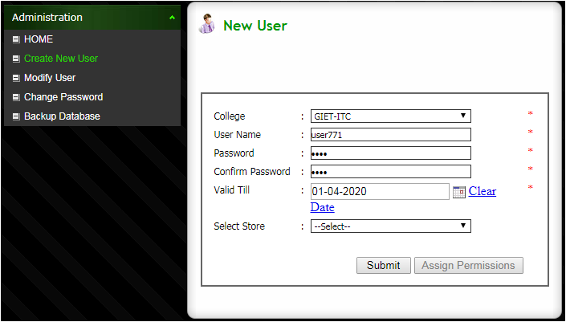
Create New User
Note: Administration Module to define different users and assign permission to access different pages in the software

Slide 7
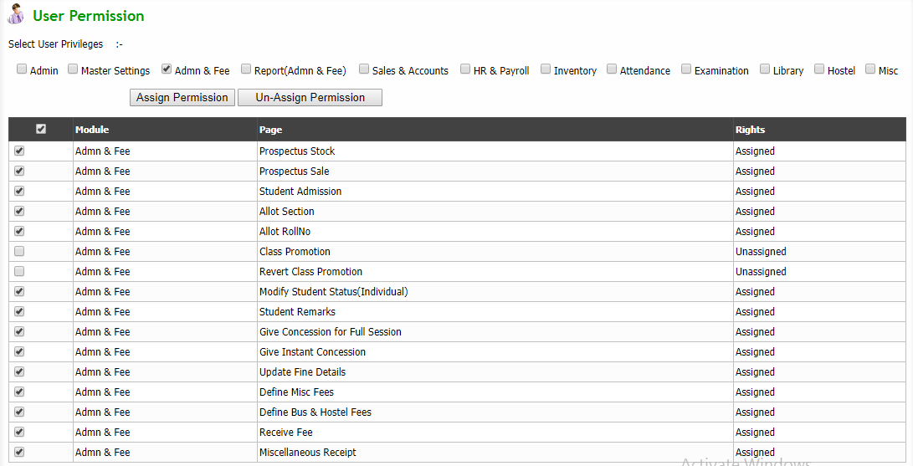
Assign User Permission
Note: User level permission can be assigned here. Only permitted user can access particular module as per the requirement .

Slide 8
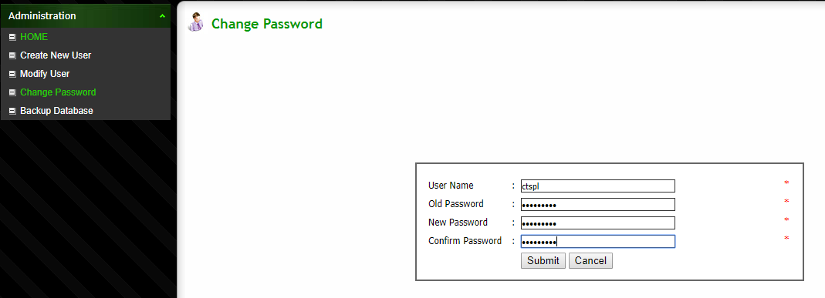
Change Password
Note: User can change concerned password as on when required

Slide 9
MASTER ENTRY

Slide 10
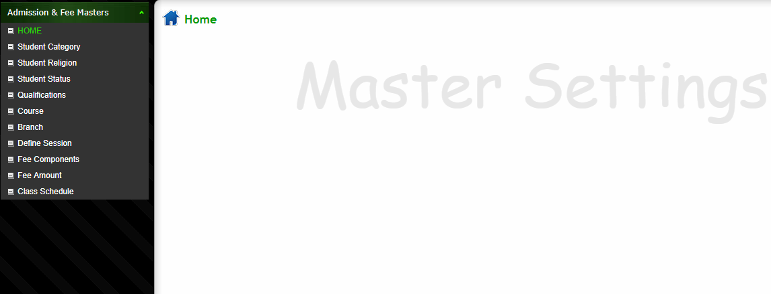
Define All Master Data
Note: All master data can be defined in this module so that the information that is repeatedly in use can be selected from the master data instead of re-entering them

Slide 11
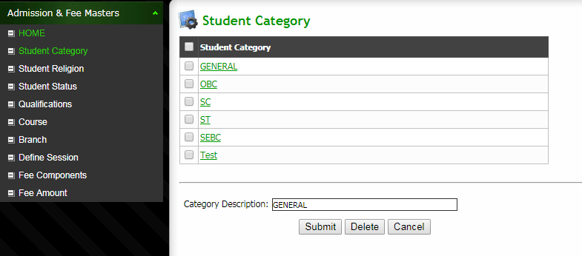
Define Student Category
Note: Define Student Category

Slide 12
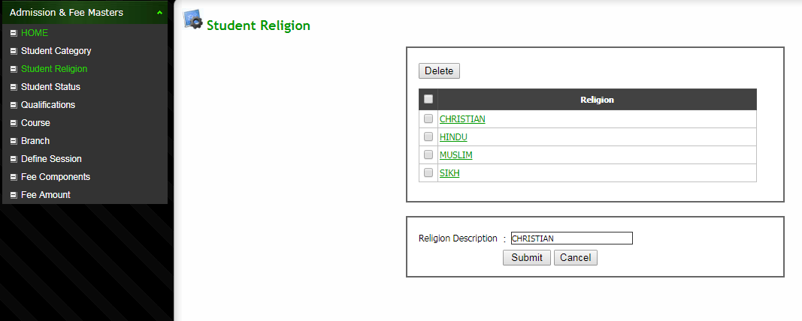
Define Student Religion
Note: Define Student Religion

Slide 13
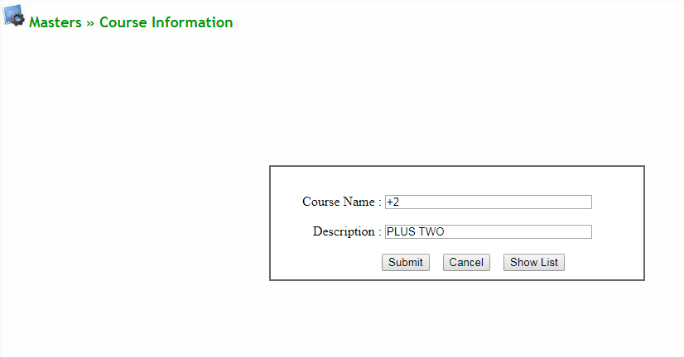
Define Course
Note: New Course can be defined here

Slide 14
List Of Course

Slide 15
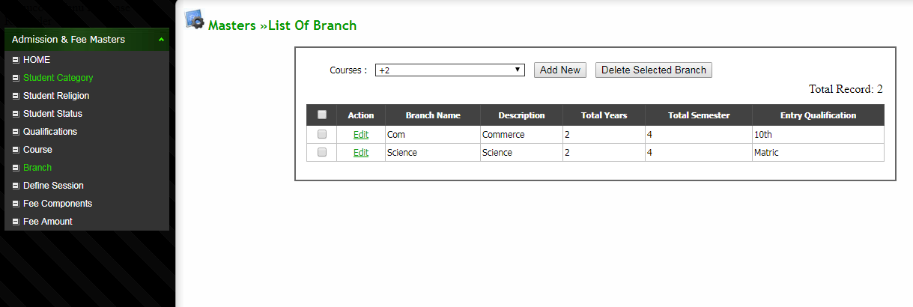
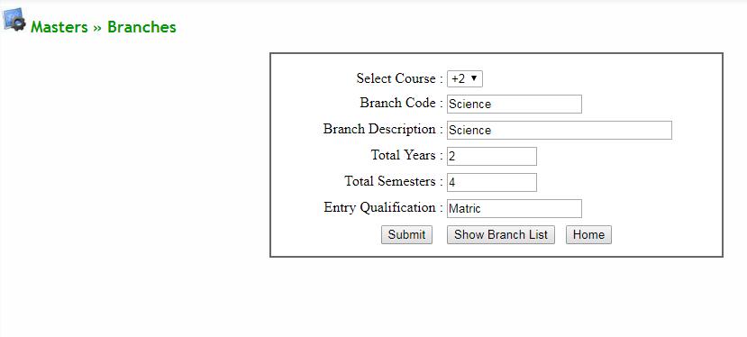
Define Course wise Branch
Note: Course wise branch can be defined here

Slide 16
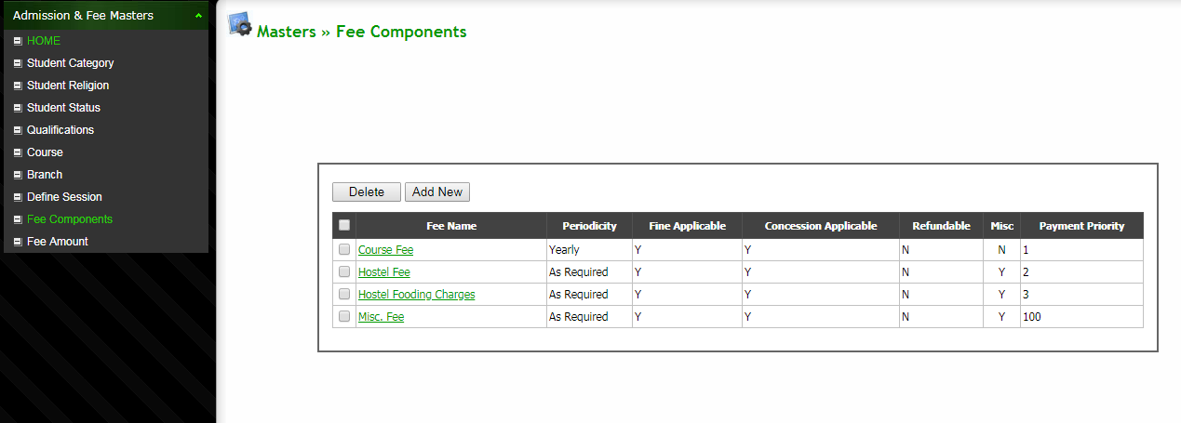
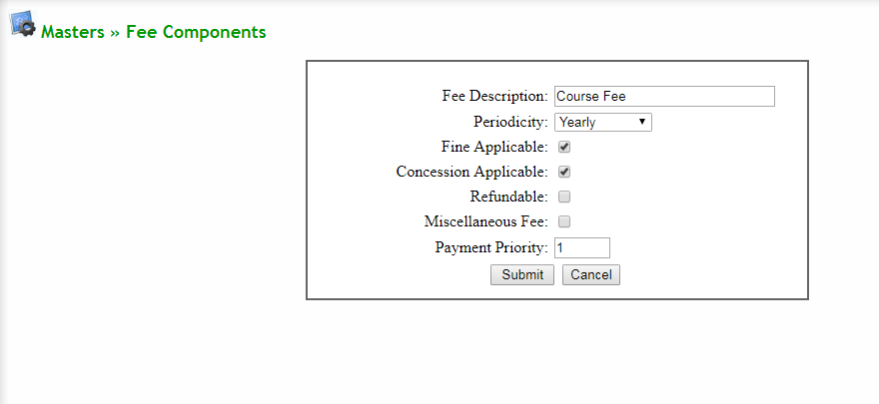
Define Fee Component
Note: Different types of fee head can be defined here

Slide 17
List Of Fee Components

Slide 18
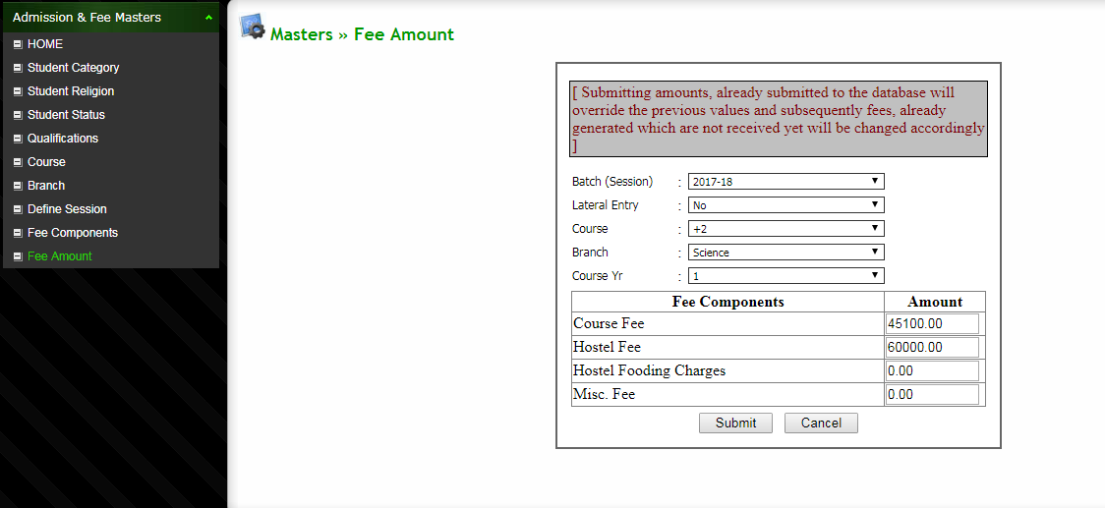
Define Course/Branch wise Fee
Note: Course/Branch wise fee amount can be defined here

Slide 19
ADMISSION & FEE MODULE

Slide 20
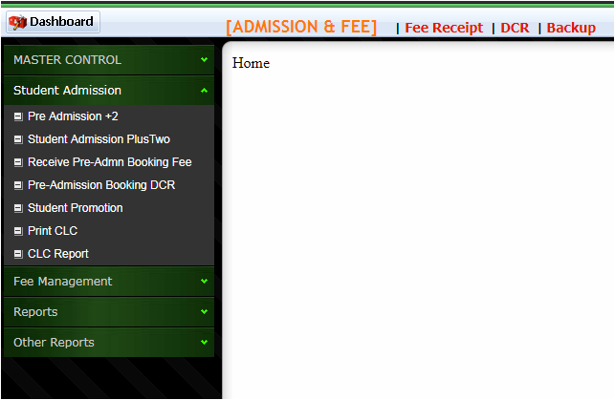
Admission & Fee Module
Note: Admission & Fee Module with left panel selection Menu

Slide 21
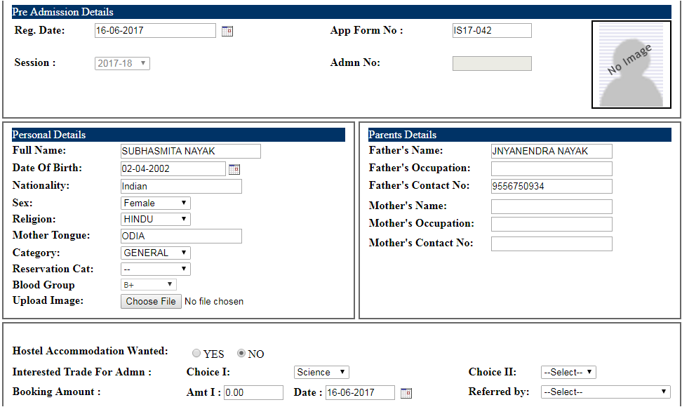
Pre Admission-Seat Booking
Note: Student details for Pre-Admission seat booking can be done here.

Slide 22
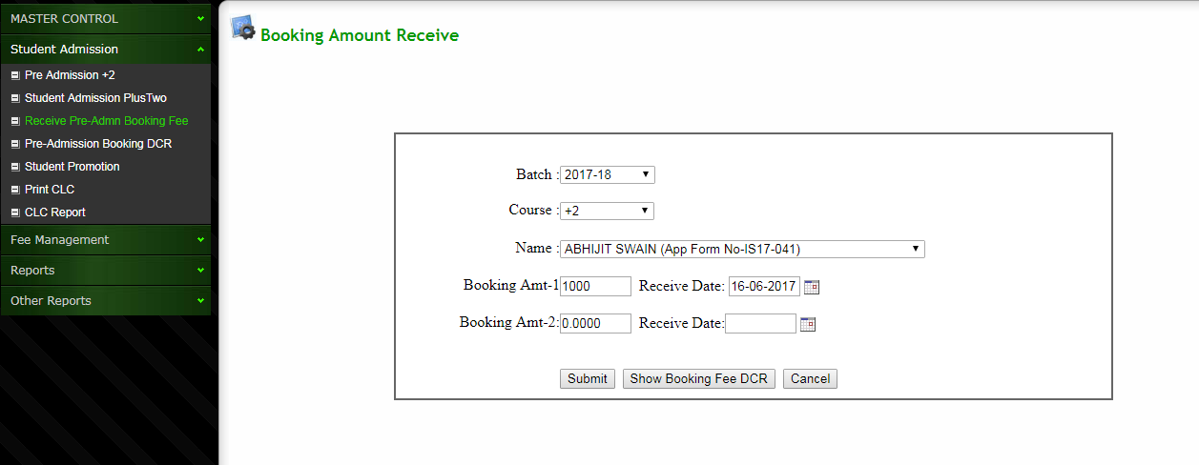
Receive Pre-Admission Booking Fee
Note: Pre-Admission booking fee can be received by using this interface

Slide 23
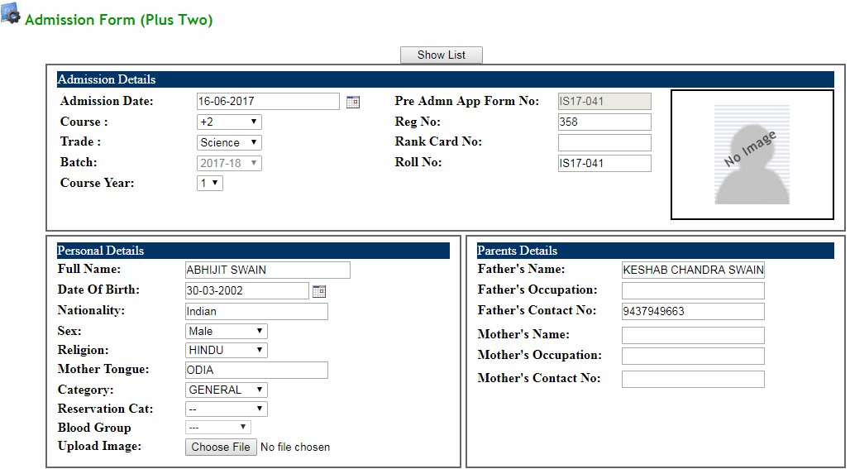
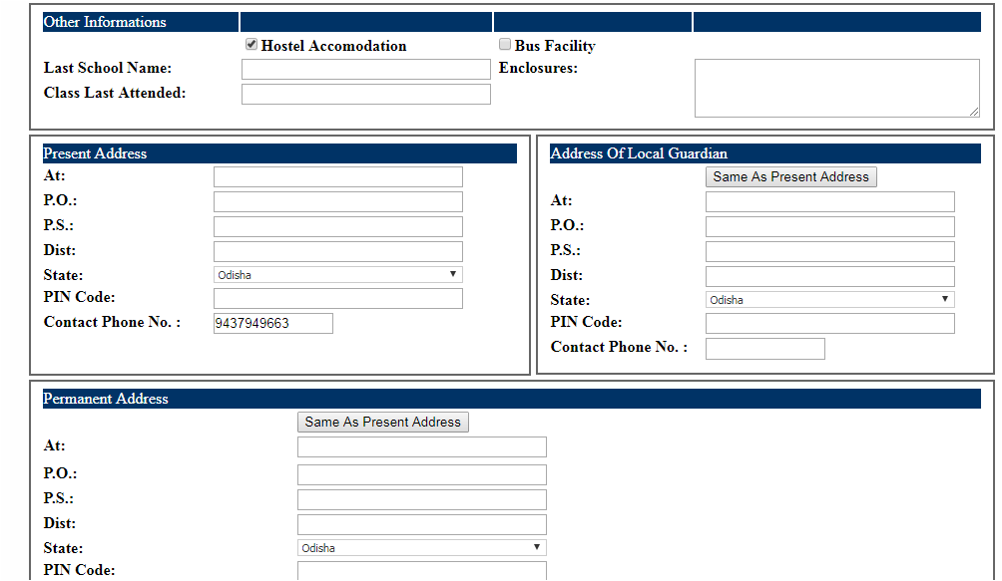
Student Admission

Slide 24
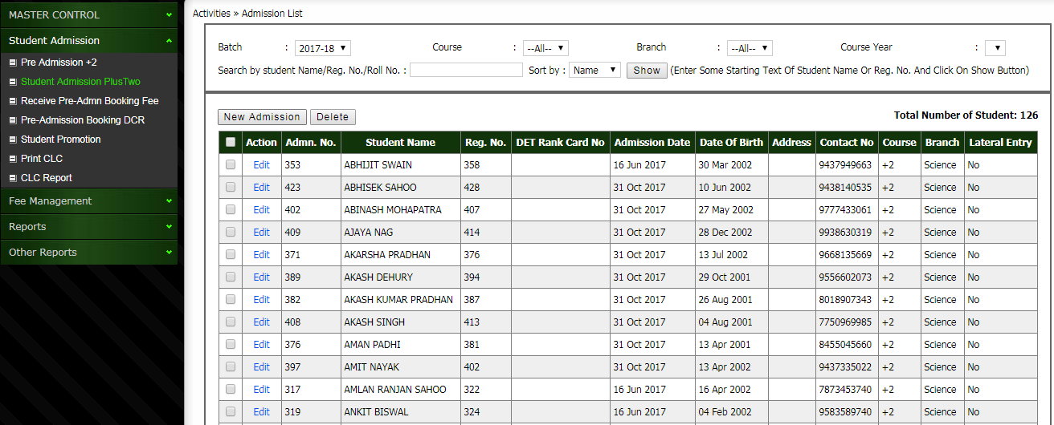
Student Admission List
Note: Student Admission list can be viewed here. Also there is some filter criteria available, so that user can get their desired report.

Slide 25
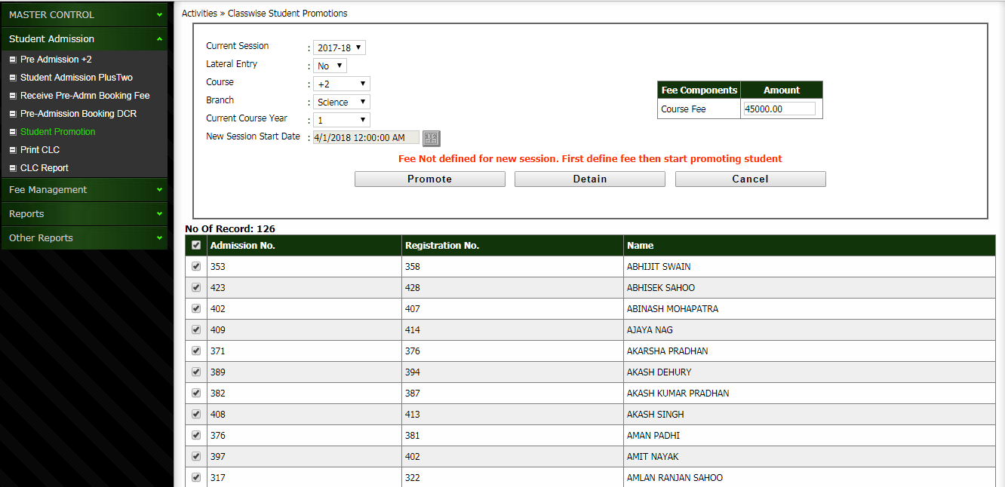
Class wise Student Promotion
Note: Class wise student promotion can be done at end of the session

Slide 26
Define Misc Fee (Not Compulsory For All)
Note: Misc Fee for individual student can be defined in addition to regular fee that is generated automatically during admission or class promotion

Slide 27
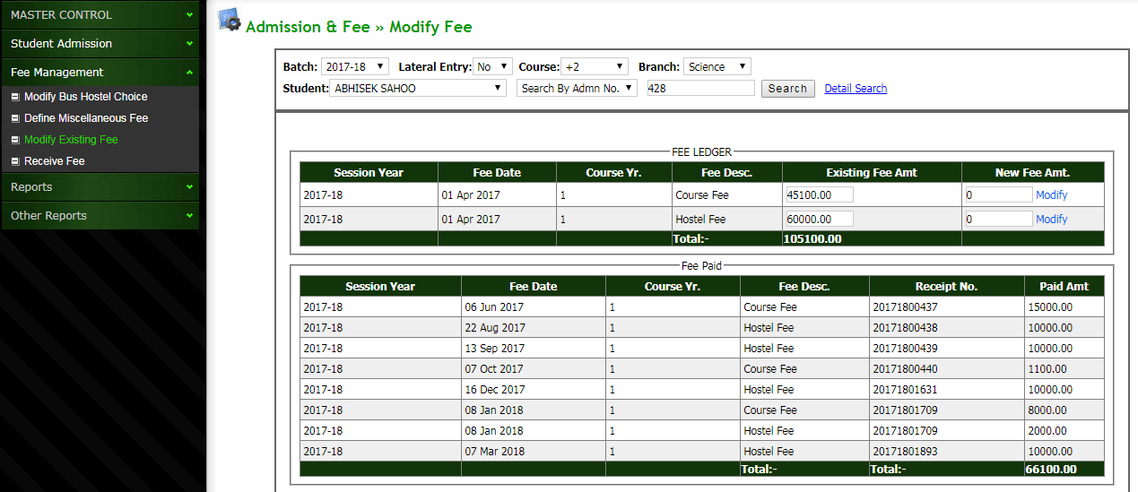
Modify The Existing Fee
Note: Existing fee of any student can be modified here by an authorized person as per the requirement

Slide 28
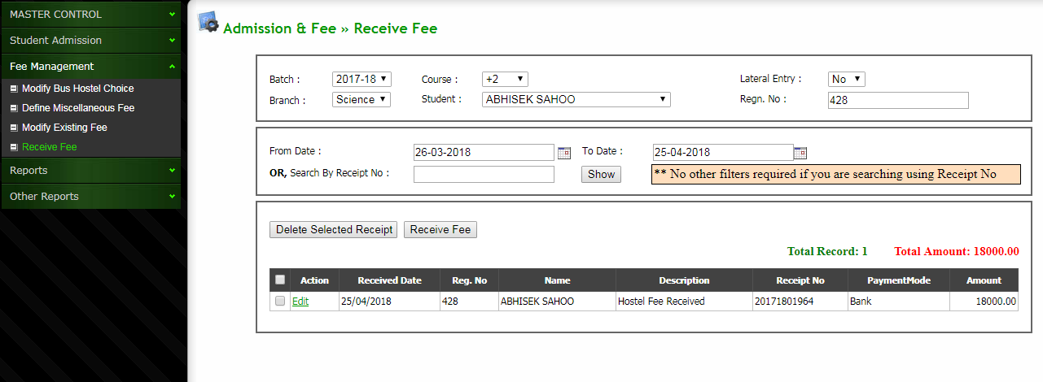
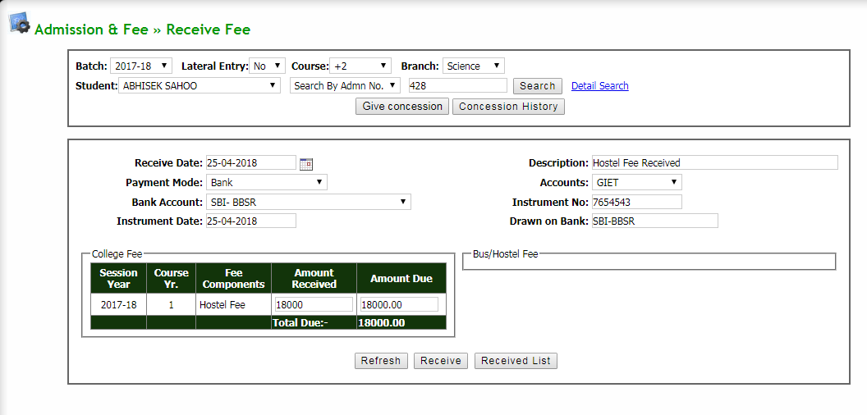
Receive Regular College Fee
Note: This interface will help the user to receive regular fee with option for cash/ bank

Slide 29
View Received Fee List
Note: History of already received fee can be viewed here with option for filter between 2 dates

Slide 30
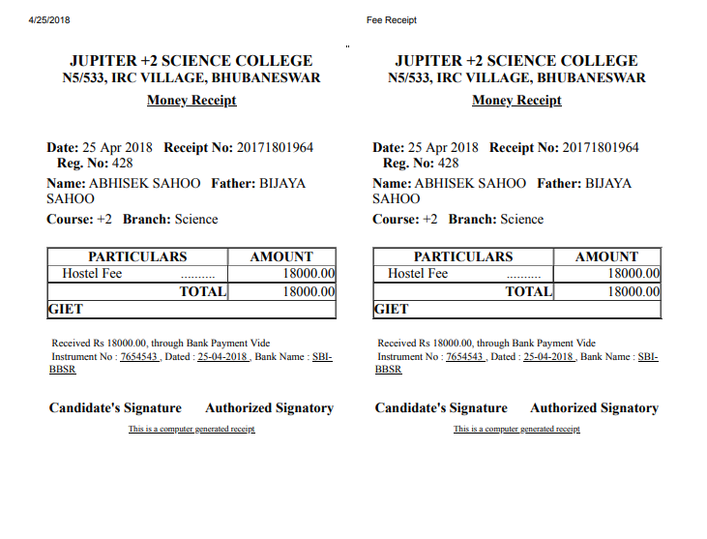
Print Fee Receipt
Note: Instantly the fee receipt can be printed after the fee is received in the counter

Slide 31
Reports

Slide 32
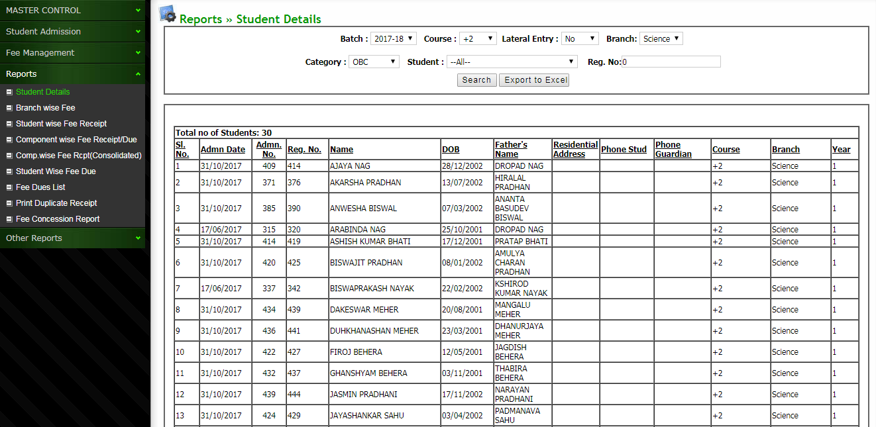
Student List
Note: Student list can be viewed with filter option like category, branch, course etc.

Slide 33
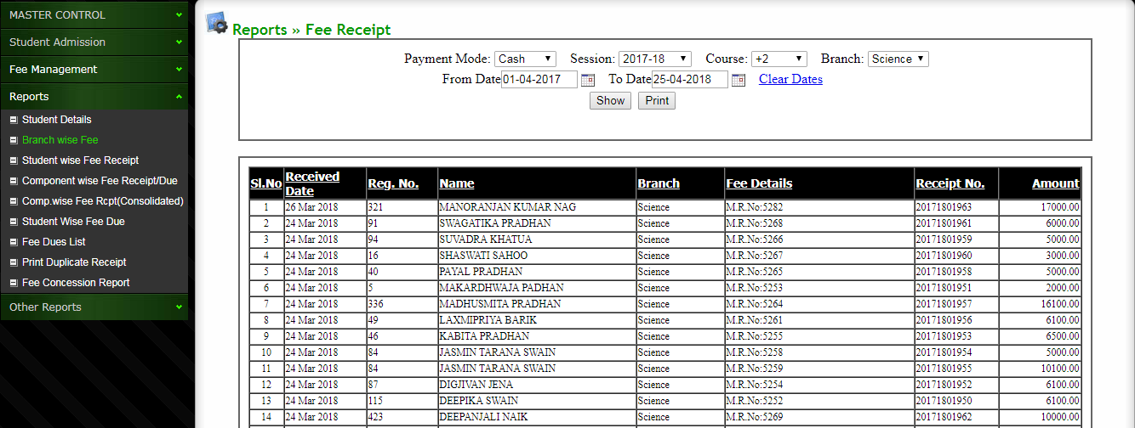
Fee Received Report
Note: Fee received history can be seen here with required filter option

Slide 34
Student wise Fee Received Report
Note: Fee received details for specific student can be checked here.

Slide 35
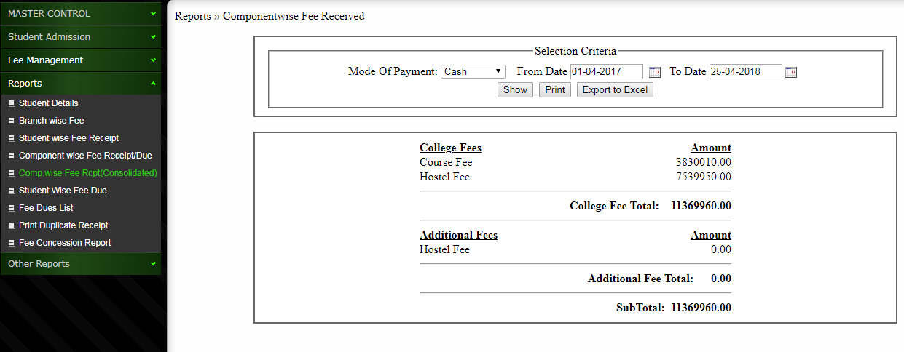
Component wise Fee Received Report Summary
Note: Fee component wise reports can be checked between 2 dates or for full session

Slide 36
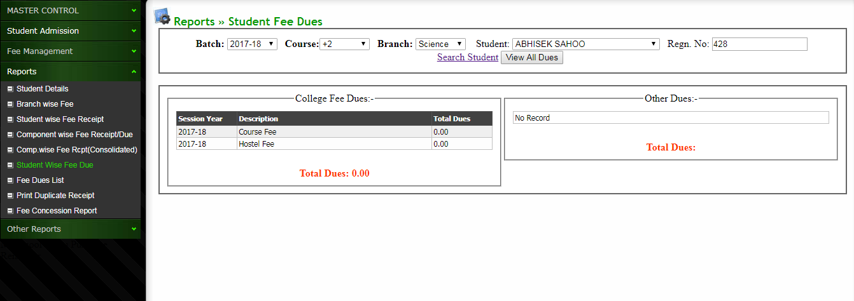
Student wise Fee Due Report
Note: Fee dues for particular student can be checked on the page

Slide 37
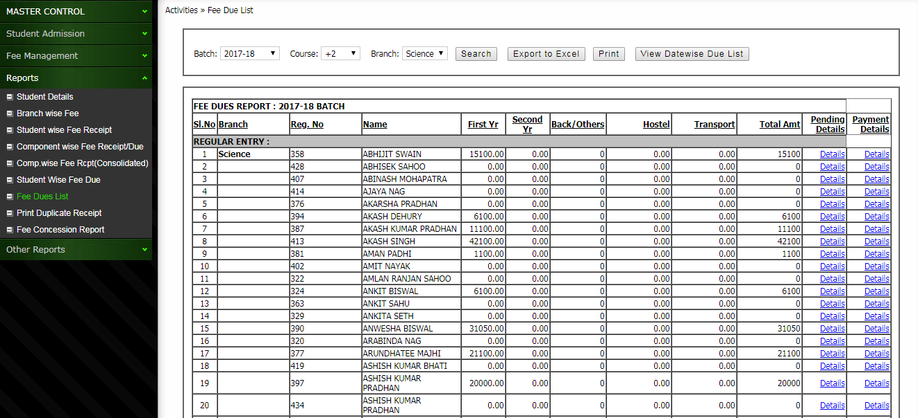
Fee Dues Report
Note: Fee defaulters report for all student can be checked with this page. With option for detail view for specific amount

Slide 38
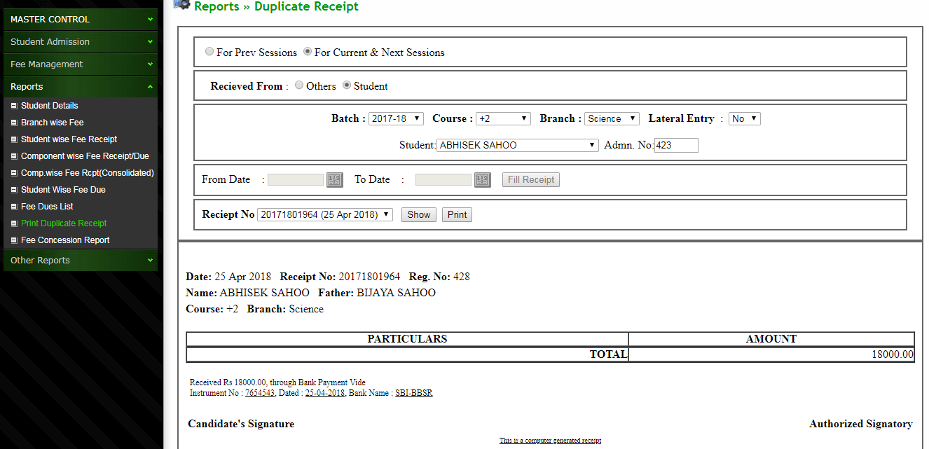
Duplicate Receipt of Student
Note: Duplicate fee receipt can be printed in case of request fro parents

Slide 39
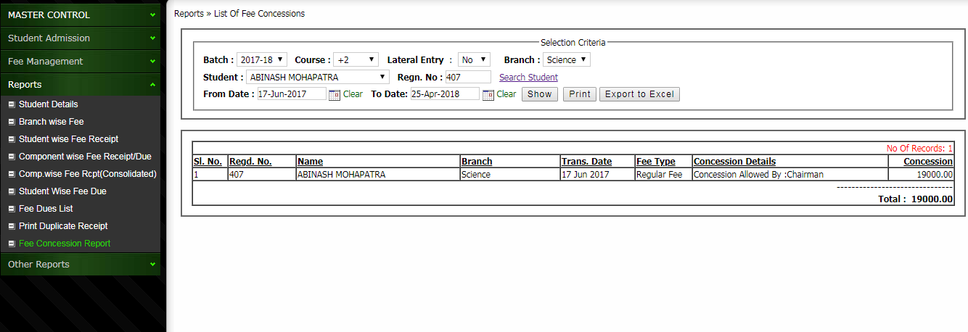
Fee Concession Report
Note: Consolidated concession report can be printed here

Slide 40
ACCOUNTS MODULE

Slide 41
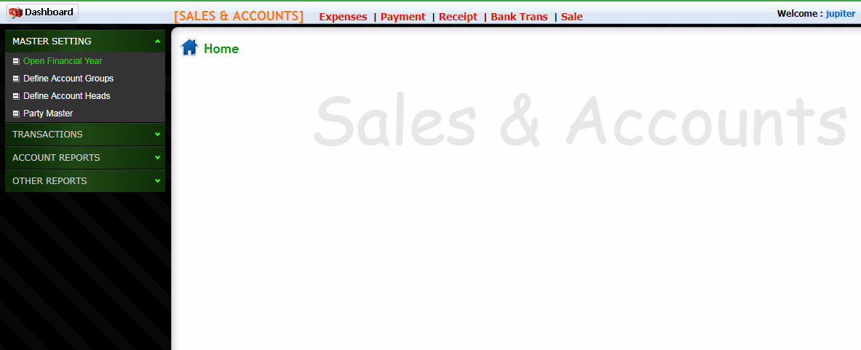
Accounts Module Home Page
Note: Welcome Page with side access Menu to access different pages

Slide 42
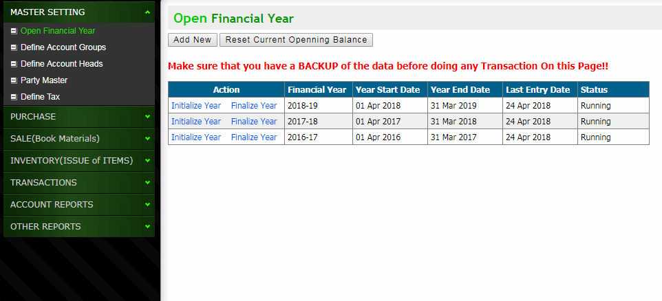
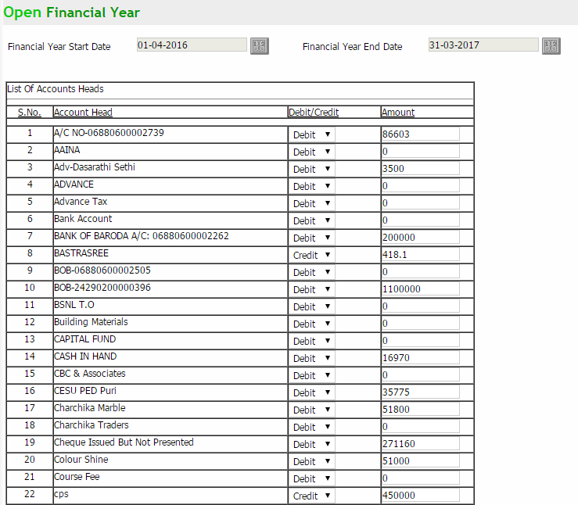
Set Opening balance on new Financial Year
Note: Opening balance can be set on opening of new financial year to match the balance sheet

Slide 43
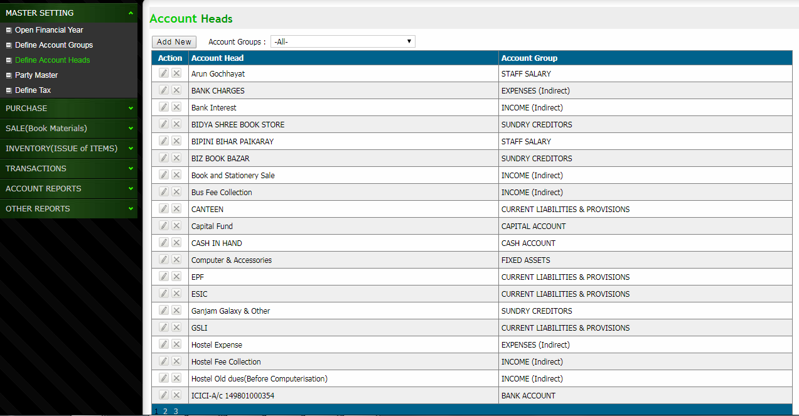
Account Heads
Note: Accounting heads can be created here as per the requirement

Slide 44
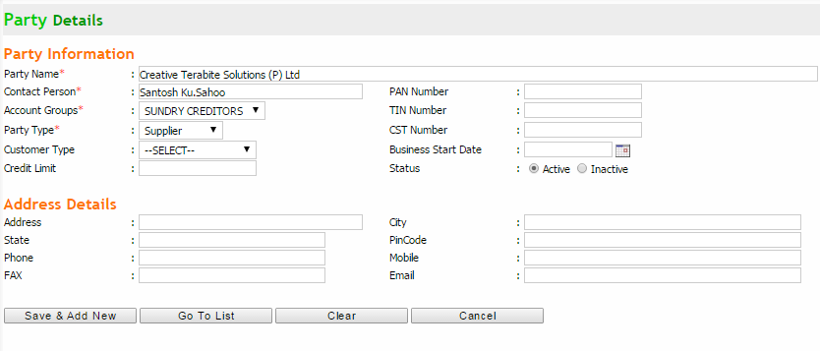
Create New Party Account
Note: Party account of creditors/debtors can be created here

Slide 45
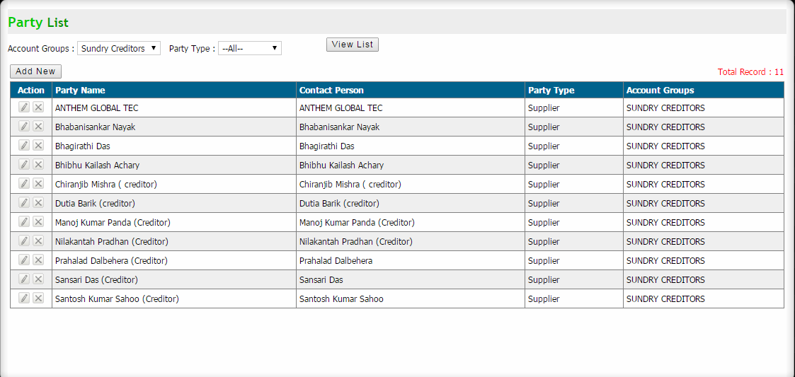
Party List
Note: Party account list can be viewed with full details

Slide 46
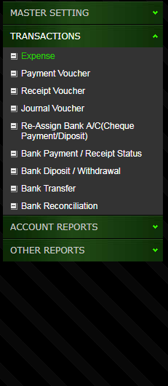
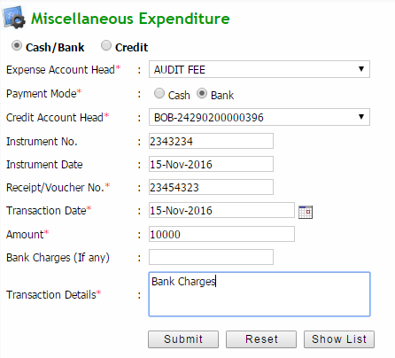
Expense Entry
Note: All day to day accounting expenses can be entered here

Slide 47
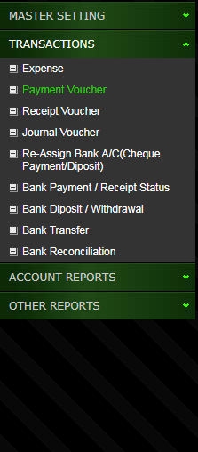
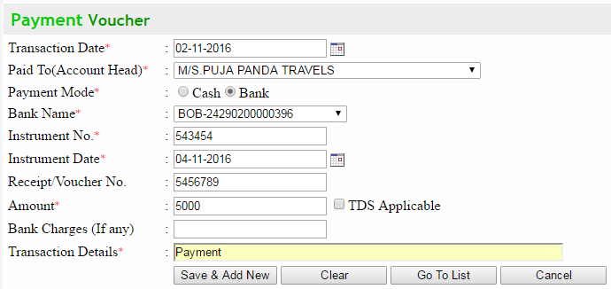
Payment Voucher Entry
Note: While doing payment to any party account the details can be posted using this page.

Slide 48
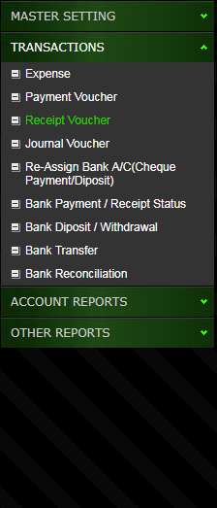
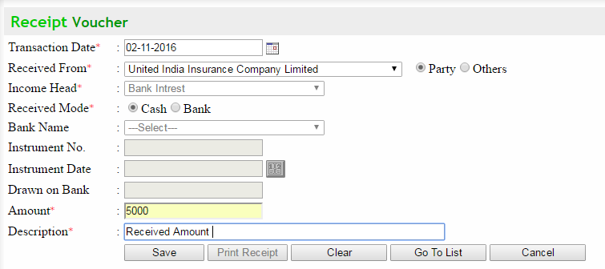
Receipt Voucher Entry
Note: Except college fee any other received amount can be posted here

Slide 49
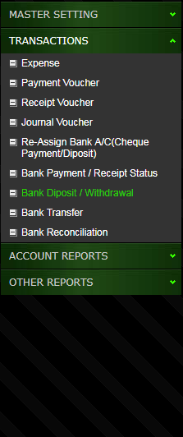
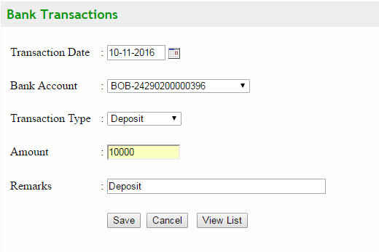
Bank Deposit / Withdrawals
Note: Bank deposit / withdrawals can be posted here that will reflect automatically in daily cash book

Slide 50
Accounts Module Reports

Slide 51
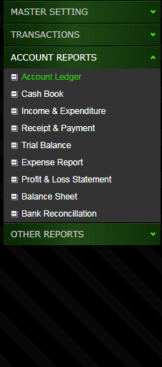
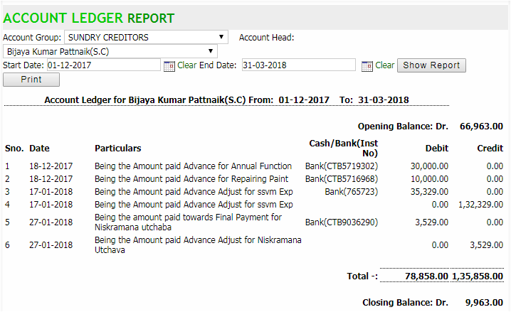
Account Ledger Report
Note: Account head wise ledger report can be viewed with required filters between 2 dates

Slide 52
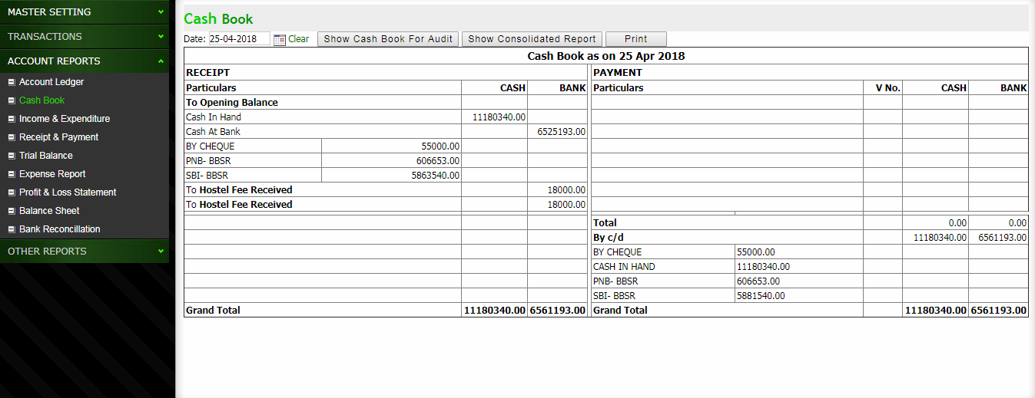
Daily Cash Book
Note: Daily cash book report can be printed and viewed here

Slide 53
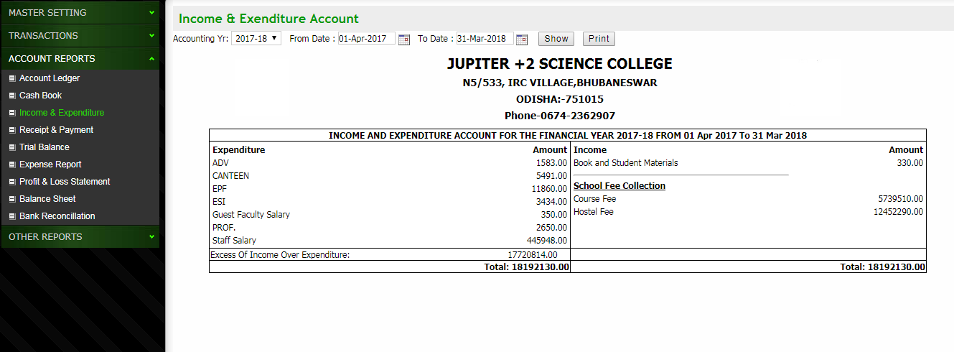
Income & Expenditure Report
Note: Income & Expense summary required for annual return can be printed from here

Slide 54
Payment & Receipt Report
Note: Payment & Receipt details for a particular Financial year can be checked / printed

Slide 55
Trial Balance Report
Note: Trial balance report required for audit purpose can be checked/ printed

Slide 56
Profit & Loss Statement
Note: Profit loss statement for audit can be checked/printed

Slide 57
Balance Sheet
Note: Balance sheet statement for any Financial year can be checked / printed for audit purpose

Slide 58
Bank Re-conciliation Report
Note: Bank Re-conciliation report can be checked with this page

Slide 59
Expense Report
Note: Expenses report between 2 dates or during a period can be checked/ printed

Slide 60
Any other accounting related reports can be generated as per the organization requirement

Slide 61
HR & PAYROLL MODULE

Slide 62
Master Entry Module
Note: All master entry can be done in this module that can be used through out the software use.

Slide 63
Create New Department
Note: Different department in the organization can be created here

Slide 64
Define Designation
Note: Define Designation for Employee

Slide 65
Define Allowance Type
Note: Different types of allowances authorized to employee like HRA, Conveyance Allow etc can be defined here

Slide 66
Define Deduction Type
Note: Different types of salary deduction can be defined

Slide 67
Define Leave Type
Note: Different types of leave authorized for employee can be defined here

Slide 68
Define Working Shift
Note: Working shift can be defined as per the organization schedule

Slide 69
Define Holiday
Note: Holiday list for the current calendar year can be defined

Slide 70
Manage Staff
Note: This module will provide interface to manage staff activities (i.e Attendance, Extra Duty, Leave etc.) in the organization

Slide 71
Employee Details-Entry

Slide 72
View Employee List
Note: Employee details and other required info can be viewed here

Slide 73
Assign Working Shift
Note: Working shift can be assigned to different employees as a whole and individually also

Slide 74
Attendance Import From Excel
Note: Import Attendance from Excel file

Slide 75
Import Attendance From Biomatric
Note: Import Attendance from Excel file

Slide 76
Mark Manual Attendance
Note: Manual Attendance can be marked in this page, In case of Biometric malfunctioning

Slide 77
Daily/Monthly Attendance Report
Note: View Daily Attendance Report

Slide 78
Yearly Attendance Summary
Note: View Yearly Attendance Report

Slide 79
Extra Duty (CR Entry)
Note: Extra duty as CR can be entered for future reference

Slide 80
Avail Leave Against CR
Note: Leave availed against CR can be entered here for future reference

Slide 81
Manage CR Encashment
Note: Balance CR Encashment for Each Employee can be done at the End of each Accounting Year

Slide 82
Extra Duty (CR Report Date wise)
Note: CR Report ,Date wise can be Checked Between 2 dates Filtered by Department / Business unit

Slide 83
Extra Duty (CR Report Summary)
Note: CR report Summary can be checked between 2 dates filtered by department / business unit

Slide 84
Authorize Leave
Note: Authorize Leave for each employee in the organization

Slide 85
Apply Leave
Note: Individual employee can apply leave online with their respective valid login to the HR Payroll software

Slide 86
Approve Applied Leave
Note: Concerned Department Head/ Team Lead can approve the applied leave with their respective valid login into the software.

Slide 87
Employee wise Leave Availed Report
Note: Employee wise leave availed report can be viewed here

Slide 88
Payroll Module
Note: Payroll Module with left side submenu

Slide 89
Define Salary Structure
Note: Salary structure for each employee can be defined here

Slide 90
Loan / Advance Entry
Note: Loan / advance given to any employee can be entered here for future accounting

Slide 91
Generate Monthly Salary
Note: Salary for the current month can be generated after all attendance & Leave Entry done for each employee

Slide 92
Salary Payment
Note: Salary Payment to individual employee can be paid through cash / bank and can be entered here for future accounting

Slide 93
Report Print Module
Note: Various reports concerned to HR Payroll can be viewed/ Exported / Printed in this module

Slide 94
Salary Pay Roll for Individual Sign.
Note: Salary Payroll can be printed for individual signing

Slide 95
Salary Pay Roll for Bank
Note: Salary Payroll letter to Bank for credit to individual account

Slide 96
Monthly Salary Office Copy
Note: Monthly Salary paid office copy can be printed for future reference

Slide 97
Monthly Salary ESI Report
Note: Monthly Salary ESI Report can be printed for future reference

Slide 98
Monthly Payment Salary Slip

Slide 99
Employee Salary Report for Govt.
Note: Employee Salary report to be submitted to Govt. office can be exported to excel file and also printed here.

Slide 100
Loan / Advance Summary Report
Note: Consolidated summary report for Loan/Advance can be accessed here

Slide 101
INVENTORY

Slide 102
Inventory Module Home Page

Slide 103
Define Inventory Item Category
Note: Different types of category like Furnitures, computer peripherals etc can be created here

Slide 104
Define Store / Room Location
Note: Different inventory location can be created here for easy tracking of inventory items

Slide 105
Define Item List
Note: List of inventory items can be created using this interface

Slide 106
Inventory Procurement
Note: Inventory item procurement details can be added here

Slide 107
Issue Inventory Item
Note: Inventory item can be issued to different locations / specific person by using this interface

Slide 108
Inventory Reports

Slide 109
Inventory Item Procurement Report
Note: Report on inventory item procurement between 2 dates

Slide 110
Issue Details Report
Note: Issue history can be checked here

Slide 111
Location wise Stock Report
Note: Location was inventory item stock report can be checked using this page

Slide 112
LAIBRARY MODULE

Slide 113
Library Home Page
Note: Welcome Page with side access Menu to access different pages

Slide 114
Define Library Item Category
Note: Different category for library item can be created here

Slide 115
Defien Library Book Subject

Slide 116
Define Publisher Name
Note: Different Publisher name can be defined here

Slide 117
Add Library Items List
Note: Library book/ other item list can be created here

Slide 118
Library Members
Note: Library members list from existing student / staff can be imported

Slide 119
Purchase/Inception
Note: After purchase the library stock can be inserted here

Slide 120
Purchase/Inception List
Note: Purchase history can be viewed on this page

Slide 121
Issue Library Items

Slide 122
Books Issue History

Slide 123
Receive Book
Note: This interface will enable to receive library items issued to students/staff

Slide 124
Library Stock Position
Note: Welcome Page with side access Menu to access different pages

Slide 125
Issue Reports

Slide 126
Return Reports

Slide 127
SMS Module

Slide 128
Send SMS Home Page
Note: Welcome Page with side access Menu to access different pages

Slide 129
Send SMS to Fee Defaulters
Note: Auto sms can be sent to all fee defaulters

Slide 130
Send General SMS
Note: General message can be sent to all students/ staff/ Managing Staff

Slide 131
Send SMS To Others

Slide 132
Send SMS To Absent Students
Note: Send SMS to all students absent from class

Slide 133
Send Fee Received SMS
Note: Auto SMS can be sent to the parents after receiving the fee from particular student

Slide 134
ABOUT CTSPL
CREATIVE TERABITE SOLUTIONS PVT. LTD. is a growing business consulting and software development firm which offers a complete range of software solutions as per the organizational need. The team here has a proven track record of on time installation of different type of IT projects and providing excellent value added and qualitative services. Looking into your requirements, some of the areas where we can bring a value addition to your organization are :-
- Customized Software Application as per the organizational Requirement
- Website Design & Development
- IT Support & Services
(Installation of CC TV Camera, Installation & Integration of Biometric Device etc.)
During the recent time, we are successful in developing following customized products for our clients:-
E-Vidyalaya (School / College Management System – Complete ERP solutions) – Successfully running at more than 200 Private Schools / colleges
Stock & Inventory Management System – For all type of organization
HR & Payroll Management System – For all type of organization
GST compatible Billing Software - For all type of Sales Counters

Slide 135
THANK YOU
For more information…
Please contact:
Creative Terabite Solutions Pvt. Ltd
Maruti Nagar|Vijaya Vihar Lane-II|Nuagaon|Samantarapur
9778177775/9090007775
www.creativetrends.in

